Slide 1

^{3RD EDITION}

Slide 2
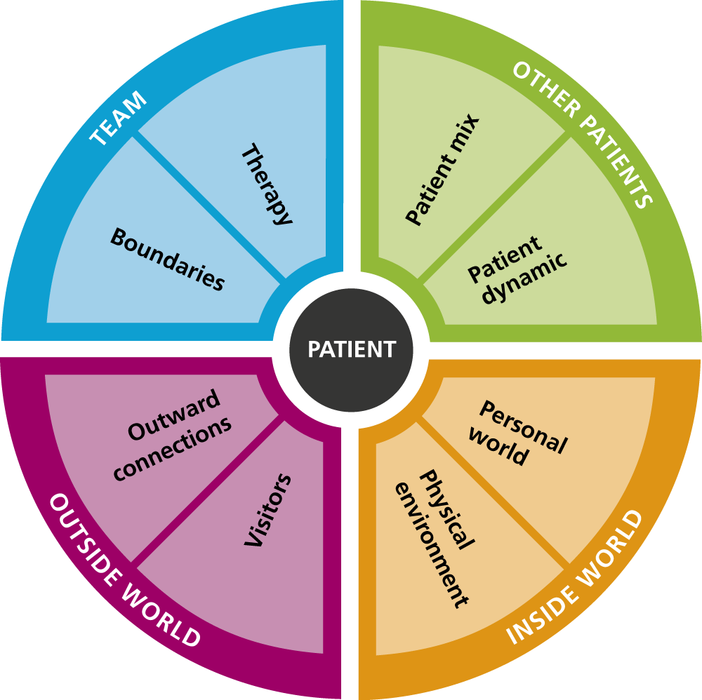
Background to See Think Act
3rd Edition revision process
Key changes
Further training & resources available

Slide 3
The Background
See Think Act was first written in 2010 (edited 2015)
Followed a ‘cluster’ of events in medium security hospitals
SoS (Justice & Health) argued for enhanced physical security in medium security
A thematic review considered events from the full spectrum of services – from HSH to community services.
It looked at not just the event but also what preceded it.
It also looked at the basic definition and explanation we had for ‘relational security’.
Applied in HS, MS, LS, Acute, PICU, CAMHS, supported living, hostels.
Adopted in UK, Canada, New Zealand, Australia, US, Netherlands, Germany etc

Slide 4
The 3rd edition
See Think Act is the policy document for relational security:
  Easy to access for staff and other stakeholders
  Digestible – so it can’t include everything
  Straightforward language
  Supported by a range of further resources available from www.frontfoot.net

Slide 5

General inclusions
Updated definition – to include “and of ourselves”
Harm to patients
Patients not seen as the “unreliable other”
Trauma informed practice
Developed service and leadership outcomes (strategic relational security)
Emphasis on – it’s not about staff numbers
Reflective questions.

Slide 6
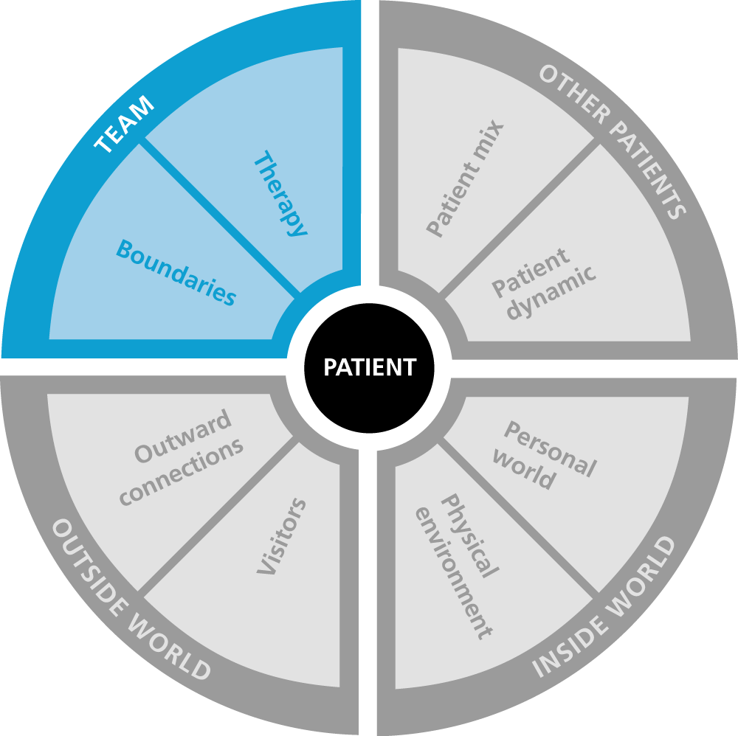
Boundaries
Recruiting the right people
Acting with integrity and curiosity
Increased emphasis on negotiable and non-negotiable boundaries
Consistency and negotiating – examples of factors to consider
Accepting it’s easy to get wrong but talking about it is safer
Understanding and properly explaining rules and boundaries.

Slide 7
Therapy
Potential harm and personal accountability
More detail on clinically valid health outcomes and how to write them (examples)
Involvement of family and friends as part of the care team
Avoidance of care plans that are about corporate assurance rather than valid clinical practice
Notes linked to health goals – not just for the sake of writing something

Slide 8
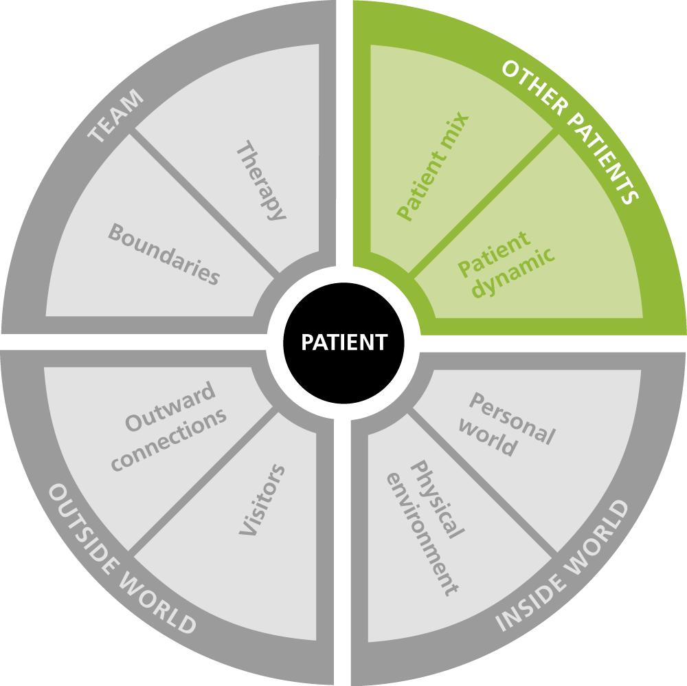
Patient mix
More detail on how to evaluate the mix
More detail on the steps to responding to the mix
Dealing with the ‘inappropriate admission’ narrative
Reflecting on why we want to move a patient – what does another service have that we can’t provide?
Examples of good practice in patient mix mapping and understanding how to respond.

Slide 9
Patient dynamic
More detail on understanding general and personal signatures for events
More emphasis on staff dynamic
Collective professional development and feedback
More emphasis on the language we use to discuss the people we care for, and how we use humour in our services.

Slide 10
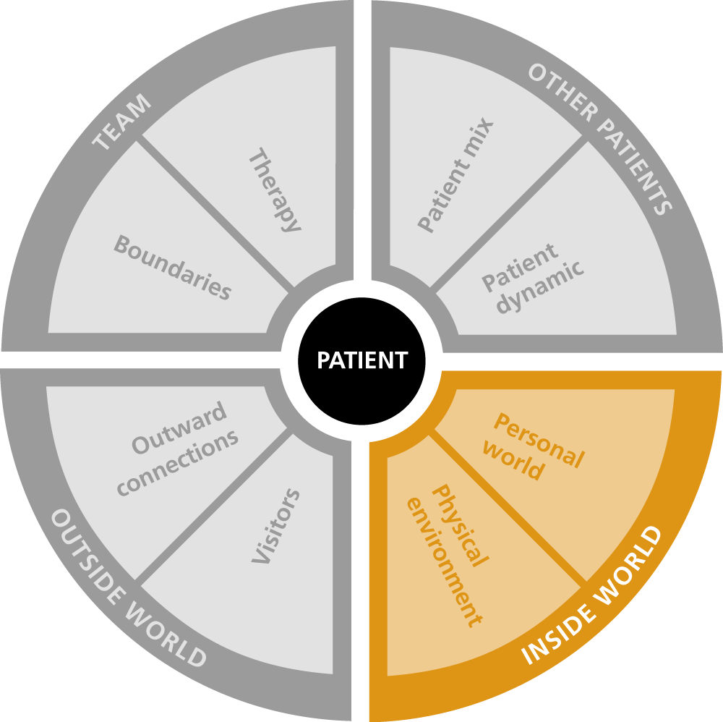
Personal world
Trauma informed
Therapeutic conversations
Thinking about the possible range of responses to predictable situations
How our own personal world, inside the service and out, impacts on our ability to care
Handover prompts.

Slide 11
Physical environment
Still talk about observing how patients use the environment
Recognising how difficult the environment is for patients
More emphasis on staff utility of the environment and rule adherence
Recognising when the office is being used as a sanctuary
Clinical effectiveness and prioritisation
Organisational fear of external judgement over-riding achieving health outcomes.

Slide 12
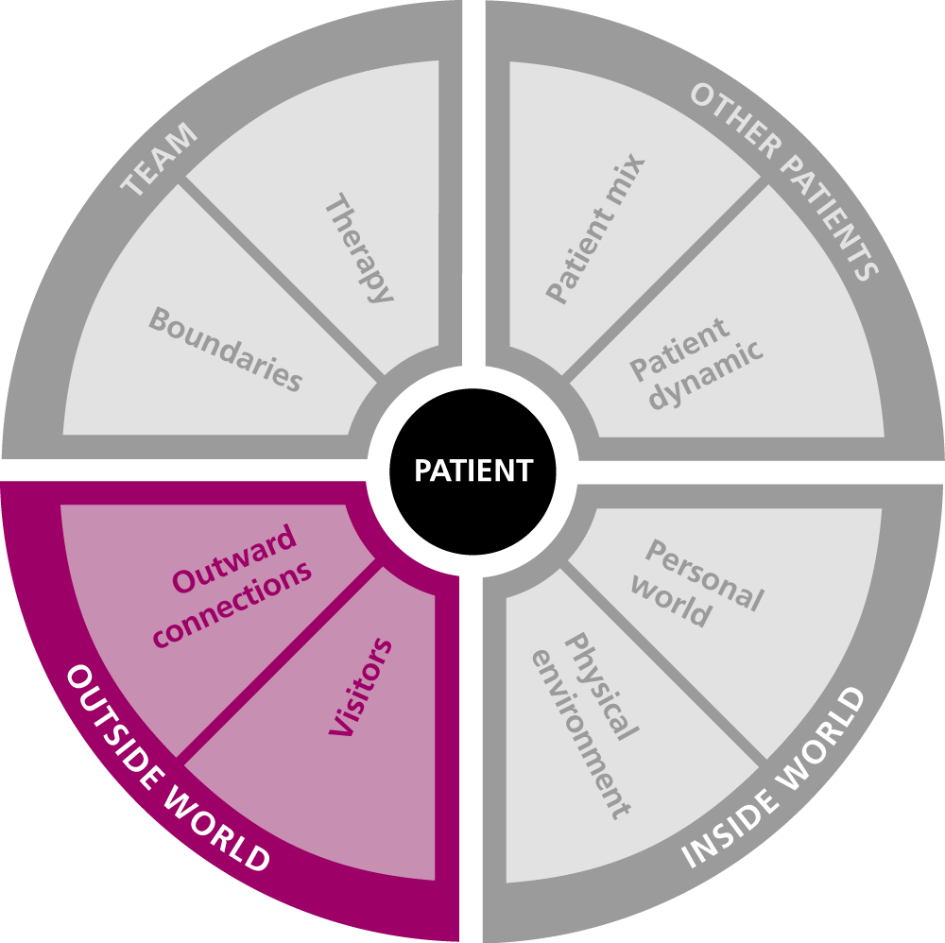
Visitors
Understanding how difficult it can be for someone visiting
Recognition that family and friends often know the people we care for better than us - and have information we don’t
Friendship
Meaningful communication and accessibility
Checking in when people leave
Setting visits up to go well
Risks of some visitors and our responsibility to protect.

Slide 13
Outward connections
A space to be outside one’s illness
Insight into what it’s like in a limited world
Digital connections and using experts to make decisions - examples
Meaningful (planned) therapeutic leave/supported leave rather than ‘escorted leave’
Connection with health outcomes
Meaningful and personalised leave – not everyone needs to learn the same things – recognizing what people have already accomplished
Understanding the responsibility of supporting someone outside the service.

Slide 14
^{3RD EDITION}

Slide 15
Additional resources & training
Direct MDT training
Leadership development workshops on strategic relational security
Relational security facilitator programmes (training & mentorship)
Revision of policies, training and care planning strategies
Relational security resource e-pack license
E-learning programmes

Slide 16

Licensed Resources
www.frontfoot.net

Slide 17
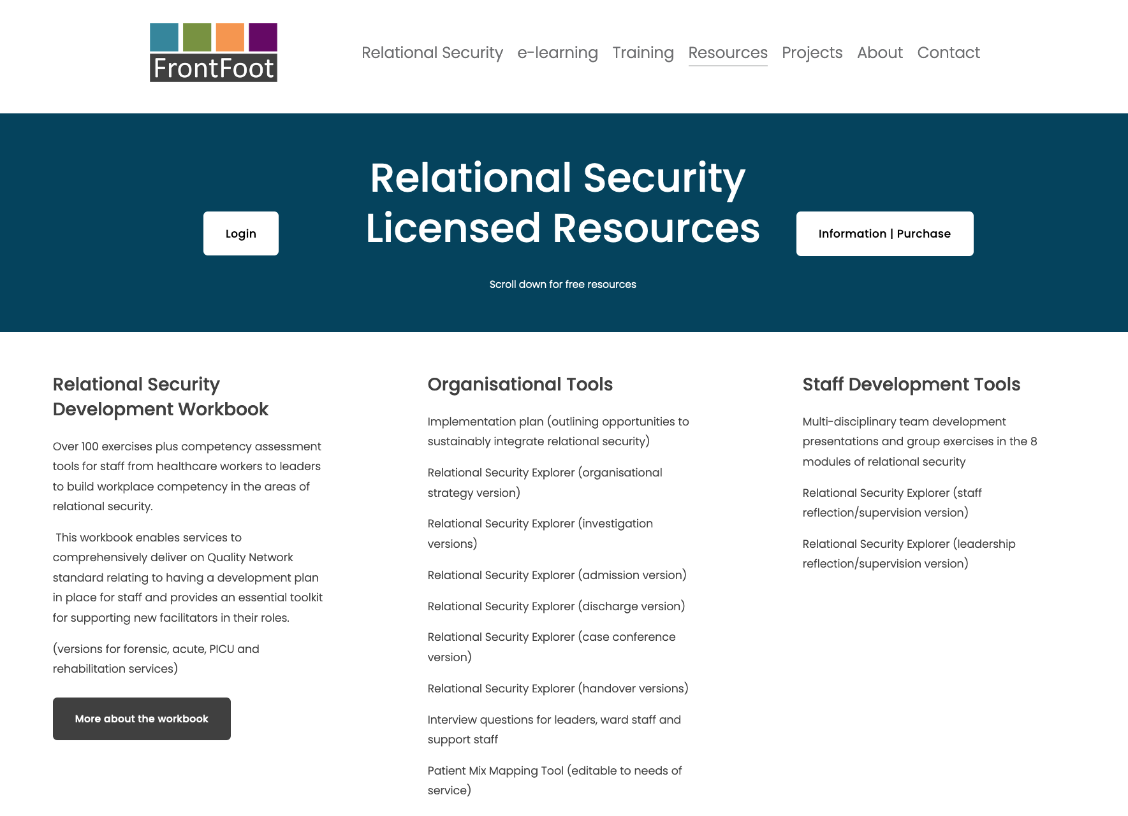

Slide 18
Learn
Develop
Lead
Reflect
Evaluate
Plan

Slide 19
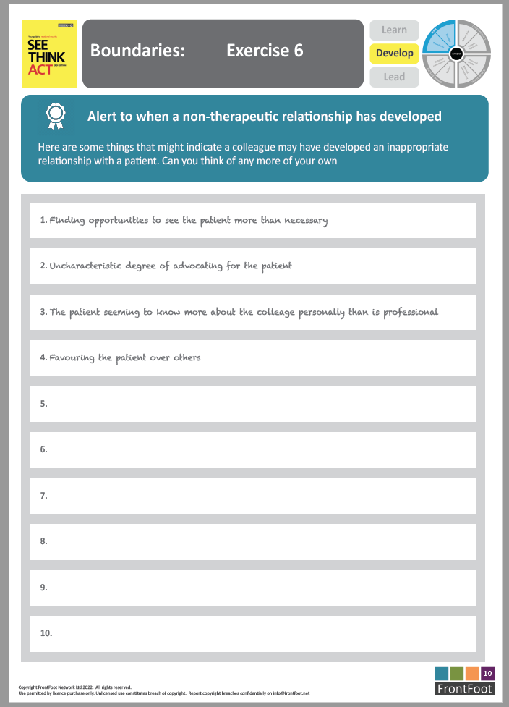
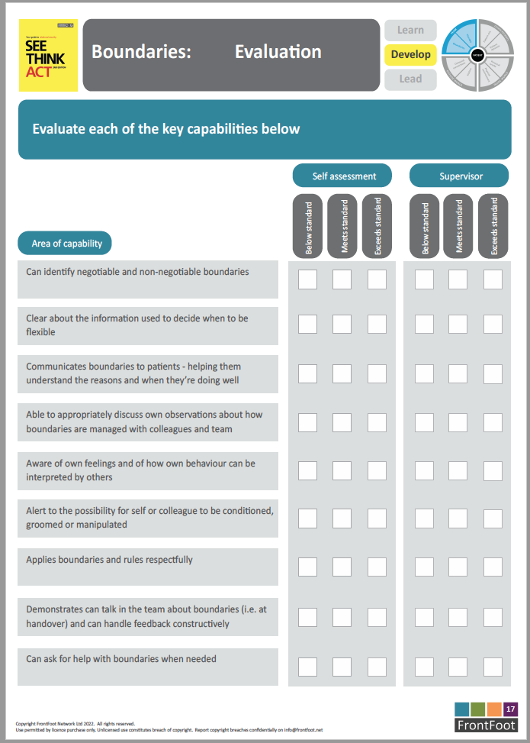

Slide 20
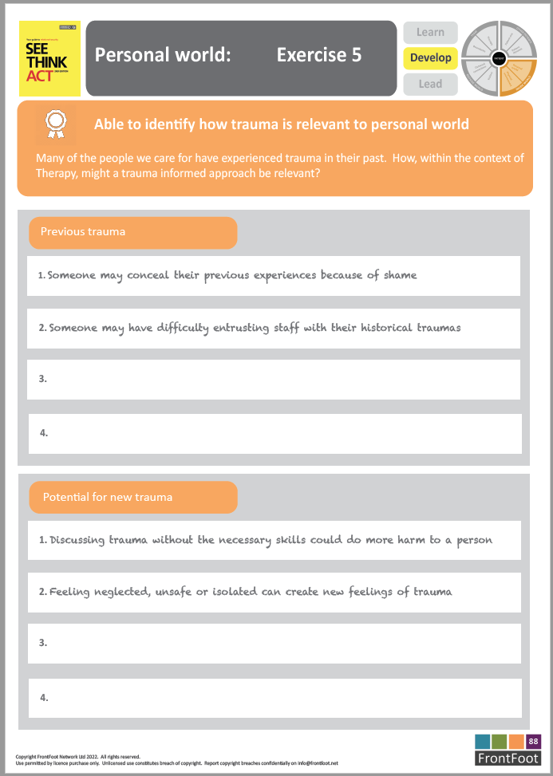
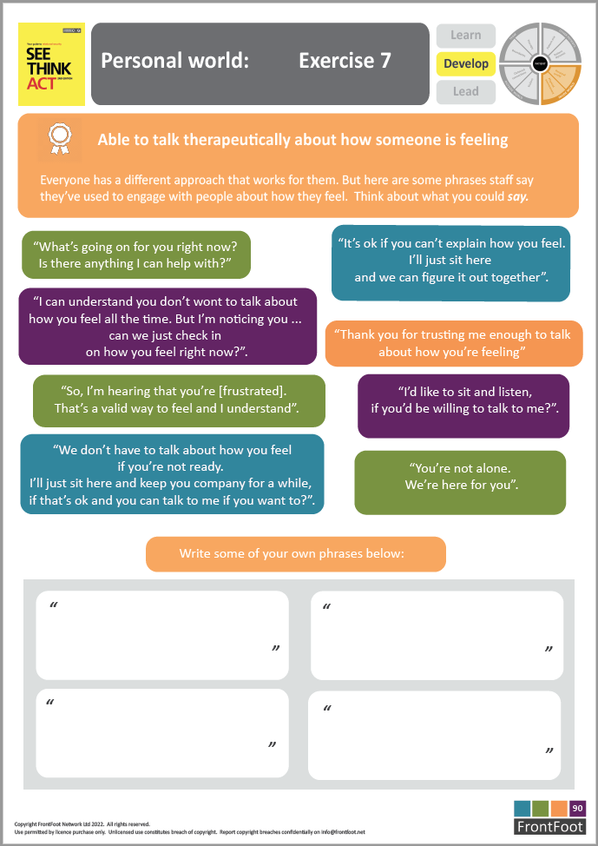

Slide 21

www.frontfoot.net
info@frontfoot.net

