Slide 1
Webinar: Suicide Prevention and COVID-19
Suicide prevention and changing mental health services
Wednesday 3rd June 2020
10:00-11:00

Slide 2
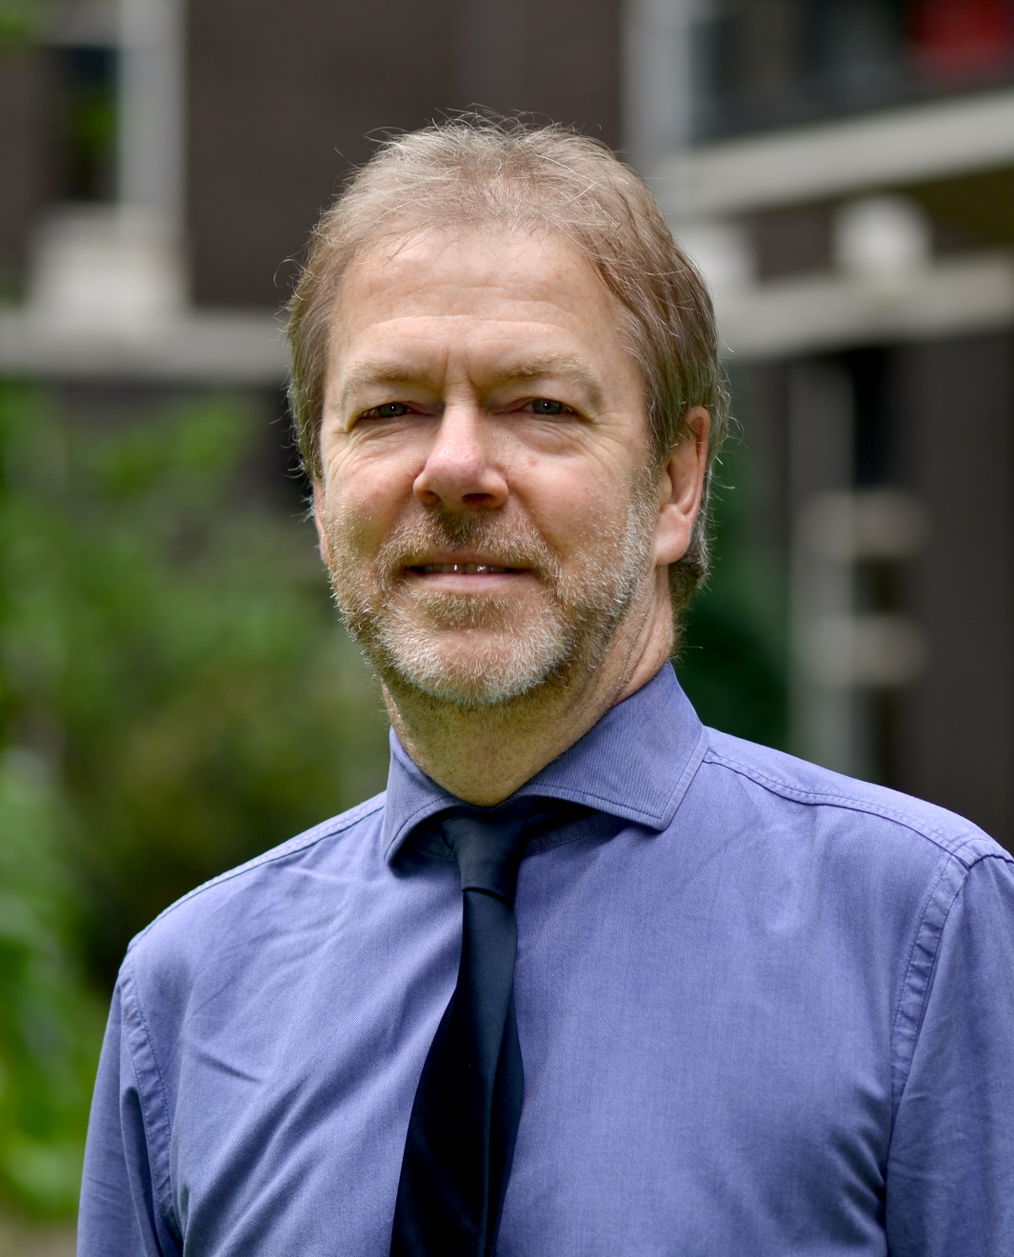
Professor Louis Appleby
Director of NCISH
Professor of Psychiatry

Slide 3
Ananta Dave
Medical Director of Lincolnshire Partnership NHS Trust
Fellow of the Royal College of Psychiatrists

Slide 4
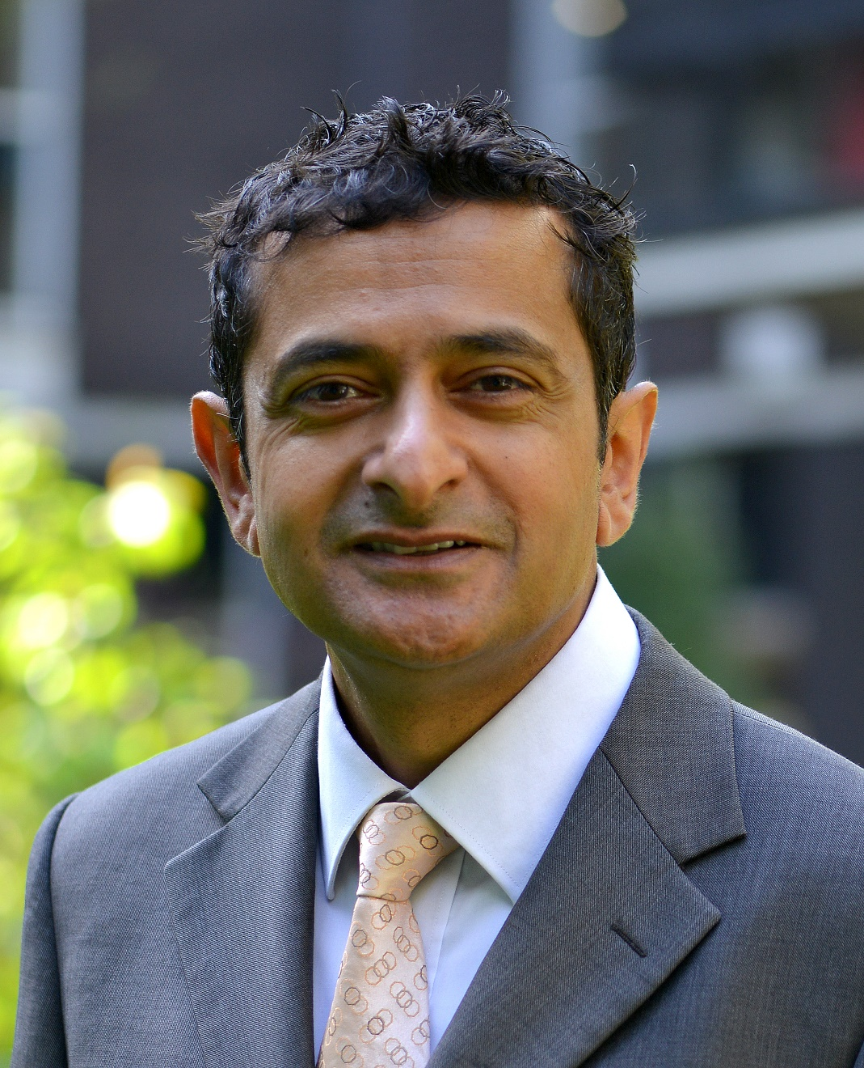
Professor Nav Kapur
NCISH Head of Suicide Research
Professor of Psychiatry and Population Health

Slide 6
Housekeeping
This is a live event, therefore unless you are an invited speaker you are on mute.
Please use the Q+A function to ask any questions you may have and vote for questions you would like answered. There will be a Q+A section at the end of the webinar facilitated by a member of our team who will present the questions to the speakers.
This webinar will be recorded and the link will be shared after the event.

Slide 7
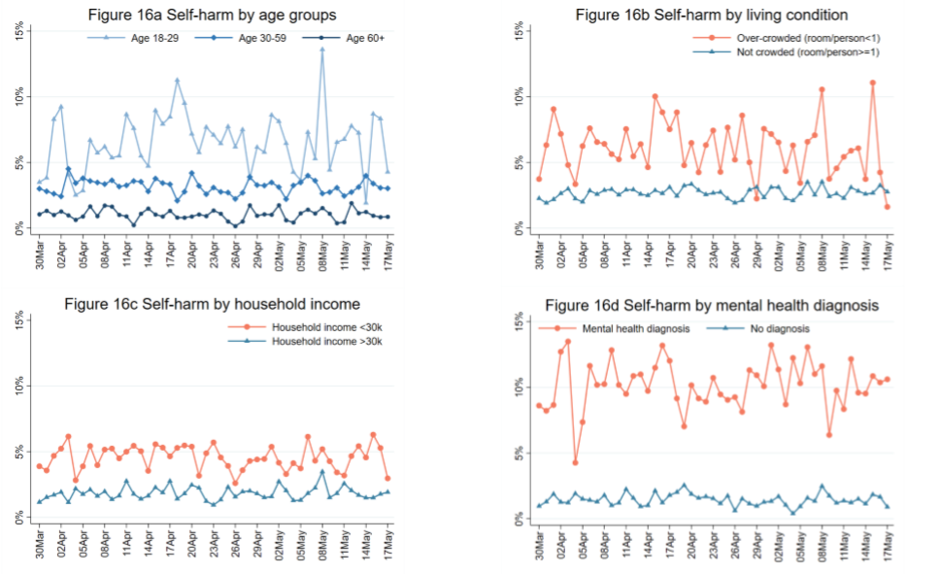
UCL social survey: Self-harm
Source:: UCL, 2020

Slide 8
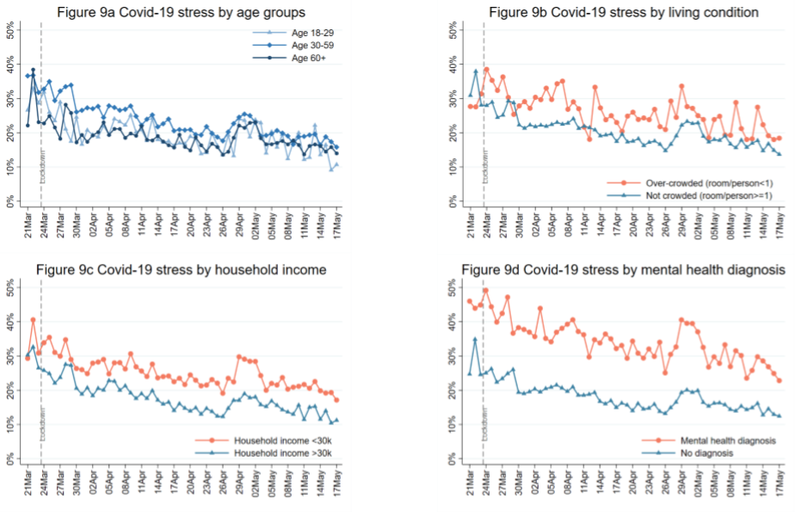
UCL social survey: Covid stress
Source:: UCL, 2020

Slide 9
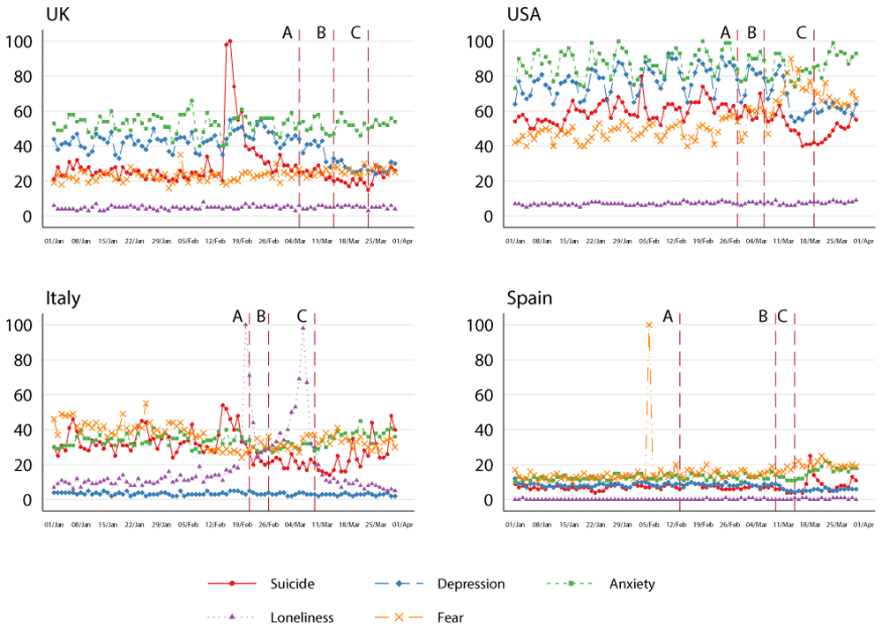
Google searches: Trends in relative search volumes of key topics
Source: Knipe D, Evans H, Marchant A et al. Mapping population mental health concerns related to COVID-19 and the consequences of physical distancing: a Google trends analysis [version 1]. Wellcome Open Res 2020, 5:82 (doi: 10.12688/wellcomeopenres.15870.1)
Notes:
Figure 2. Trends in relative search volumes of key topics indicating mental distress in the UK, USA, Italy and Spain between 01 Jan 2020 and 01 Apr 2020. Showing figures for daily searches. A: Date of first Covid-19 related death; B: Date of first 10 deaths; C: Date of lockdown.
Knipe D, Evans H, Marchant A et al.. Mapping population mental health concerns related to COVID-19 and the consequences of physical distancing: a Google trends analysis [version 1]. Wellcome Open Res 2020, 5:82 (doi: 10.12688/wellcomeopenres.15870.1)

Slide 10
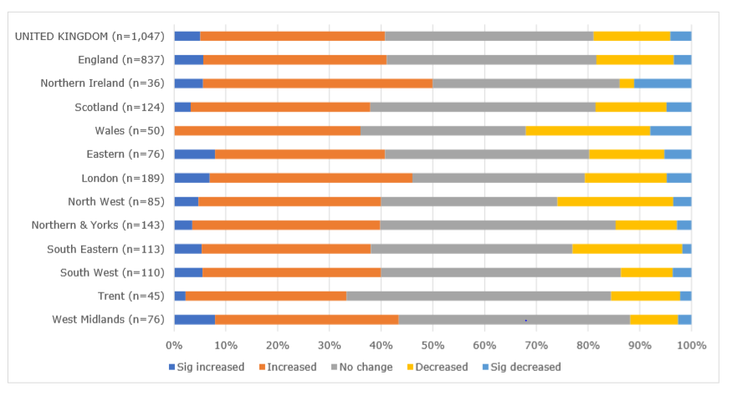
Clinician survey: Urgent interventions workload
Source: Royal College of Psychiatrists, 2020

