Slide 1
Self harm and Suicide in older adults
Tier 1

Slide 2
Contents
Definition and potential methods that can be used
The risk factors and warning signs in older adults to look out for
How to respond if an older adult reports an attempt at self harm
Self harm preventative strategies

Slide 3
Definition
We are using the National Institute for Health and Care Excellence’s (NICE’s) definition of self harm
Self-harm is any self-injurious act carried out by a person regardless of intention e.g. overdose (most common, cutting or burning)
Self-harm does not refer to harm arising from overeating/starvation or excessive alcohol or drugs.
Self harm in older adults is associated with a 100 fold increase in risk of suicide so MUST be taken seriously

Slide 4
Self harm in Older adults
Overall incidence of self-harm in older adults aged 65 years and older was 4.1 per 10 000 person-years in a study done in primary care between 2001 to 2014
Self-harm rates might be under-estimated due to stigma and shame resulting in lack of disclosure
Risk of repetition is high (17%)
Self harm in older adults is associated with less impulsivity and higher levels of lethal intent

Slide 5
Risk factors for self harm in older adults
Female sex
People with physical health conditions(especially being in pain)
Alcohol and/or drug use
Previous self-harm history
Previous psychiatric history
Currently having treatment for a psychiatric condition (such as depression)

Slide 6
Staff approach to report of self-harm
Take all self‑harm seriously and listen carefully, in a calm and compassionate way
The adult should have a psychosocial assessment of their needs and an assessment of their current risk of repetition or suicide
Bear in mind that if the adult is cognitively impaired they may have more difficulties in recalling the event
Ask permission to talk to family members/friends
Inform your seniors immediately
Don’t think just because it was an ineffective method that it was not serious
Enquire about what the person thought would happen
Hopelessness is an important predictor of suicide
Offer information about support services

Slide 7
Other individuals who may also need support
The family/friends
Any staff
The care team
Give them information of any local support groups / help lines

Slide 8
Responses to avoid
Staff should try to avoid the following responses towards an individual who has self- harmed
Reacting with strong or negative emotions
Becoming irritated
Using terms such as ‘manipulative’ or ‘attention seeking’
Becoming frustrated
Focussing too much on the self‑harm itself, rather than the underlying issues

Slide 9
Self harm prevention strategies
Avoid expressing negative views towards those engaging in self-harm
Identify older adults who self-harm
Seek to understand the individual’s motivations for self-harm
Every older adult who self‑harms should have a Safety Plan, which gives specific personalised advice to care providers on how they can reduce the individual’s risk of self‑harm
Communities play a critical role in prevention and are key to providing social support to vulnerable individuals and supporting follow-up care
Social connectedness can help protect vulnerable people from attempts at suicide

Slide 10
Suicide in Older Adults
Frequency
Method
Risk Factors
Warning signs
Responding to expresses suicidal ideas
Managing risk
Other individuals who need support
Preventative strategies

Slide 11
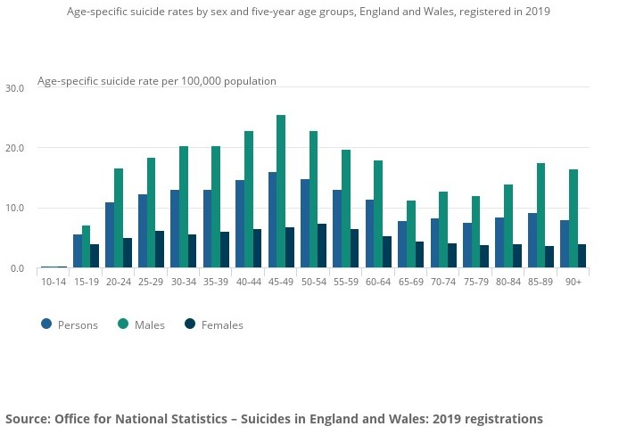

Slide 12
Methods used
Methods used by older adults for suicide include:
Overdoses
Cutting with knife / razor
Drowning
Hanging
Any older adult who says they want to kill themselves must be taken seriously

Slide 13
Risk factors for suicide
Self-harm is the leading risk factor for suicide
Male gender
Single
Living alone/isolation
Past psychiatric history esp. depression, anxiety
Depression
Chronic pain
Alcohol/drug use
Bereavement
Stressful life events
Low socioeconomic status

Slide 14
Possible Warning signs
If an older adult starts talking about suicidal feelings and suicide, sometimes they may even describe how they intend to carry out the attempt
Talking about feeling worthless, hopeless, that they are a failure, or see no point in life
Becoming very withdrawn and uncommunicative
Reported poor sleep, loss of appetite, loss of weight
Notes:
It is a myth that people who talk about suicide don't attempt it

Slide 15
How to respond
If someone reports suicidal thoughts
Avoid saying, “Things can't be that bad”, or brushing them aside.
Don't argue with the older adult but reassure them that you care about them.
Be patient and listen
It is difficult to support someone who is expressing suicidal ideas on your own, so seek help from a senior

Slide 16
Managing risk
Document and share concerns: if there is a major risk, duty of care outweighs confidentiality
If the person
Is distressed but no intent/plan: GP
or
Has significant thoughts about self-harm but no immediate risk: Ask GP for urgent mental health review or Out of Hours GP
or
Has few /no reasons for living, and the person can’t assure you they will be safe if left: Call GP/senior staff member urgently and don’t leave alone. If all else fails consider calling 999.
Bear in mind that if the adult is cognitively impaired they may have more difficulties in recalling if they have any plans

Slide 17
Other individuals who need support
The family
The staff
The care team
It is essential to met with them to allow them space to talk about the incident as soon as possible after the incident
Give them information of any local support groups / help lines

Slide 18
Self harm and suicide prevention strategies
Identify older adults who self-harm due to the increased risk of repetition and suicide
Seek to understand the individual’s motivations for self-harm
Communities can provide social support to vulnerable individuals and support follow-up care
Creating social connectedness can help protect vulnerable persons from suicide
Fighting stigma and supporting those bereaved by suicide
Every older adult who self‑harms and/or has suicidal thoughts should have a Safety Plan

Slide 19
Safety Plan
Required for everyone who self-harms and/or has suicidal thoughts
Co-produced with the patient
Gives personalised advice to care providers on how they can reduce the individual’s risk of self-harm and suicide
It should have explicit reference to:
Removal and/or mitigation of means to harm themselves
List of calming/distracting activities and coping strategies
Information on how to access social, psychological and emergency support
Safety plan template: https://www.getselfhelp.co.uk/docs/SafetyPlan.pdf

Slide 20
Resources
Self-harm_and_suicide_prevention_competence_framework_-_adults_and_older_adults_8th_oct_18.pdf (ucl.ac.uk)
Role of primary care in supporting older adults who self-harm: a qualitative study in England | British Journal of General Practice (bjgp.org)
Self-harm in a primary care cohort of older people: incidence, clinical management, and risk of suicide and other causes of death https://www.thelancet.com/journals/lanpsy/article/PIIS2215-0366(18)30348-1/fulltext

Slide 21
Resources
MPC_05_07 Suicide Risk And Prevention For Older People | Suicide Risk And Prevention For Older People (mindedforfamilies.org.uk)
This is an easy to access website for older adults and their families which has good advice about warning signs, responding in a crisis along with practical step for family and friends

