Slide 1
The Annual Conference of the Faculty of Forensic Psychiatry, Milan
15 May 2024
Dr. Alan MITCHELL
President of the CPT

Slide 2
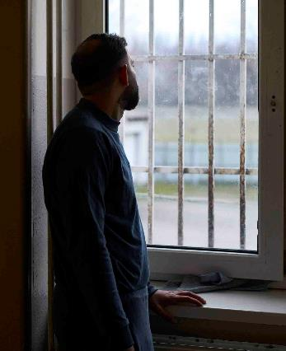
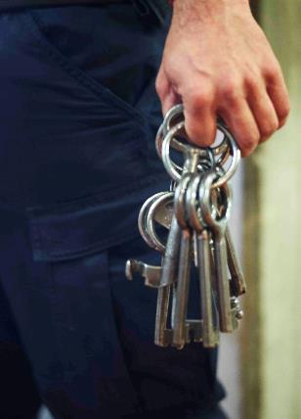
May 2024

Slide 3
The Committee's mandate
"No one shall be subjected to torture or to inhuman or degrading treatment or punishment".
1950 - Article 3 of the European Convention on Human Rights inspired the drafting of the Convention establishing the CPT.
"By means of visits, the Committee examines the treatment of persons deprived of their liberty with a view to strengthening, where necessary, their protection against torture and inhuman or degrading treatment or punishment."
1989 - Ratification of the convention establishing the CPT (article 1).

Slide 4
A preventive function
Preventive, non-judicial mechanism
The CPT is not a commission of inquiry, but a non-judicial preventive mechanism which :
Examines situations of abuse at European level,
Is attentive to the warning signs of potential mistreatment of persons deprived of their liberty.
Monitoring mechanism
Observes the physical conditions of deprivation of liberty,
Examines the procedures in place to prevent abuse,
Analyses the root causes of situations leading to mistreatment and disrespect for human dignity.
Torture
Inhuman or degrading
treatment

Slide 5
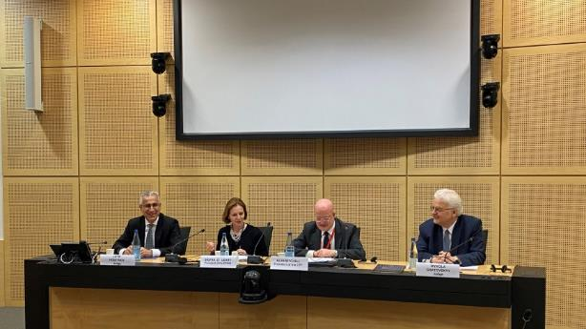
CPT vs. ECHR
CPT | ECHR
General situation | Individual cases
Prevention (before) | Repair (after)
Automatically (own initiative) | On request
Legal and other expertise | Legal expertise
Reports (recommendations) | Decisions / rulings (final, binding)

Slide 6
CPT vs ECHR
The CPT complements the judicial work of the ECHR.
The CPT is a preventive mechanism. It does not deal with individual complaints or intervene in legal proceedings.
The CPT intervenes on its own initiative, whereas the ECHR is seized on the basis of requests from individuals or states.
The CPT is made up of a panel of members with a wide range of human rights skills and professional experience in areas relevant to the CPT.
The CPT drafts reports and submits recommendations to States Parties to the ECPT.

Slide 7
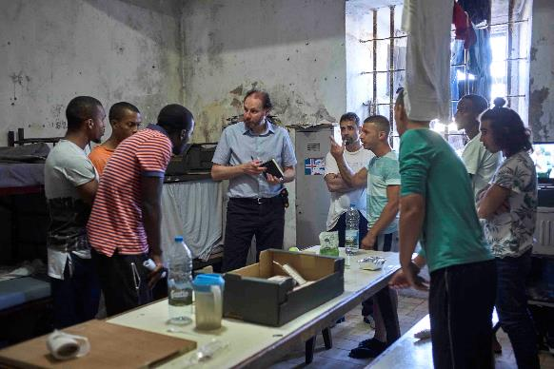
Unlimited access
To all persons deprived of their liberty by a public authority.
All places of unrestricted deprivation of liberty (including places where people may be deprived of their liberty de facto).
All necessary information (individual/medical files, registers, video recordings).
Private interviews
Without advance notice

Slide 8
Places visited by the CPT
Police stations
Military installations
Psychiatric
hospitals
Prisons
Court cells
Juvenile detention centers
Detention centres
for migrants
Social care homes

Slide 9
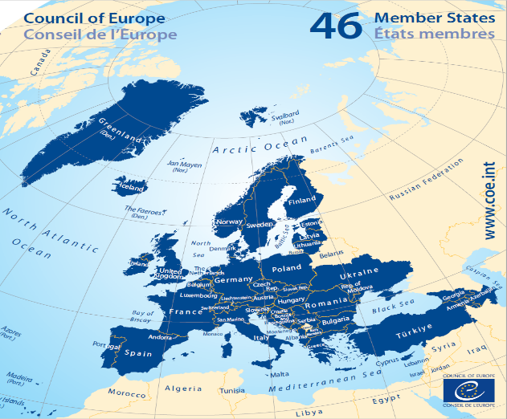
The Russian Federation nevertheless continues to be a Contracting Party to the Convention as a non-member of the Council of Europe.
Geographic coverage
47 member states
46 Council of Europe member states + Russian Federation
Since March 2002 and the adoption of a Protocol to the Convention, any non-member state of the Council of Europe can also be invited to sign the ECPT by the Council of Ministers of the COE.
Since March 16, 2022, the Russian Federation has been excluded from the Council of Europe, but continues to be a high contracting party to the ECPT as a non-member of the COE.

Slide 10
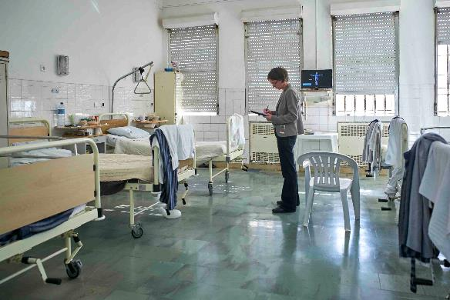
Methodology
Information gathering and triangulation
The CPT has built its methodology of information gathering and analysis around the concept of triangulation: the practice of corroborating one piece of information with another, notably by consulting registers, through interviews with persons deprived of their liberty and staff, and through its observations of the establishment.

Slide 11
Prisons
Treatment by staff and inter-prisoner violence
Material conditions/ overcrowding
Ordinary regime (activities, walks, visits, interaction)
Security: searches, means of restraint
Special regimes (high security, radicalised persons)
Isolation measures (disciplinary and other)
Medical examination upon admission and access to care

Slide 12
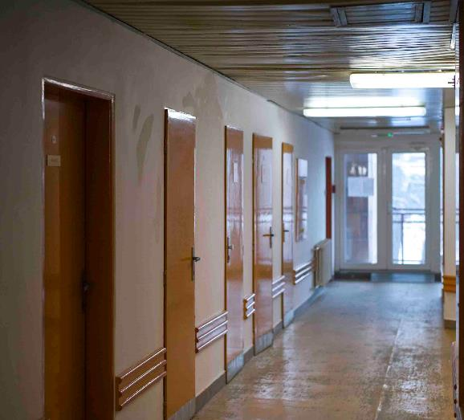
Psychiatry
Material conditions
Treatment and care
Restraint (restraint and isolation)
Legality of placement and maintenance
Informed consent
Forensic psychiatry: prison vs. care perspectives

Slide 13
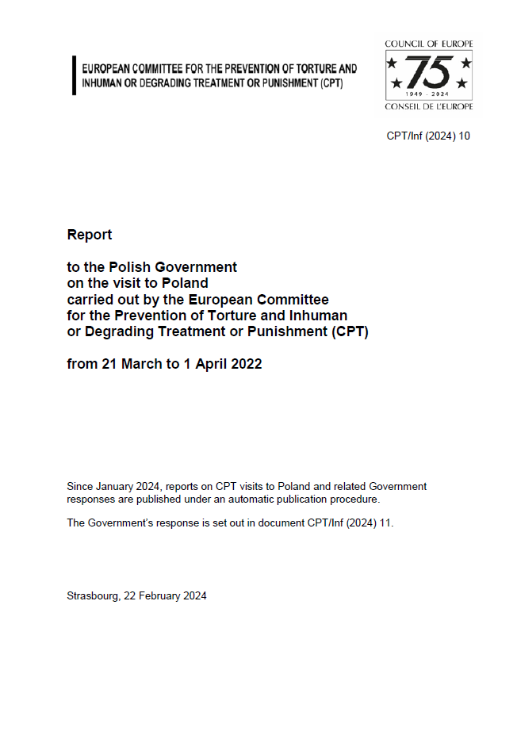
Dialogue
Visit report (recommendations)
The report brings together the CPT's findings, recommendations, comments and requests for information. It is then adopted by the Committee in plenary session.
Response by authorities
The CPT requests a detailed response to the points raised in its report within 3 to 6 months.
Cooperation
Cooperation with national authorities is at the heart of the Convention, since its aim is to protect people deprived of their liberty rather than to condemn states for abuse.
Privacy
The Committee's findings, reports and government responses are strictly confidential. The authorities request publication of the reports and information on the automatic publication procedure.

Slide 14
Some of the CPT’s Key Findings and Recommendations
(very similar across different CoE member states)

Slide 15
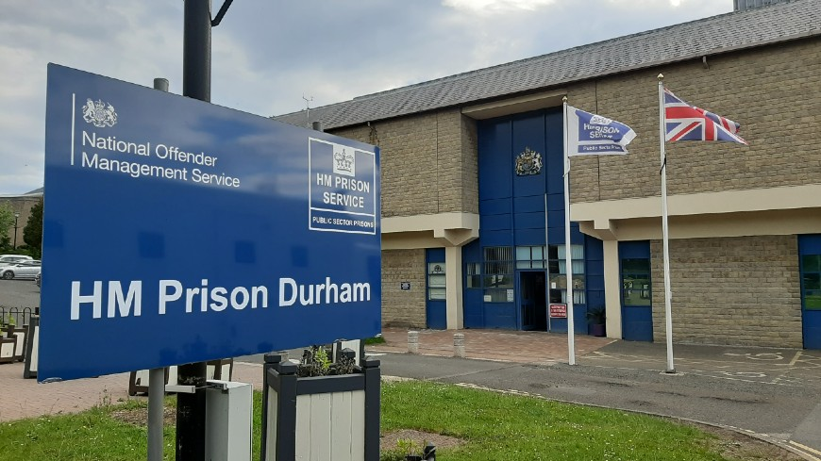
United Kingdom 2021
Woodhill/Wormwood Scrubs-Considerable delays in transferring mentally unwell prisoners to a psychiatric hospital
Durham- Very good impression of mental health services
Lack of psycho-social and occupational therapy
Patients not aware of treatment plans
Physical Restraint
Long term segregation/isolation

Slide 16
HMP Bronzefield
Number of women with severe mental mental health problems could not be provided with adequate care in a prison setting
Inpatient unit was essentially a mental health facility without structured therapeutic activities
Management of people with personality disorder, complex trauma or frequent propensity to self-harm

Slide 17
Article 3
Slawomir Musial v Poland 2009- ECtHR
3 elements in relation to compatibility of health with stay in prison
i. Medical condition of the prisoner
ii. Adequacy of medical assistance and care provided in detention
iii. The advisability of maintaining the detention measure in view of the state of health of an applicant

Slide 18
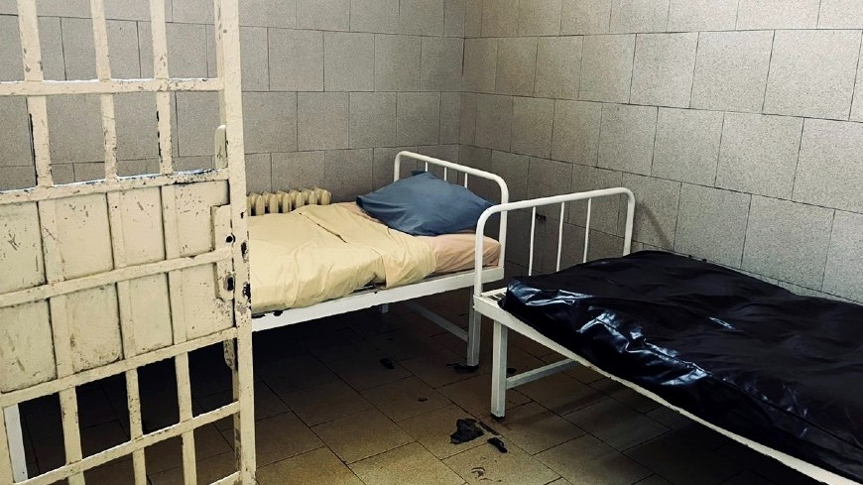
Bulgaria 2023
A psychiatric expert opinion which is independent of the hospital in which the patient is held would offer an additional important safeguard
Ensure that compulsorily detained patients receive copies of the psychiatric assessment reports on them provided to the court
Explain the content of these reports (and court decisions) to the patient and to ensure that the patient can understand and challenge them

Slide 19
Portugal 2022
Concern about the presence and treatment of four forensic patients accommodated in the in-patient unit of the Santo Cruz do Bispo Feminino Prison. Confined, in their pyjamas, to their dormitories for more than 22 hours per day and had no access to fresh air whatsoever.
Article 8(5)
1) At least one hour of access to fresh air and preferably more
2) Immediate steps be taken to provide additional activities during the day

Slide 20
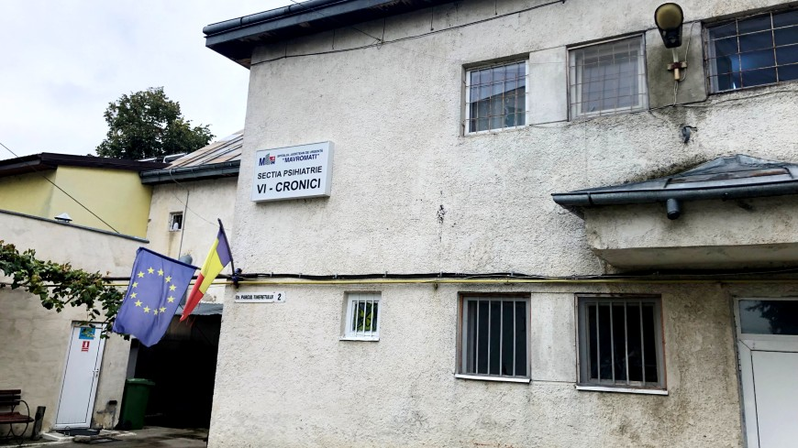
Romania 2022
Patients who have committed minor offences held alongside those who have committed homicide or serious violence with no stratification of security needs
Article 109 of the Criminal Code- recall to hospital without any medical assessment as to whether hospitalization is necessary {patient missed an appointment with the police or the clinic}
Pathway of care for patients with a psychiatric disorder who offend to be sent to a broader range of hospital units with levels of security no greater than is required

Slide 21
Spain 2020
Prison Psychiatric Hospitals of Alicante and Sevilla
a. Carceral conditions
b. Penury of activities
c. Frequent resort to seclusion and fixation
d. Overmedication
e. Problems of consent to treatment

Slide 22
Croatia 2022
Zagreb Prison Hospital
I. Allegations of physical ill-treatment consisting of slaps, punches and blows with truncheons inflicted by prison staff on patients
II. Appalling conditions and neglect- dirty pyjamas, torn mattresses, absence of bed linen, no underwear
III. Lack of psychiatrists; reliance on pharmacotherapy

Slide 23
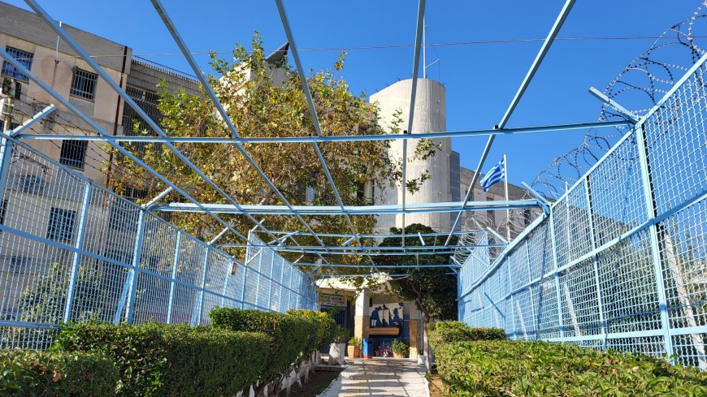
Greece 2022
Korydallos Psychiatric Hospital for prisoners remains a prison both in its design and functioning
Treatment based almost exclusively on pharmacotherapy
No resident psychiatrist
Only one fully trained nurse for 170 patients
Small dedicated team of prison officers with no formal training on mental health issues

Slide 24
Italy 2022
Placement of forensic patients in prison due to lack of space in REMS (Rezidenze per l’Esecuzione delle Misure di Sicurezza)
42 patients subject to a security measure of placement in a REMS being held in prison
586 persons in prisons had a severe mental disorder and had been placed on a waiting list for assessment to be admitted to a REMS

Slide 25
Court Judgements
ECtHR 24 January 2022 Sy v Italy- violation of Article 3 due to extended accommodation of a patient at Regina Coeli Prison in inadequate conditions instead of transferring him to a REMS
Italian Constitutional Court decision (No.22/2022) 27th January 2022 asking for the system of placing forensic patients in REMS to be reformed, stressing the importance of providing an adequate number of beds and the offer of a real therapeutic approach for forensic patients

Slide 26
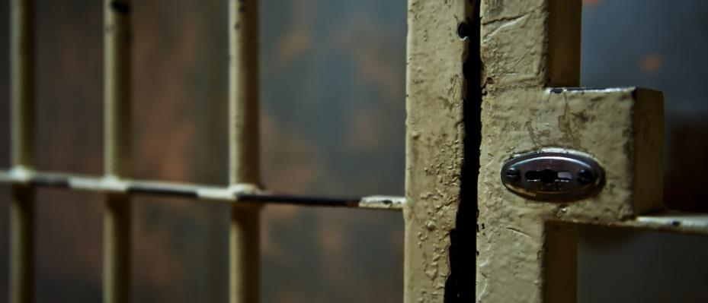
Thank you
www.cpt.coe.int

