Slide 2
Tourette Syndrome: Recognising and understanding the distinct and shared neurodivergent characteristics associated with chronic neurodevelopmental tics
Hugo Critchley

Slide 4
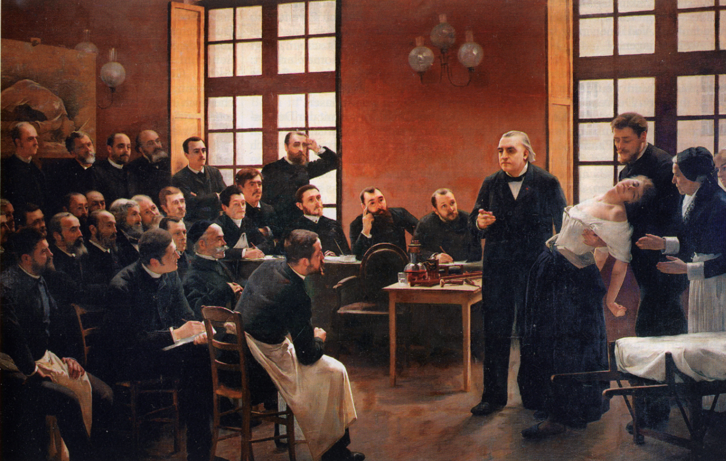
L. Brouillet, Une Leçon Clinique à la Salpêtrière (1887)

Slide 5
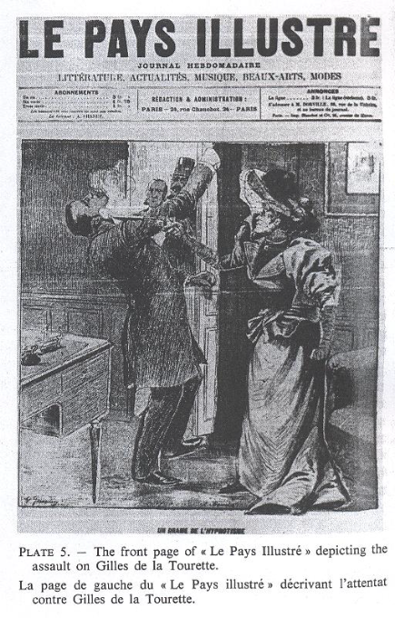
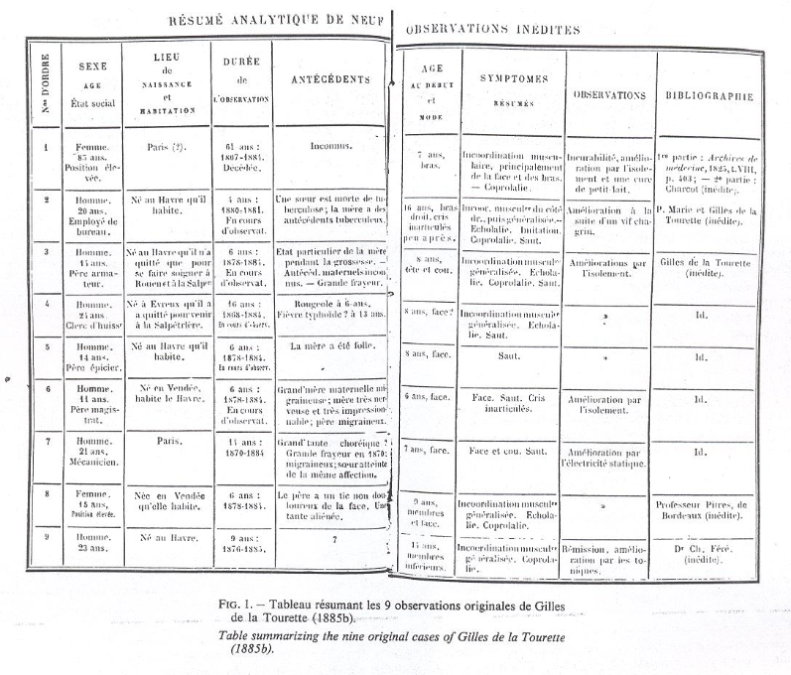
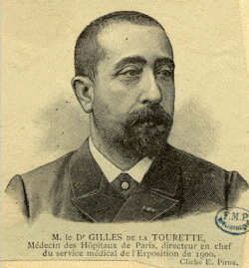
Georges Albert Édouard Brutus Gilles de la Tourette

Slide 6
Tic types
Premonitory urges
Suppressibility
Echophenomena Coprophenomena
Contagion Forced
Anxiety /arousal
Stress sensitivity

Slide 7
Recognition of tics and comorbidities
DSM-5: Sudden rapid recurrent, non-rhythmic movements or vocalisations
usually appearing in bouts while waxing and waning in frequency, intensity, number, complexity, and kind of tic
Tic conditions / TS usually appear in childhood mostly between 5-6yrs
TS chronic >1yr combination of motor and vocal/phonic tics
Co-occurring conditions: OCD, ADHD and autism common

Slide 8
Epidemiology
0.3-1% of general population
Mean onset c. 5yrs (<40% lower?)
Mostly in under 18s; 3:1 M:F in children
Waxing and waning course; peaking in most between 8-12 yrs
Complex tics present later than simple tics; vocal later than motor

Slide 9
Diagnostic classification
Labels Category TS Chronic tic disorder Provisional / transient

Slide 10
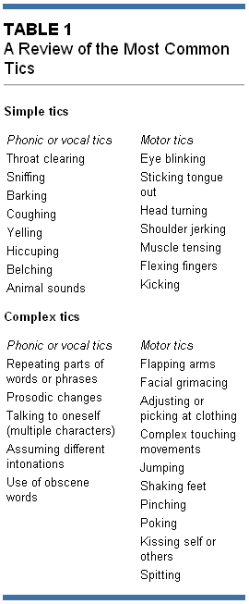
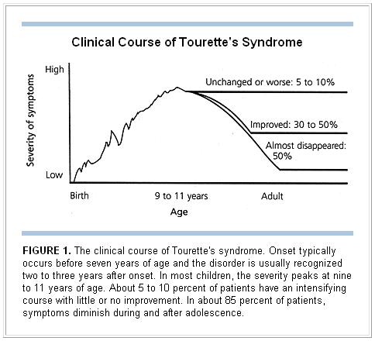
Bagheri et al 1999:

Slide 11
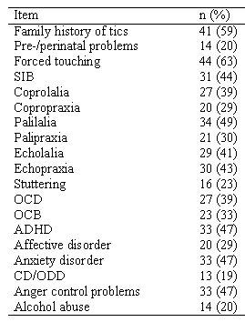
Features: N=70 adults
Not screened for autism
Cavanna et al. Compulsive behaviours in Gilles de la Tourette syndrome. Confinia Neuropsychiatrica. 2006

Slide 12
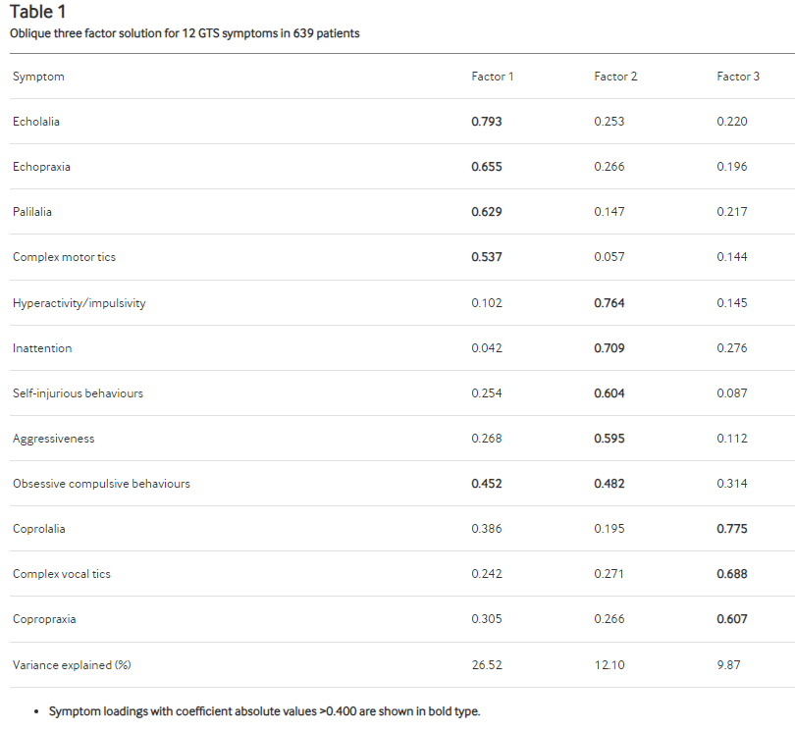
Cavanna AE et al (2011)

Slide 13
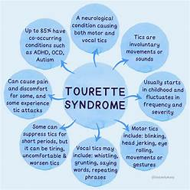
Tic-like phenomena and co-morbidities
Compulsive tics
Forced-touching
Tapping, evening-up, just-right
Negativism, self-injurious behaviour
Obsessive compulsive disorder 22-66%
Symmetry, numbers, ordering, not-just-right
Compulsions and impulsiveness
ADHD: Inattention & hyperactivity 55-65%
CD/DSPD
Mood instability , rage and anger
Autism 23% children 9% adults (but SPFT NDS experience)
CD/DSPD
Mood instability
Other neurodevelopmental
Dyspraxia
Dyslexia
Other cognitive e.g. dysexecutive
Gillberg ESSENCE framework
ADHD, ASD, DCD, IDD, SLI, Tourettes, early onset bipolar disorder, behaviour phenotype syndromes, neurological disorders
behavioural/cognitive problems at an early age: usually "comorbid" with each other; share genes, risk factors and clinical symptoms.

Slide 14
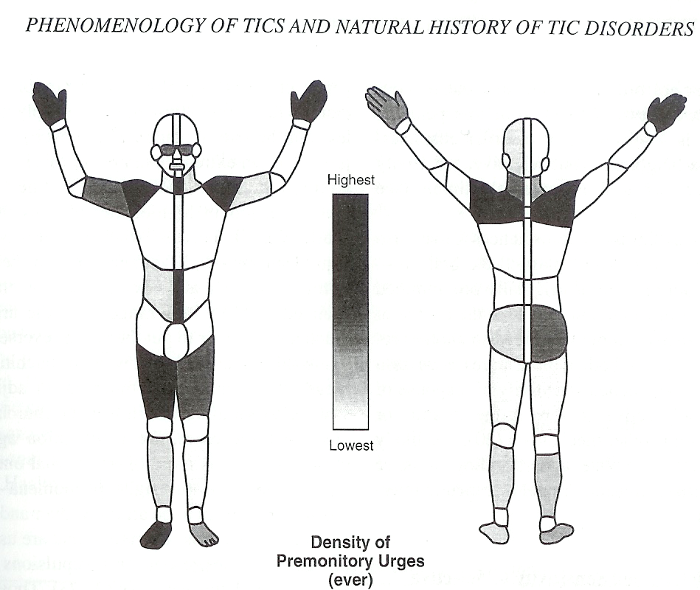
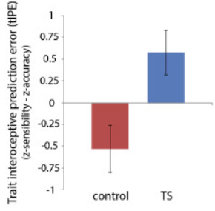
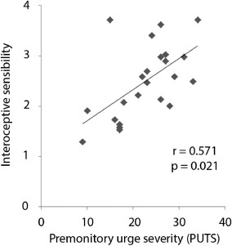
Rae et al. Dimensions of interoception predict premonitory urges and tic severity in Tourette syndrome. Psychiatry Res. 2019
Leckman JF. Phenomenology of tics and natural history of tic disorders. Brain Dev 2003;25:S24-28.

Slide 15
Differential diagnosis
Other hyperkinetic movement disorders:
Dystonia, Myoclonus, Chorea, Wilson’s
Stereotypies
Functional movements and vocalisations:
more rhythmic, more complex and varied
Somatic conditions
PANS paediatric acute onset neuropsychiatric syndrome
PANDAS paediatric autoimmune neuropsychiatric disorder associated with streptoccocal infection
Martino et al. Anti-basal ganglia antibodies and Tourette's syndrome: a voxel-based morphometry and diffusion tensor imaging study in an adult population. J Neurol Neurosurg Psychiatry. 2008
Cavanna et al. Neuropsychiatric-developmental model for the expression of tics, pervasive developmental disorder, and schizophreniform symptomatology associated with PANDAS. World J Biol Psychiatry. 2009

Slide 16
Evaluation
Biopsychosocial approach
Neurological examination
Clinical interview
Tic history
age, what, when, where (face, limbs, vocal, elsewhere)
complexity, sensation, triggers, control
treatments / sleep
Impact
Worse tics?
Comorbidities: depression, anxiety, SUD,OCD, ADHD, Autism
Severity, QoL

Slide 17
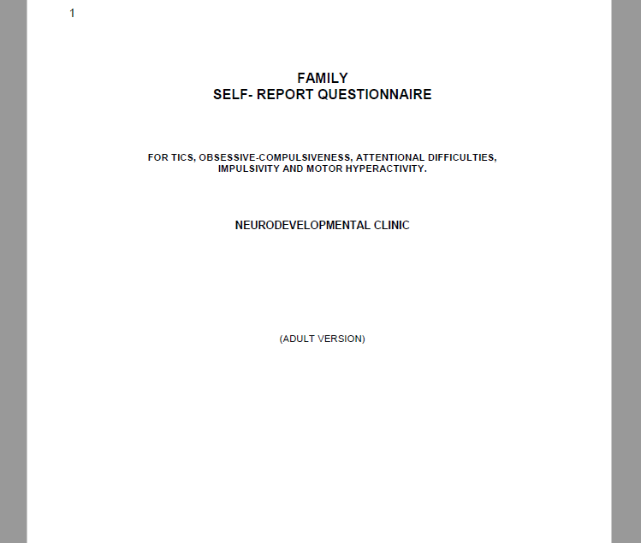
Helpful materials
Rating scales etc
Tic screening tool
MOVES
Tic Severity Scale e.g. Yale Global Tic Severity Scale (YTSS)
ADHD Scale e.g. Connors (CAARS)/Wender-Utah WURS
OCD scale e.g. Leyton OC / YBOCS
Autism screening e.g. AQ10, AS-IS, RAADS

Slide 18
Management
Do symptoms compromise
Academic or occupational performance?
Family or social interactions?
Healthy physiological development?
YES
NO
Symptomatic treatment
Pharmacological, Physical
Psychological
Social
EDUCATE
REASSURE
SUPPORT

Slide 19
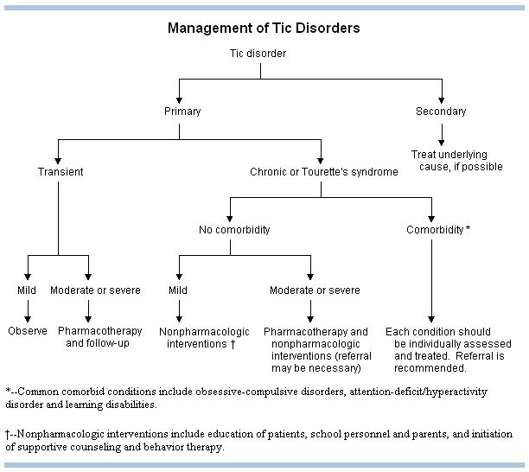
Bagheri et al.1999

Slide 20
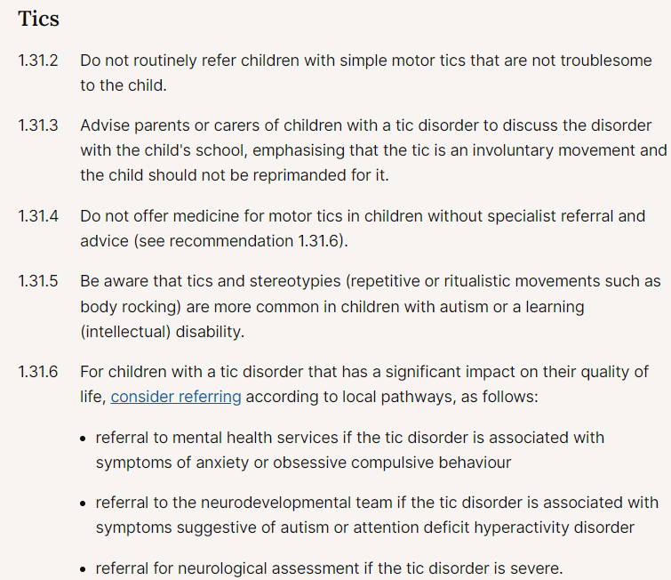
NICE recommendations

Slide 21
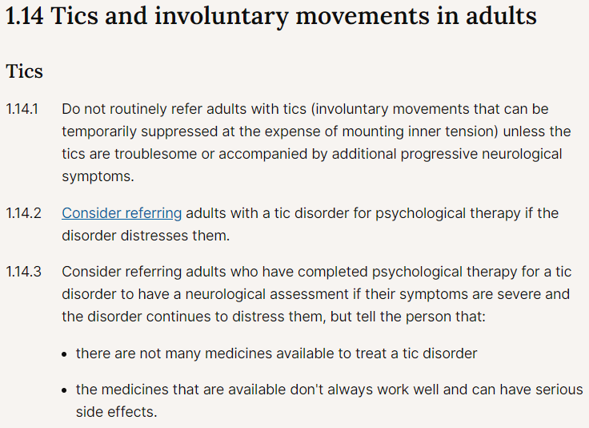

Slide 22
Psychological Interventions
Psychoeducation and signposting
Reassurance frequency, acceptance
Prognosis
Experiences and approach to management
Interaction with comorbidities
Psychotherapy, behavioural therapy
Habit Reversal Therapy (HRT)
Comprehensive Behavioral Intervention for Tics (CBIT)
Exposure and Response prevention (ERP)
Other cognitive behavioural therapies (e.g. ACT)
individual v. group

Slide 23
Online Remote Behavioural Intervention for Tics (ORBIT)
online, remotely delivered
therapist-supported exposure response prevention
behavioural therapy for tics
Translation of Karolinska BIT TIC
NICE approval 2024 for children

Slide 24
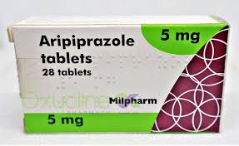
Pharmacological interventions: For tics
‘Decrease excitability of motor systems’
Dopamine modulation (D2 antagonism)
Dopamine hyper-innervation in striatum
Supersensitive striatal D2 receptors
Presynaptic dopa carboxylase abnormality
Elevated tonic synaptic dopamine
Haloperidol
Amisulpiride
Quetiapine
Risperidone
Aripiprazole
Even low dose can cause significant side-effects
Hyperprolactinaemia
Weight gain
Sexual dysfunction
sedation

Slide 25
Pharmacological interventions: For tics
Noradrenaline modulation (alpha2 agonism)
Clonidine
Guanfacine
Other
Tetrabenazine
Topiramate
Clonazepam
Cannabis based
CBD
THC Dronabinol
Botulinum Toxin
Not especially potent in adults
Effects on OCD and ADHD symptoms also
Low BP generally well tolerated but don’t stop suddenly
Liked by some neurologists
Best avoided
Liked by some patients
Best avoided
Can be really helpful for target tics

Slide 26
Pharmacological interventions: anxiety/OCD/compulsivity
SSRIs
SNRIs
Betablocker (propranolol)
Higher dose can help with OCD
compulsiveness premonitory urges
Helpful if anxiety driven or anxiety comorbidity
Consider if physiological arousal a tic driver

Slide 27
Pharmacological interventions: ADHD (impulsivity)
As per ADHD guidance / protocols
Stimulants Methylphenidate, Dexamfetamine
Methylphenidate MR, Lisdexamfetamine
Atomoxetine
Guanfacine
Can enhance control, executive self-regulation, etc mitigating tics

Slide 28
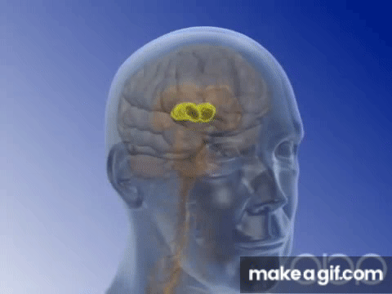
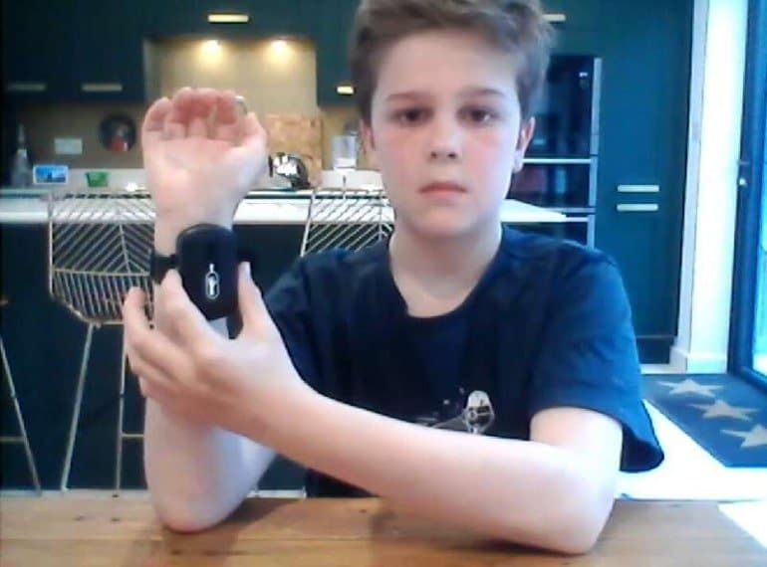
Other interventions
Deep brain stimulation
Peripheral (e.g. median) nerve
stimulation

Slide 29
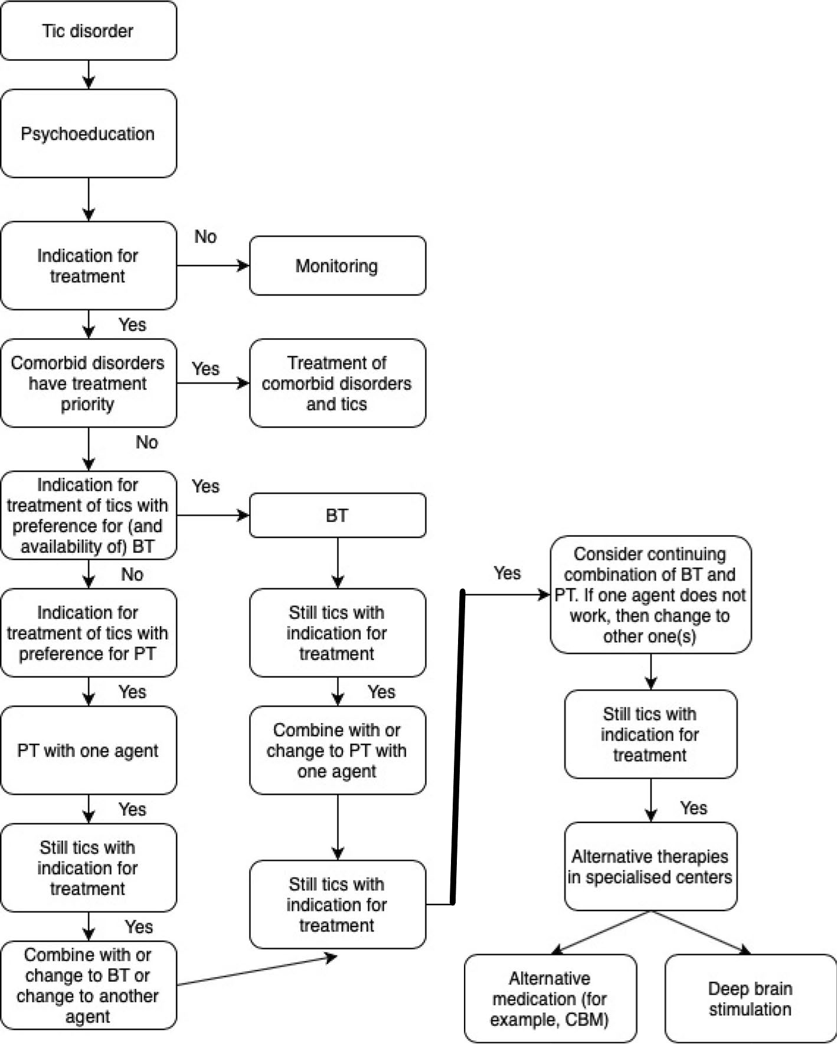

Slide 30
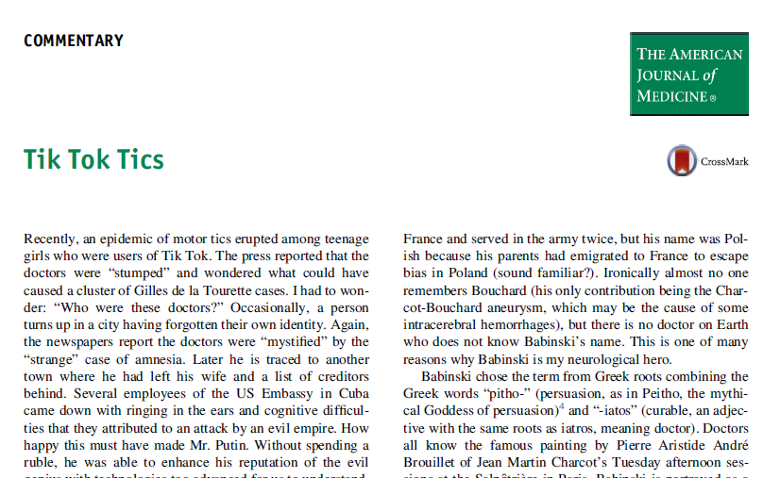
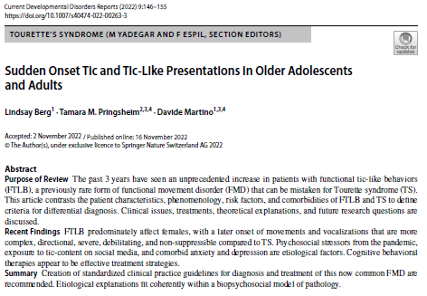
Functional tics

Slide 31
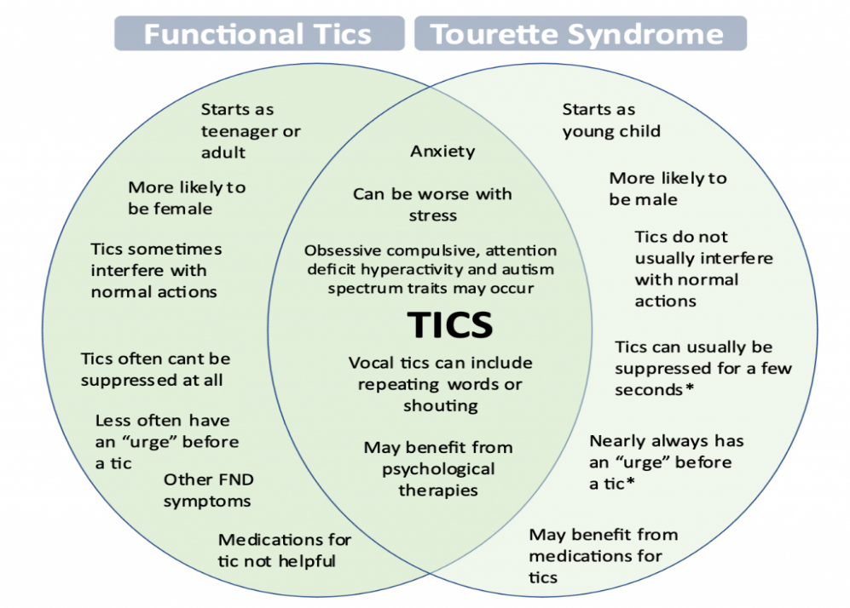
Functional tics
Tourette
gradual symptom onset
onset 4-6 yrs peak 10-12 yrs waning during adolescence
Rostrocaudal simple to complex progression
males > females
Functional tics
Rapid onset peaking within hours/days
later onset in adolescents young adulthood
not typical rostrocaudal progression
complex tics often at outset
large amplitude movements more common; self/other
females>males
absence of family history
more functional impairments high YGTSS
anxiety/depression; school work absence

Slide 33
Great resources at Tourettes Action
https://www.tourettes-action.org.uk/
European Society for the Study of Tourette Syndrome: ESSTS

Slide 34
Rae et al. Elevated representational similarity of voluntary action and inhibition in Tourette syndrome. Brain Comm 2023
Rae et al. Amplified engagement of prefrontal cortex during control of voluntary action in Tourette syndrome. Brain Comm 2020
Rae et al. A Bayesian Account of the Sensory-Motor Interactions Underlying Symptoms of Tourette Syndrome. Front Psychiatry. 2019
Rae et al. Dimensions of interoception predict premonitory urges and tic severity in Tourette syndrome. Psychiatry Res. 2019
Rae et al. Face perception enhances insula and motor network reactivity in Tourette syndrome. Brain. 2018
Rae et al. Subjective embodiment during the rubber hand illusion predicts severity of premonitory sensations and tics in Tourette Syndrome. Conscious Cogn. 2018
Polyanska et al. Centrality of prefrontal and motor preparation cortices to Tourette Syndrome revealed by meta-analysis of task-based neuroimaging studies. Neuroimage Clin. 2017
Nagai et al. Biofeedback treatment for Tourette syndrome: a preliminary randomized controlled trial. Cogn Behav Neurol. 2014
Eddy et al. A controlled study of personality and affect in Tourette syndrome. Compr Psychiatry. 2013
Cavanna et al. Dissecting the Gilles de la Tourette spectrum: a factor analytic study on 639 patients. J Neurol Neurosurg Psychiatry. 2011
Draganski et al. Multispectral brain morphometry in Tourette syndrome persisting into adulthood. Brain. 2010
Nagai et al. Influence of sympathetic autonomic arousal on tics: implications for a therapeutic behavioral intervention for Tourette syndrome. J Psychosom Res. 2009
Cavanna et al. The Gilles de la Tourette syndrome-quality of life scale (GTS-QOL): development and validation. Neurology. 2008
Cavanna et al. Neuropsychiatric-developmental model for the expression of tics, pervasive developmental disorder, and schizophreniform symptomatology associated with PANDAS. World J Biol Psychiatry. 2009
Mula et al. Phenomenology of obsessive compulsive disorder in patients with Temporal Lobe Epilepsy or Tourette Syndrome. J Neuropsychiatry Clin Neurosci. 2008
Cavanna et al. Catatonic signs in Gilles de la Tourette syndrome. Cogn Behav Neurol. 2008
Martino et al. Anti-basal ganglia antibodies and Tourette's syndrome: a voxel-based morphometry and diffusion tensor imaging study in an adult population. J Neurol Neurosurg Psychiatry. 2008
Cavanna et al. Uneven focal shoe deterioration in Tourette syndrome. Neuropsychiatr Dis Treat. 2006
Cavanna et al. Schizotypal personality traits in Gilles de la Tourette syndrome. Acta Neurol Scand. 2007
Robertson et al. A patient with both Gilles de la Tourette's syndrome and chromosome 22q11 deletion syndrome: clue to the genetics of Gilles de la Tourette's syndrome? J Psychosom Res. 2006
Cavanna et al. Compulsive behaviours in Gilles de la Tourette syndrome. Confinia Neuropsychiatrica. 2006

