Slide 1
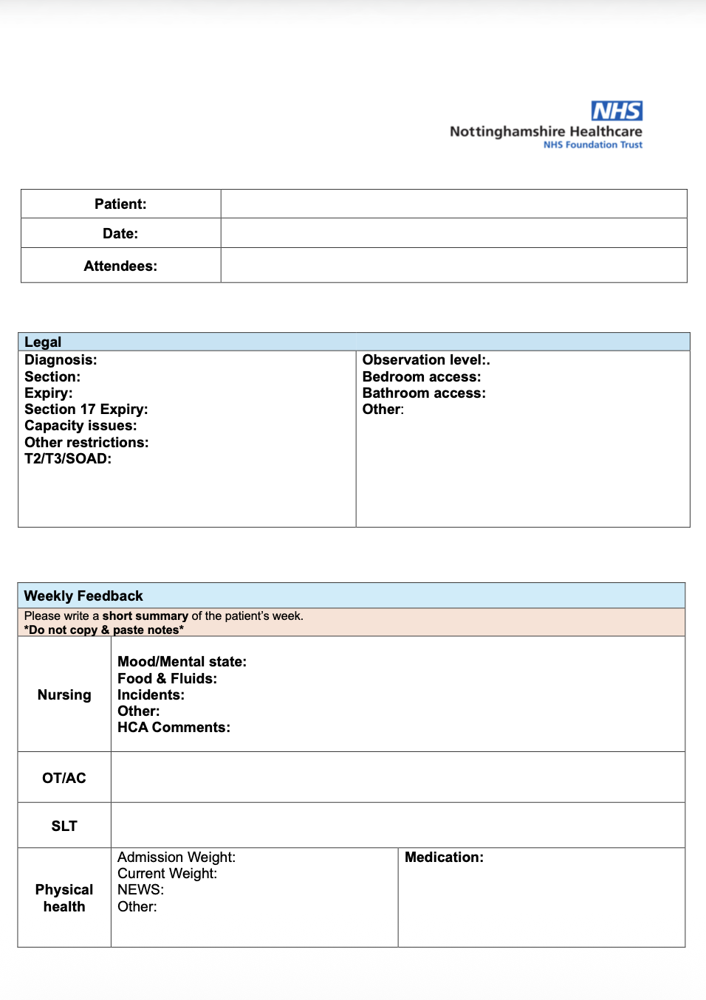
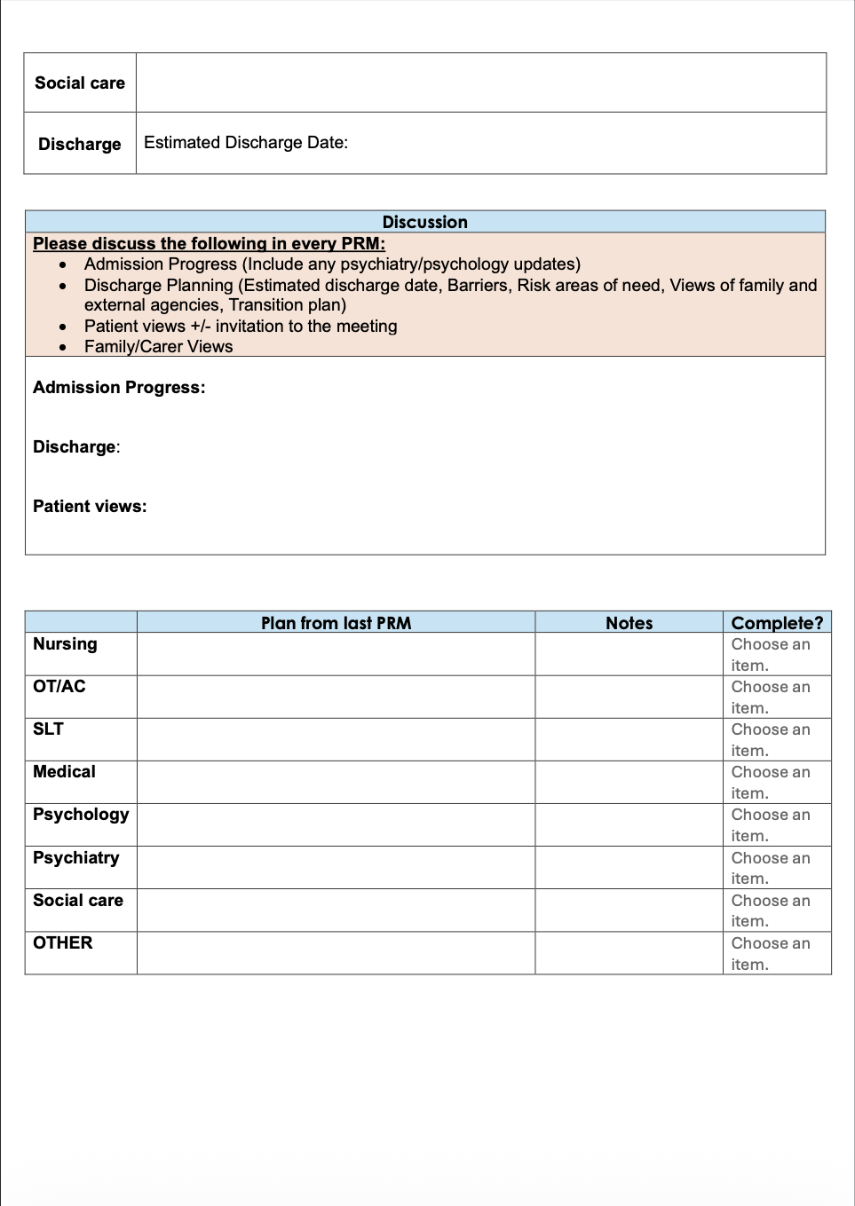
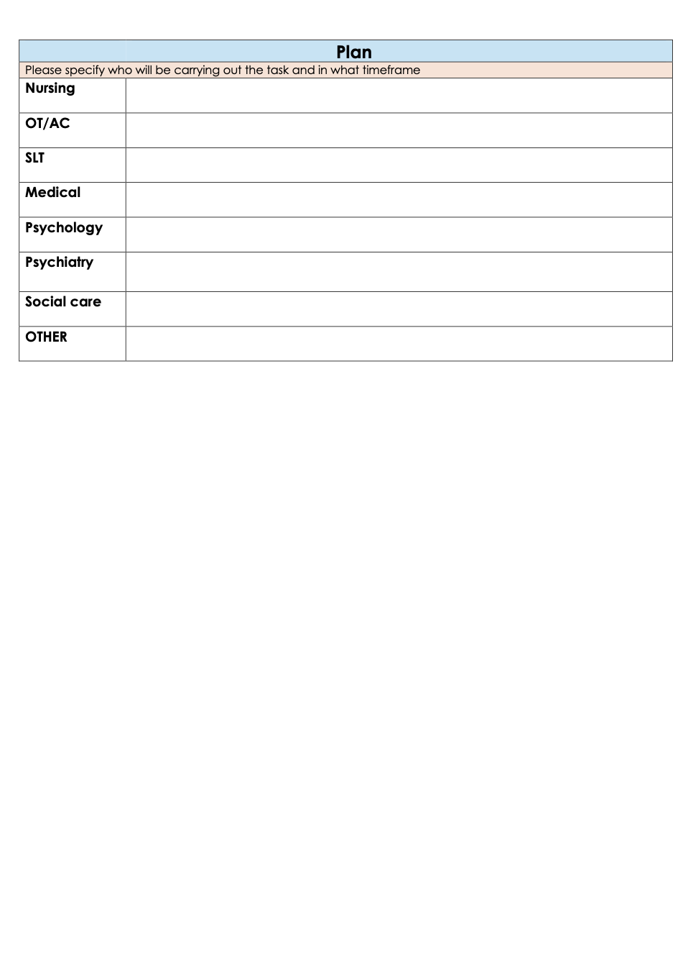
Enhancing MDT Documentation Compliance Through Redesign of the Weekly Patient Review Meeting Template in an Intellectual and Developmental Disabilities Inpatient Ward
Authors: Dr J.Victor^{1,2}, Dr A.Ghosh^{1,2}, Dr N.Zulkifli², Dr M.Akinduyi², Dr D.Bagalkote²
Affiliations: 1. Nottingham University Hospitals NHS Trust, 2. Nottinghamshire Healthcare NHS Foundation Trust
Introduction
Results
Patient Review Meeting (PRM) documents are used by various members of the multidisciplinary team (MDT) as part of the weekly ward round. The PRM is comprised of two main sections; the ‘weekly feedback’ section detailing MDT assessments and observations for the week, and a ‘Plan’ section, outlining actions for each patient.
Incomplete or inconsistent documentation can obscure clinical decisions, weaken accountability and disrupt continuity of care. Staff described the existing PRM template as lengthy, repetitive and difficult to complete.
This quality improvement project aimed to create a more clear and practical template to increase MDT engagement and improve the documentation and follow-up of agreed actions during ward rounds.
88 PRM documents were reviewed throughout the project: 34 at baseline, 27 in cycle 2 and 27 in cycle 3.
Overall ‘weekly feedback’ completion increased from 64.4% to 77.2%, then 84.0%.
‘Plan’ outcome documentation improved from 35.9% to 77.0%, then 84.9%.
The greatest improvements were in discharge planning (14.7% to 92.6%) and admission progress (26.5% to 100%).
Mean staff-rated usability increased from 5.9/10 to 8.7/10.
Methods
Baseline measurement: PRM documents from April 2026 were retrospectively audited. Completion rates of ‘weekly feedback’ and ‘plan’ outcome documentation sections were reviewed.
Staff consultation: Questionnaires sent to MDT members assessed usability, barriers to completion and opportunities for improvement.
Intervention 1: Audit findings and staff feedback informed a template redesign with simplified formatting, improved visibility of key clinical information and restructuring of the plan section.
Post-intervention evaluation: Documentation rates and user experience were evaluated over four weeks.
Sustainability intervention 2: Profession-specific completion prompts were embedded into the existing morning safety handover.
Re-audit: A further four-week audit assessed whether improvements were sustained.
Project handover: Incoming resident doctors to take over the project.
Intervention 1
Conclusions
Redesigning the PRM template improved ‘weekly feedback’ completion from 64.4% to 84.0% and ‘plan’ outcomes documentation from 35.9% to 84.9%.
Simplifying the layout made key information easier to record and strengthened the ownership and follow-up of MDT actions.
Embedding profession-specific prompts into the existing morning safety handover helped sustain improvement.
This project demonstrates that small, co-designed changes to routine documentation can improve MDT engagement, accountability and continuity of care in intellectual and developmental disabilities inpatient ward.
Conflict of Interest Declaration: All authors have declared no conflict of interest

