Slide 1
Young Onset Dementia Webinar
Dr Janet Carter
Associate Professor of Old Age Psychiatry UCL Division of Psychiatry Consultant in OAP, NELFT
Dr Paul Gallagher
ST7 Psychiatry Dual Trainee, ELFT
Dr Joanne Hew
ST4 Psychiatry Dual Trainee, ELFT
Dr Mohan Bhat
Academic Secretary Faculty of Old Age Psychiatry
Consultant in OAP, NELFT

Slide 2
Audience poll
What is your professional background?

Slide 3
Learning Objectives
Provide some examples of typical presentations encountered in young onset dementias
Identify key red flags in the history
Describe the investigations and cognitive testing required to establish a diagnosis of young onset dementia
Identify the importance of genetic testing in young onset dementia
Describe the wider social context of a diagnosis of young onset dementia
To be aware of the barriers in current service models and what constitutes good practice

Slide 4
“Young” Onset Dementia (YOD)
Dementia presenting under age of 65 years
Accounts for approximately 5.5% of dementia diagnoses in the UK
Diverse clinical presentations, differing from older onset
Greater impact on psychosocial functioning
Rarer dementia types over-represented
Alzheimer's remains common (atypical presentations)
Frontotemporal dementia (behavioural variant) also common

Slide 5
Case Vignette (Background)
Mr MG, 62 year old male
2 year history of progressive decline in short term memory and word finding difficulties
Making extensive use of notes as reminders
Not recalling points of technical language
Recent redundancy (1 year previously) describes he has been more anxious since then
Lives with wife, 2 children aged 15 and 17 and remains independent in ADLs
How do we proceed with the assessment?

Slide 6
Facets of assessment
History
Psychiatric history
Family history
Collateral history
Mental state examination
Neurological examination
Cognitive screening
Imaging
Biological investigations

Slide 7
Psychiatric history
Observed the memory difficulties before the redundancy
Taking on contracting work following redundancy
Still having memory problems, but relies extensively on notes
More anxious since redundancy
No other reported mood symptoms
No prior psychiatric contacts
No current psychotic features

Slide 8
Family history
Maternal grandmother
Alzheimer's dementia (uncertain of age)
Mother
Alzheimer's dementia aged 63
Maternal aunt died in mid-fifties
Younger brother
Clinical diagnosis of Fronto-Temporal Dementia
No genetic testing
Diagnosed aged 43, died aged 48

Slide 9
Collateral History
No observed personality or behaviour changes
Eating & sleeping well
Managing ADLs without any difficulty
“Jerky movements”
Observed through the day
3-4 times a night, sleep not interrupted.
Premorbid
“Open, calm and laid back.”

Slide 10
Examinations
Mental state – unremarkable
Cognitive Screening (ACE III)
Total 89/100
Attention 18/18
Fluency 11/14
Memory 19/26
Language 25/26
Visuospatial 16/16
Neurological examination
Myoclonic jerks observed, otherwise unremarkable
Concluded Diagnosis – Amnestic MCI

Slide 11
Indicators of Young Onset Dementia
Collateral history
Behaviour changes (loss of sympathy, empathy, compulsive behaviours)
Changes in appetite preference, swallowing problems, oral fixation
Occupational history, level of daily function
Change in sleep pattern
Change in ability to read and write
Family history
Three generations (if possible)
First degree relative with YOD

Slide 12
Indicators of Young Onset Dementia
Neurological examination
Cerebellar signs
Fasciculation
Extra-pyramidal features
e.g. parkinsonism, abnormal movements
Cognitive assessment
Praxis impairment
Frontal release signs
Use of standardised cognitive tools (Frontal Assessment Battery)

Slide 13
Delays to diagnosis
Diagnosis often encounters delays
Longer time to diagnosis (mean time 3.5 years - additional 1.6 years)
Younger age, personal history of depression, dementia other than AD or FTD, increased number of services consulted
Consulted an average of 3 clinicians prior to diagnosis
Frequently diagnosed with psychiatric disorder in early stages – delay 3-10 years
Level of cognitive impairment not associated with length of delay

Slide 14
What gets overlooked in assessment
Assessment of neurological symptoms
Cerebellar signs
Parkinsonism
Assessment of Praxis
Review of behaviour changes
Standardised neuro-imaging protocol (MRI T1, T2 & FLAIR)
Review of the needs of the patient & carer(s) before assessment

Slide 15
Differentiating from mood disorders
Psychiatric history
Mental state examination
Characteristic changes in speech e.g. dysfluent, effortful
Abnormal perceptions
Abnormal beliefs
Mood symptoms
Use of a validated rating scale (e.g. Geriatric Depression Scale, Beck Depression Inventory, Hamilton Anxiety & Depression Scale)

Slide 16
Case Vignette – Mr MG
Initial diagnosis: Amnestic MCI
Remained under services, had repeat assessment after 1 year
ACE-3 score to 85/100
Memory subset domain deteriorating to 15/26
More concerns about deterioration in ADLs
Had applied for 4 jobs in the last year and reported difficulties in “organising himself”.
Appears to have lost his jobs due to difficulty functioning appropriately at work.
What are the next steps for investigation?

Slide 17
Further testing – genetics Alzheimer’s disease
First person to be assessed must be affected
i.e. symptomatic vs predictive testing in family members - importance of FHx
ALZHEIMER’S DISEASE | Age of onset | Probability of genetic mutation
Affected family in 3 generations | <60 YRS | 86% | GENETIC MUTATIONS GENES APP PSEN1 (COMMONEST) PSEN2
Two or more affected first-degree relatives | <65YRS | 15%
Two or more affected first-degree relatives | >65YRS | <1%

Slide 18
Further testing – genetics Familial FTD
About 30% FTD is genetic
It is inherited in Autosomal dominant fashion
BvFTD – accounts for 60% of cases – most highly heritable
Genetic testing may be predictive for children of the person with FTD
Gene | Chromosome location |  | Clinical characteristics
C9orf72** | 9 | Psychosis may precede dementia by years | Bv FTD / FTD-MND
MAPT | 17 |  | Bv FTD Parkinson’s plus syndromes
GRN | 17 |  | bvFTD PPA/CBS

Slide 19
Audience poll
What imaging is available for you to use? (Tick all that apply)

Slide 20
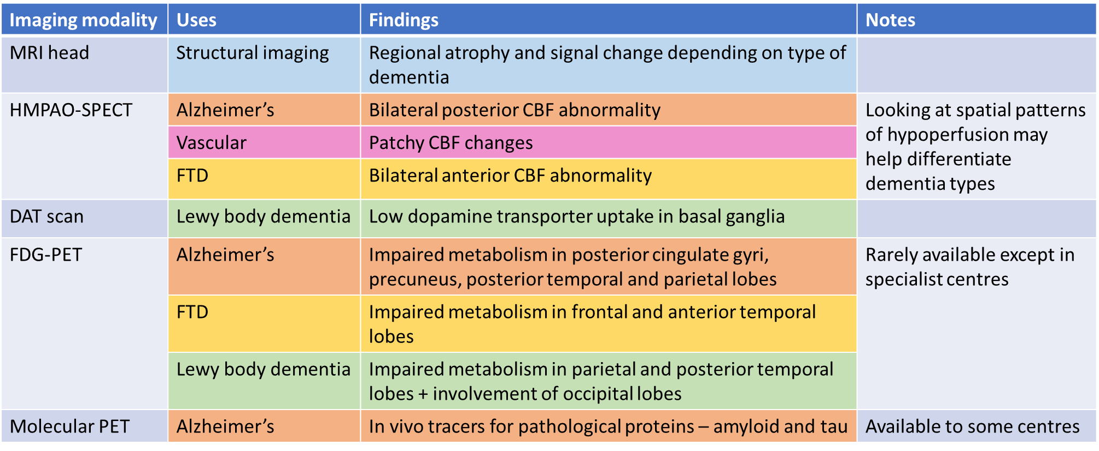
Further testing – imaging
Less likely to find changes on imaging in YOD
Richard et al (2014), Talbot et al (1998), Sala & Perani (2019), Sampson et al (2004), O’Malley et al (2019)

Slide 21
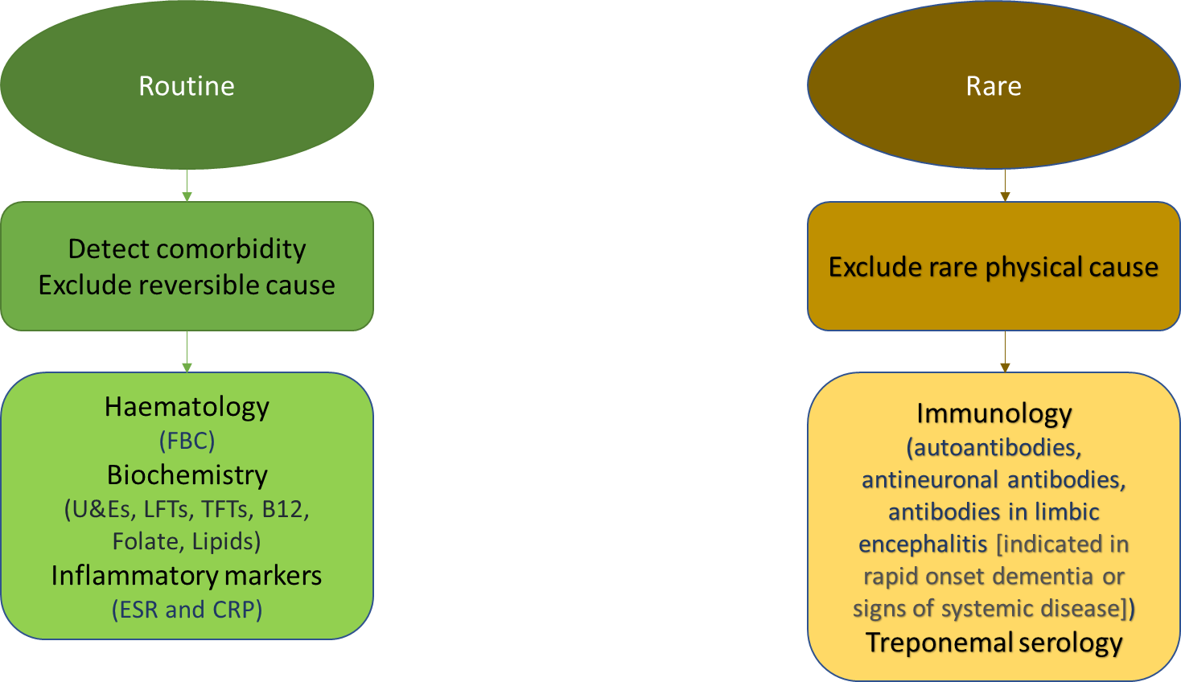
Further testing – blood
Sampson et al (2004)

Slide 22
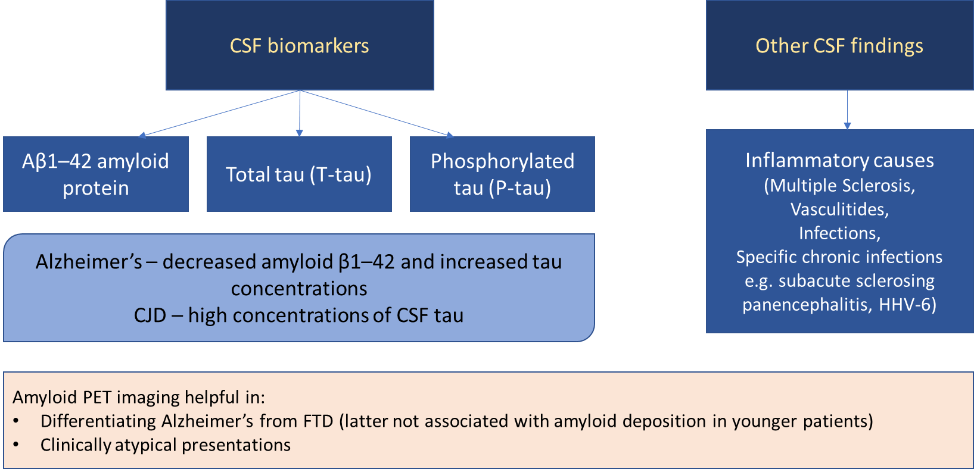
Further testing – CSF
Sampson et al (2004), O’Malley et al (2019)

Slide 23
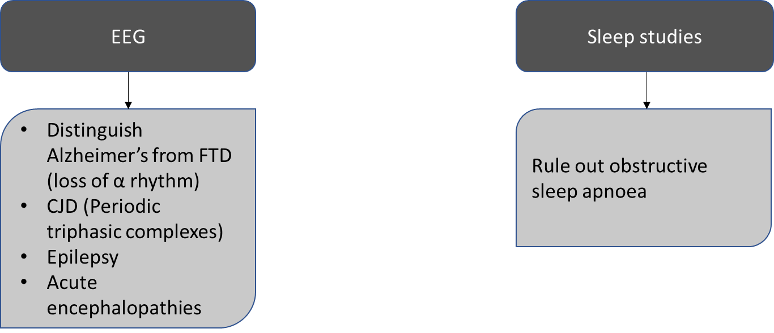
Further testing – EEG, sleep studies
Sampson et al (2004)

Slide 24
Case vignette – Mr MG
Referred to genetic clinic for pre-testing counselling and genetic testing
Test showed PSEN1 mutation
MRI head
Unremarkable
Blood screen
NAD
Diagnosed with young onset Alzheimer’s disease
Note different diagnosis concluded compared to brother

Slide 25
Social history (update)
Mr MG is sole breadwinner of the family, family now having to use savings as Mr MG’s contract work is sporadic
Older child has started university, younger child in 6th form
Wife’s father unwell with physical health problems, he has moved in with them and they are looking after him

Slide 26
Impact of diagnosis
Wide variation in the support requirements – arising primarily from stage of life at diagnosis
Vastly different to older people living with dementia
10.4% living with children in their homes
Possible carers for a parent living with YOD
5.6% currently employed
15% living alone
60% requiring significant support (>5 hours daily) from family
Many requiring in excess of 8 hours daily
Loss of income from family members and individual (although many lose job prior to diagnosis and opportunity for vocational rehab is lost)
Stamou et al (2020)

Slide 27
Case vignette – Mr MG
Genetic counselling for children
Vocational support
Financial advice
(Lasting Power of Attorney)
Future healthcare decisions
(Advance Directives)

Slide 28
Conclusions about the case
Detailed family history (3 generations if possible)
Genetic testing
Neurological examination (especially praxis / frontal lobe functions)
Access to specialist imaging early in diagnostic journey
Anything else?

Slide 29
Audience poll
What services are available for individuals with YOD in your area? (Tick all that apply)

Slide 30
Current services
Heterogenous route to diagnosis (UK Study)
More than 1 in 3 diagnoses made in memory clinic
Around 1 in 4 diagnoses in neurology clinic
Less that 1 in 5 specialist YOD service / older adults mental health service
42% reported no follow up 6 weeks after diagnosis
70% of family members had no carers’ group or respite care
Care managed by:
1/5 managed solely by specialist YOD service
1/5 managed by GP
16% nobody managed care
Stamou et al (2020) Loi et al (2020)

Slide 31
What do patients/carers want from services?
https://www.youngdementiauk.org/support-needs-films

Slide 32
Research from Angela Project
People with YOD want:
Young onset specific information, advice and support to stay independent
Age-appropriate support to stay fit, active and mentally well
Age-appropriate activity and occupation to maintain identity
Carers of people with YOD want:
Specialist support to know how to care for issues specific to young onset dementia
Support to retain life beyond caring, such as employment
Both carers and people with YOD want:
To feel connected with each other
To feel connected with friends or others who understand challenges of living with young onset dementia
To have opportunities to contribute to wider society

Slide 33
Gold standard services
Satisfaction and quality of care highest in specialist services
Specialist services more likely to offer follow up within 6 weeks, ongoing care management appointments, and care planning
Streamlined diagnostic pathway
Appropriate investigations and timely diagnosis
Flexible, person-centric and age appropriate
Financial and employment issues, management of comorbid psychiatric symptoms, provide meaningful and stimulating activities.
Acknowledge role of caregiver, and provide support for them: perceived lack of recognition, lack of understanding of symptoms and early recognition, gaining access to social and professional support.
Loi et al (2020), Stamou et al (2020)

Slide 34
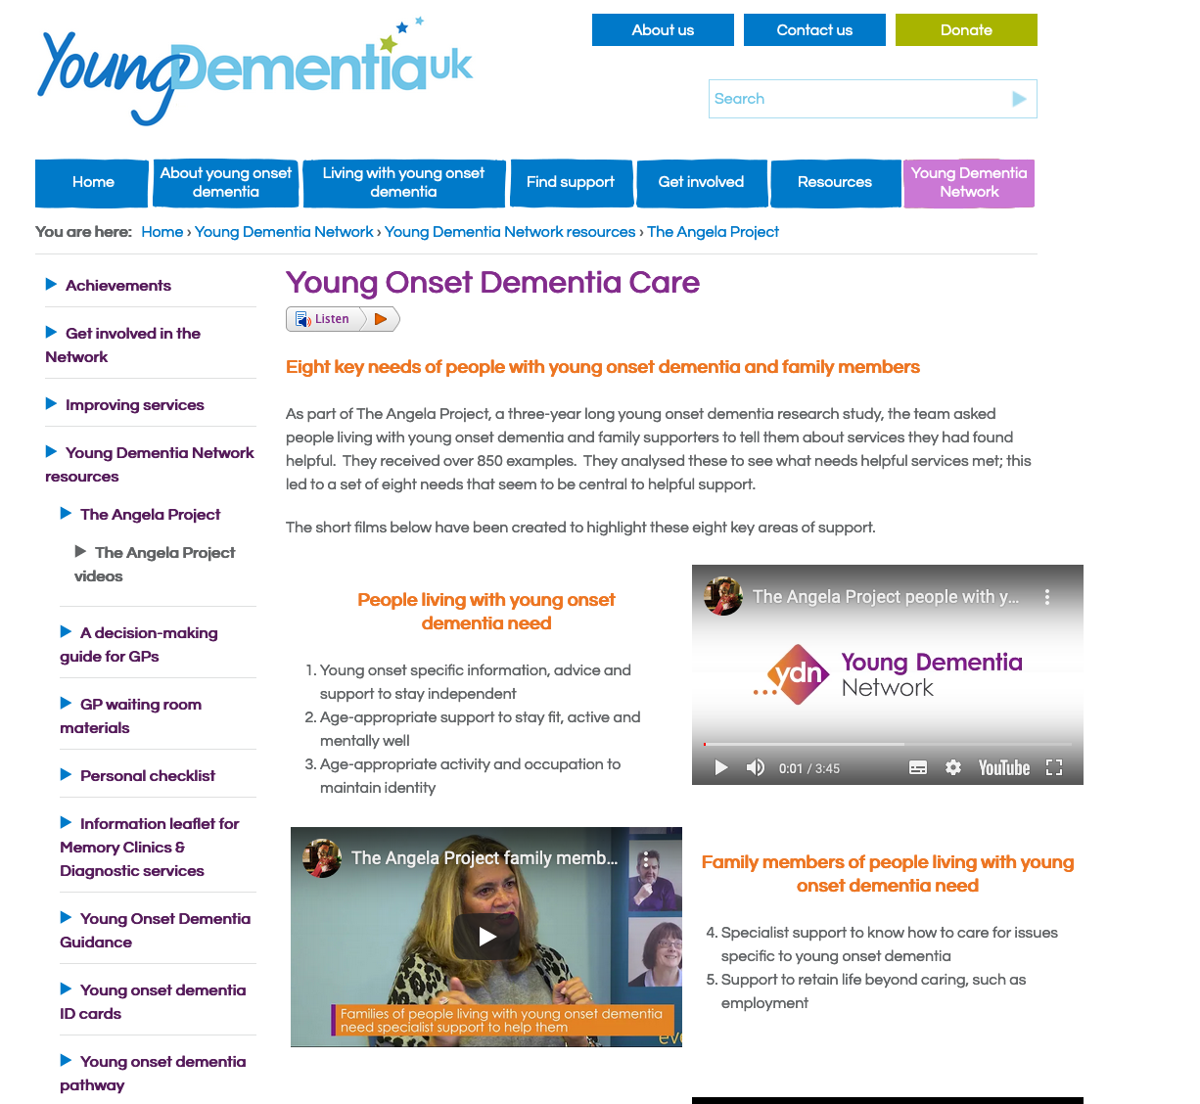
Concluding remarks

Slide 35
References
Brown KJ, Bohnen NI, Wong KK, Minoshima S and Frey KA (2014) Brain PET in Suspected Dementia: Patterns of Altered FDG Metabolism Radiographics : a Review Publication of the Radiological Society of North America, 34(3):684-701
Loi SM, Goh AMY, Mocellin R, Malpas CB, Parker S, Eratne D, Farrand S, Kelso W, Evans A, Walterfang M, Velakoulis D (2020) Time to diagnosis in younger-onset dementia and the impact of a specialist diagnostic service Int Psychogeriatrics 28;1-9. doi: 10.1017/S1041610220001489
O’Malley M, Parkes J, Stamou V, LaFontaine J, Oyebode J and Carter J(2019) Young-onset dementia: scoping review of key pointers to diagnostic accuracy BJPsych Open 5, e48, 1–9. doi: 10.1192/bjo.2019.36
Sala A and Perani D (2019) Brain Molecular Connectivity in Neurodegenerative Diseases: Recent Advances and New Perspectives Using Positron Emission Tomography Front. Neurosci. doi: 10.3389/fnins.2019.00617
Sampson EL, Warren JD and Rossor MN (2004) Young onset dementia Postgrad Med J 80:125–139. doi: 10.1136/pgmj.2003.011171
Stamou V, La Fontaine J, Gage H, Jones B, Williams P, O'Malley M, Parkes J, Carter J, Oyebode J. (2020) Services for people with young onset dementia: The 'Angela' project national UK survey of service use and satisfaction. Int J Geriatr Psychiatry. doi: 10.1002/gps.5437. Epub ahead of print. PMID: 32979287
Stamou V, La Fontaine J, O’Malley M, Jones B, Gage H, Parkes J, Carter J and Oyebode J (2020) The nature of positive post-diagnostic support as experienced by people with young onset dementia, Aging & Mental Health, DOI: 10.1080/13607863.2020.1727854
Talbot PR, Lloyd JJ, Snowden JS, et al (1998) A clinical role for ^{99m}Tc-HMPAO SPECT in the investigation of dementia? Journal of Neurology, Neurosurgery & Psychiatry 64:306-313.

