Slide 1
National Audit of Dementia
National Round 5 findings and recommendations

Slide 2
In this presentation…
Background National Audit of Dementia
Round 5 of audit – development and content
Key findings
Recommendations

Slide 3
Welcome and Aims of the day
Welcome to the learning, sharing and networking event
This is the first face to face general event since 2019
Exciting opportunity:
To share successes
To help each other
To feedback to the project team
To network and arrange to link up
Sharing practice sessions
Plenary feedback
Meet ups at lunchtime and sharing contact details

Slide 4
Agenda overview
10.00 | Introduction and welcome
10.10 | Background to the audit and key results and improvements | NAD
10.35 | Sharing practice Katy Mundy, Princess Royal Hospital Ste Nicholson, University Hospital North Tees
11.00 | Sharing practice Group work – share and discuss your local QI activities and plans | All
11.45 | Break | All
11.55 | Sharing practice - Short feedback presentations and Q&A | All
12.50 | Lunch. 1.20 Lunchtime networking
1.50 | Carer and patient feedback | NAD
2.10 | Sharing practice Rebecca Goadsby, Northampton General Hospital
2.20 | Sharing practice – Group discussions - Using and collecting patient and carer data | All
2.50 | Break
3.00 | Group feedback and top tips review | Plenary
3.30 | Priorities for future audit? | Plenary
4.00 | Close

Slide 5
Housekeeping
The Wifi code is on your table
Toilets located on ground and first floors
There is no fire alarm practice planned
We will note any questions not answered today and get back to you via email

Slide 6
National Audit of dementia… how we got here…

Slide 7
Summary background
In 4 previous rounds of NAD, patient notes sampling was done using ICD10 codes
These are applied post discharge, which can take 1-3 months, and sometimes longer
Leads to significant time lag between patient admission and receiving any reporting
Key aim for national audits is a greater QI focus
More frequent and timely reporting
Rapid feedback of performance to identify and address issues outside of formal reporting
Better integration with QI techniques and ability to evaluate their effectiveness throughout the audit
Rounds 5 and 6
Prospective identification of patients with dementia
Curtailed and focused data set, based on priorities identified during consultation
New data platform

Slide 8
We’ve learnt…
Information systems
May not be set up to hold information about dementia – not knowing how many people with dementia are in the hospital at any one time
People admitted with dementia will be patients in all wards and departments – no ready made sample
Numbers of admissions
Because of casefinding/ coding difficulties, these may not be reliable. Often lower numbers than expected for audit sample, leading to variations in time period
Resourcing
Teams are usually small, often without consistent administrative support – impact on clinical work
Reporting
Auditing close to the admission and data availability on submission can help with identifying areas for improvement. Utility versus feasibility

Slide 9
Where next
2024 is the last year of the current cycle. The audit will go out to open tender in 2024
Lessons learned have been fed back
This year’s report will cover
Round 6 in comparison to Round 5 key metrics
update on recommendations learning from the Flex data collection periods
Release will be in the Autumn
Annual Dementia Statement update will be end of March

Slide 10
Summary of Key results Round 5

Slide 11
Summary of Key results Round 5
Delirium screening
Overall improvement – up to 87%
Pain assessment and reassessment
92% of patients receiving this (though for 61% as question rather than structured assessment)
Discharge planning
84% within 24 hours (when reasons for later initiation are taken into account)
Feedback from carers
Carer ratings of both quality of care and communication were lower. Lower numbers returned (average 23, previously 24-26)

Slide 12
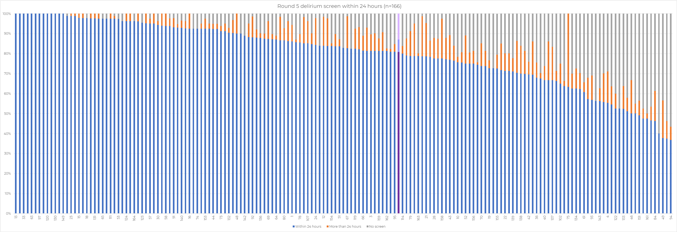
Key metrics reporting – delirium screen
Range: 40 – 100% (R4 9-100%)
Average: 87% (R4 58%)
Although methodology has changed this is a very large positive change

Slide 13
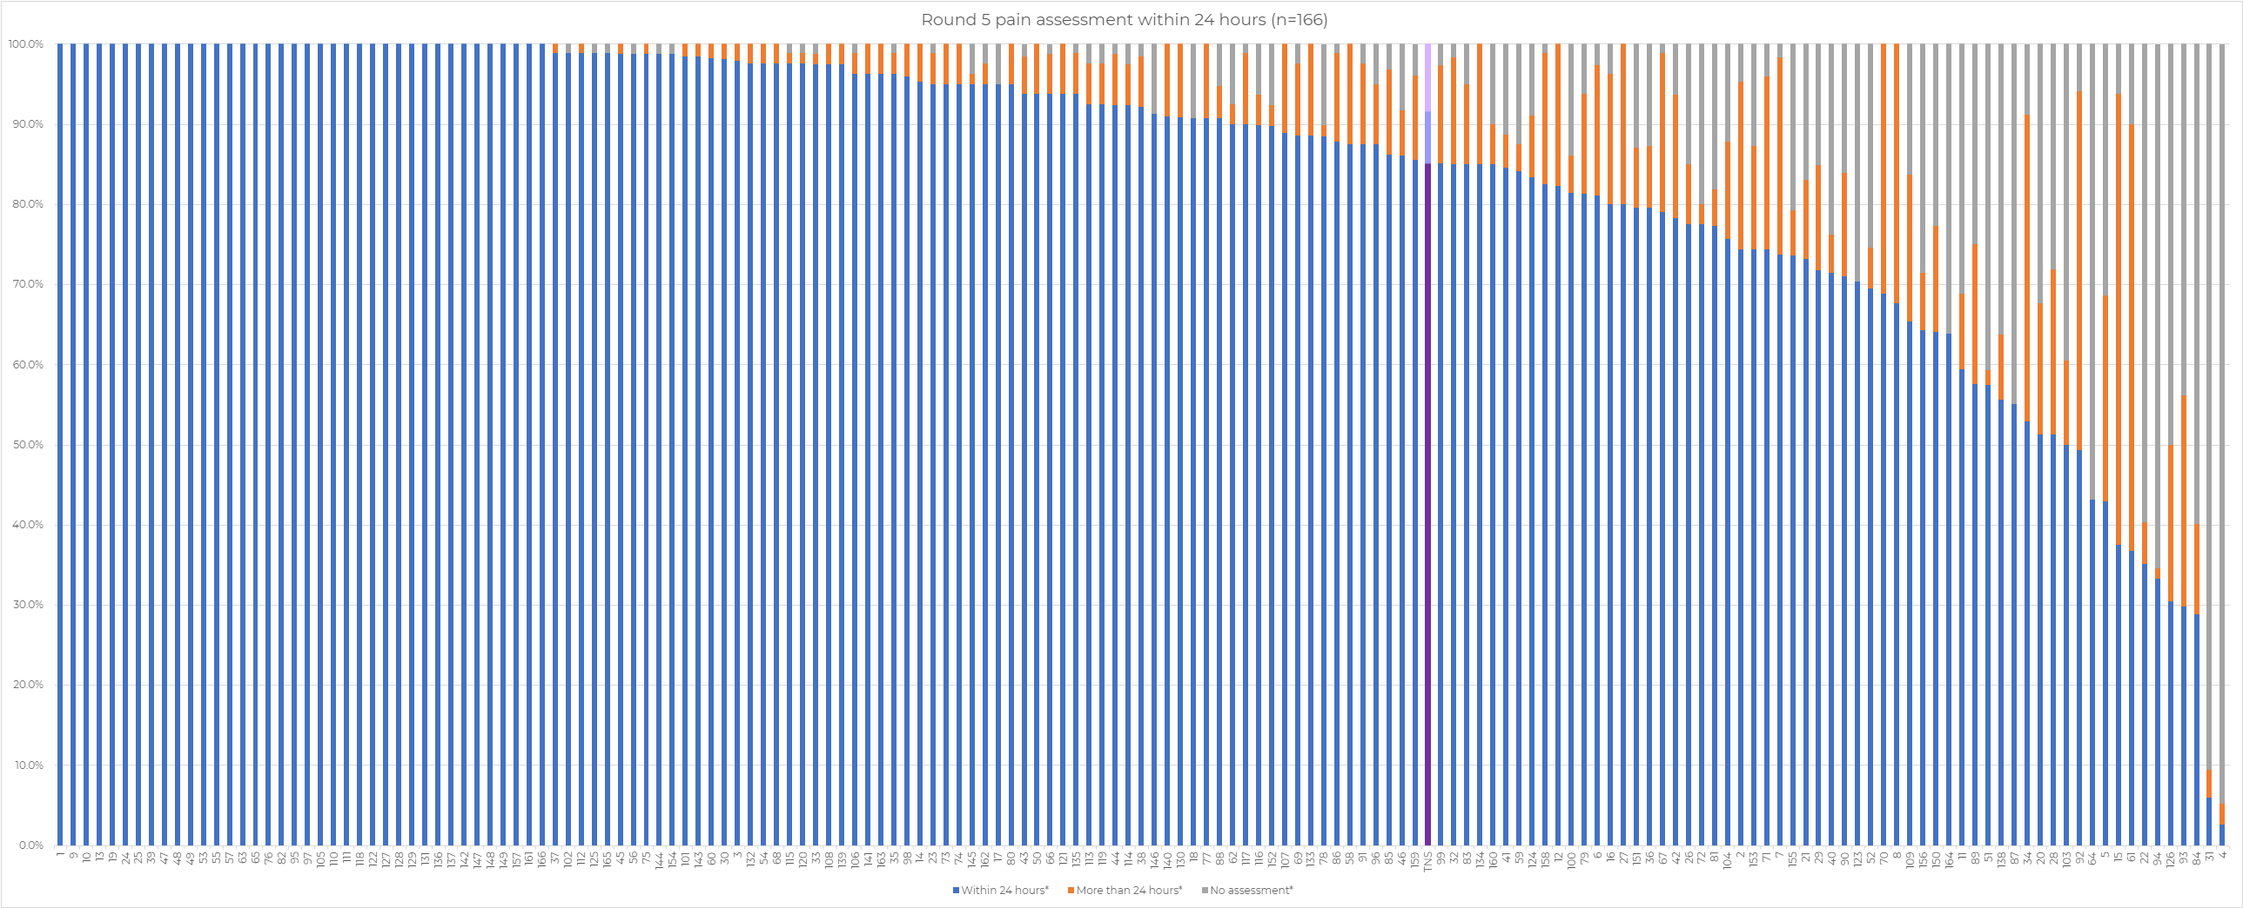
Key metrics reporting – pain assessment
Range: 5-100% (R4 16-100%)
Average: 92% (R4 85%)
61% assessments were a question. Range per site for question only 0-100% (5 sites 0)

Slide 14
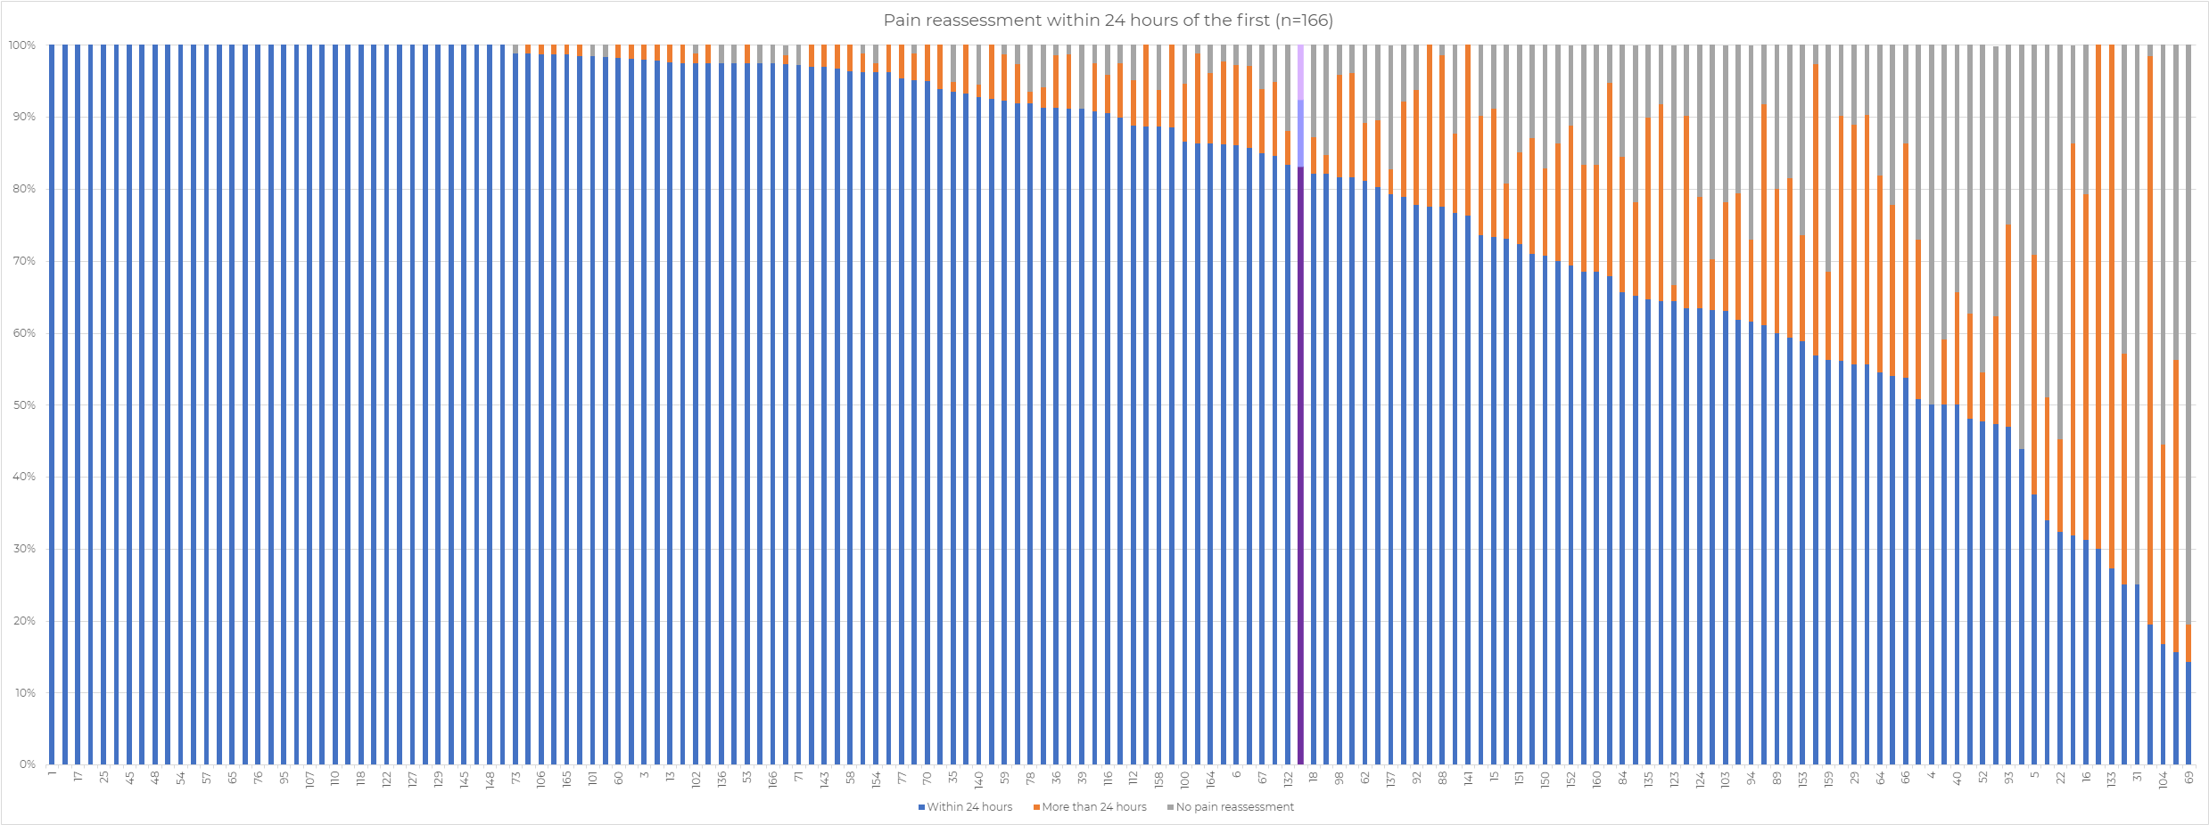
Key metrics reporting – pain assessment repeated
Range: 14-100%
Average: 83%

Slide 15
Key metrics reporting – discharge planning within 24 hours
Reasons given for not initiating planning within 24 hours raise the national result to 83.5%
Range: 3-100%
Average: 39%
N.B this figure does not take into account reasons leading to cases treated as N/A for outlier analysis

Slide 16
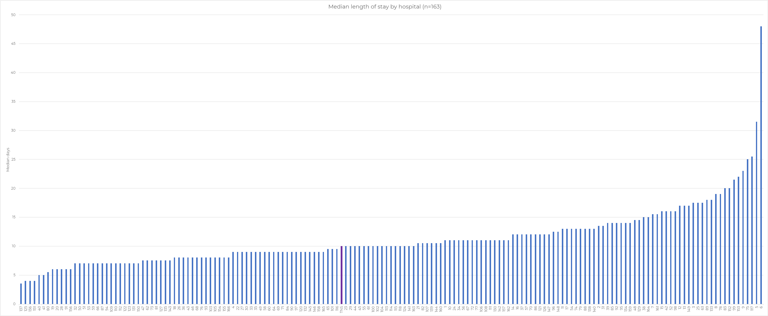
Key metrics reporting – Length of Stay
Median Range: 3.5-48 days
Average: 10 days
R4 not compared due to change in methodology

Slide 17
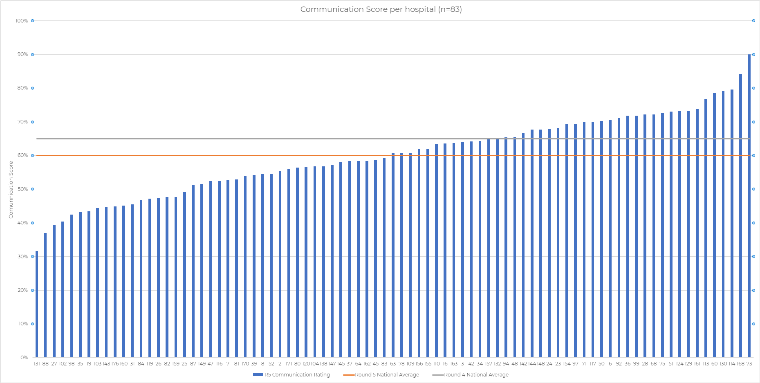
Key metrics reporting – Carer communication rating
Range: 32-90 (R4 17-96)
Average: 60 (R4 65)
Average return 23 (83 hospitals). Top return 75

Slide 18
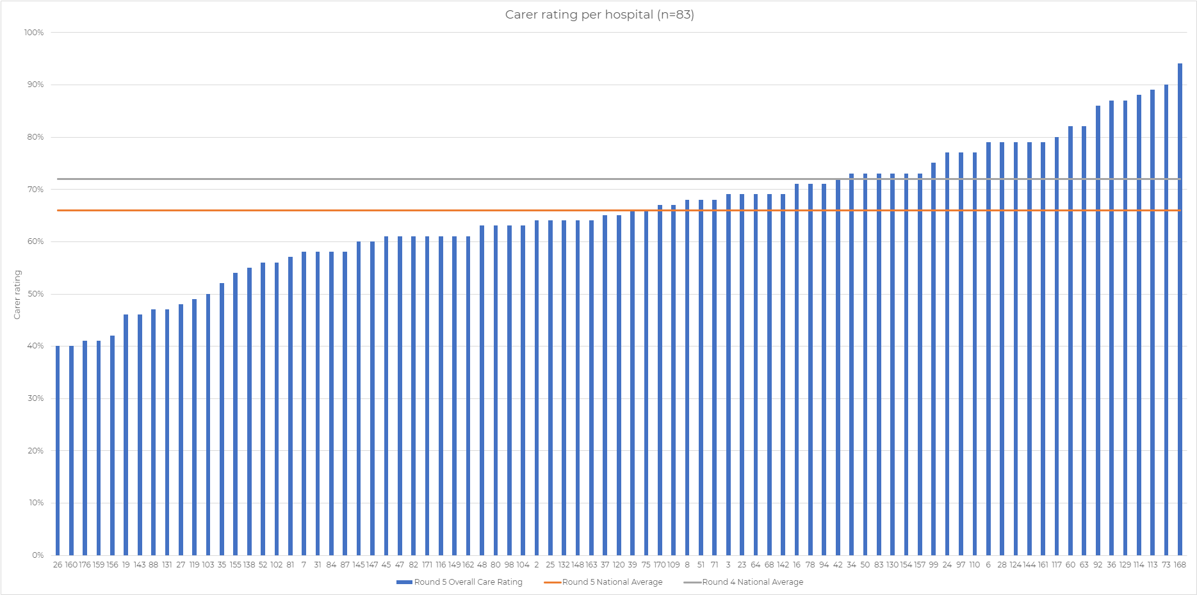
Key metrics reporting – Carer overall rating of care
Range: 40-94 (R4 13-100)
Average: 66 (R4 72)

Slide 20
Sharing practice
Katy Mundy
Dementia education and the benefit of a specialist dementia unit
Ste Nicholson
Improving formal pain assessment completion for patients with dementia on our acute wards

Slide 21
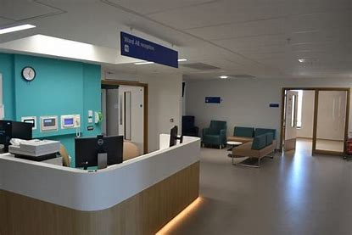
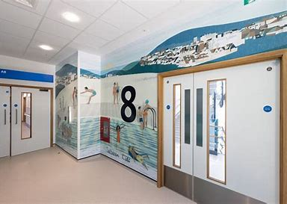
A Dementia specialist unit in an acute hospital
University Hospitals Sussex Foundation Trust.
Katy Mundy

Slide 22
Who is in our team. The team comprised an MDT approach with multiple stakeholders involved. Care of the elderly consultants with a specialist interest in dementia Clinical site team Dementia team Older peoples mental health team Care of the elderly matron Ward psychiatrist Frailty operational managers Acute floor matron Small acts of friendship charity Care for carers
Notes:
Who lead the work on a day to day basis?
Who supported your improvement work and acted as the champion with your SMT?
Who understood the various parts of the system you tried to improve? What expertise/experience did they bring?
Did you need to recruit service users/carers?
Who will be affected directly by the changes you made?

Slide 23
What change ideas did we apply?
There was already a 'dementia unit'! but this was not functioning as one in terms of a pathway or highly trained staff.
We set out by writing a pathway with a view as to getting the right patients on the unit and how staff could refer them to the specialist dementia unit. Delirium is also a key focus on inclusion.
There were also clear guidelines around an exclusion criteria which is key in its protection.
Ensuring that all staff had the relevant training needed and felt supported.
A change management process was established to ensure we were constantly reviewing what was & wasn’t working and how we could impact change.
Ensuring ownership by the ward leadership team was key to its success.
Notes:
Applied change ideas from the ‘evidence’, other services, adapted ideas from other QI projects, from other people
Examples of change ideas:
- Eliminate things that are not used
- Eliminate multiple entry/overkill
- Review and reduce controls
- Review and reduce stages
- Minimise handoffs
- Find and remove bottlenecks
- Focus on patient experience
- Standardise processes/reduce variation

Slide 24
How we identified our problem
Aim (population, target, time frame)
• Get It Right First Time (right patient, right place)
• To provide specialist care with knowledge of the different types of dementia and delirium
• To balance excellent dementia care with the treatment of acute illness
• To reduce the requirement for pharmaceutical intervention and use of security and specials
• To improve the inpatient experience for patients, families and carers in a safer environment with a specialised team
• To complement and contribute to the work of Small Acts of Friendship on the Unit
Target population is anyone with a cognitive impairment, diagnosed or undiagnosed dementia.
Anyone experience delirium especially if they are highly distressed or hypoactive.
Notes:
Problem statement – What is influencing current performance? Are there bottlenecks? Are there steps taking longer than expected?
Problem statement example: Our staff report that the screening tools are not user-friendly, so they are not carrying out screening.
Identifying aim - what did we want to improve? Why?
Population – for whom?
Target – how much do we want to change?
Time frame – by when?
Aim example: To increase use of screening tools by staff for Ward 10 by 20% from baseline by December 2018

Slide 25
How we measured our change
We measured our change by looking at key metrics, such as:
Length of stay
Datix,
Security incidents
Patient and carer feedback
Staff feedback
Antipsychotic use.
We have gone through several PDA cycles and the measurements need regular review and change.
Notes:
What measures did we collect?
focussed on a vital few (about 3 measures)?
Could it be integrated into our routine?
Were there any unintended consequences we had to worry about (ie. Aim to reduce length of stay but what if readmission rate increased)?
Could we measure the outcome directly or did we use proxy measurements?
Who was affected directly by the changes you made?
How did we measure
Continuous measurements
Count of classification of observations
What people thought/felt
Ratings
Rankings

Slide 26
Results
Improved patient experience with the digitisation of the THIS IS ME on all care of the elderly wards.
Reduction in security, and duration of delirium.
Patient quality improvement - reduced incidents by 26% initially.
Cost savings on the use of security £19,289 in the first seven months
Reduction in the use of sedatives
Reduction in complaints
Increased training for staff that work on the unit, this has led to an improvement in staff retention.
Bespoke patient and next of kin (carers) leaflet.
Holistic patient care weekly psychiatrist visit and daily input from the dementia team.
Empowerment of patients, alongside working with the Small Acts of Friendship charity.
Less time on the acute floor which leads to a reduction in distress.
Notes:
What did we measure and what were the results – continuous measurements, count of classification of observations, what people thought/felt, ratings, rankings

Slide 27
Where are we now and what are our future plans?
Roll out of a specialist dementia unit across all sites within UHSussex.
The dementia units become centres of excellence and help to provide an outreach service to other wards within UHSussex especially out of hours.
To continue to monitor the effectiveness of the units.
To ensure all staff within the acute trust are up-skilled enable them to manage complex behaviours around dementia and maintain these skills.
To have dementia units identified as a speciality that is highly skilled. There are many nurses that love working with people living with dementia and we want their skills recognised.
Moving to a new building has had its challenges and we need to focus on a reduction in falls and how we manage the boredom felt by patients who are inside rooms, taking into account the restraints of staffing levels.
Notes:
Summary of the project at the moment and any future plans.
What worked – strengths of this approach
Limitations and learnings – what would you do differently

Slide 28
Improving formal pain assessment completion for patients with dementia on our acute wards
Your hospital logo
Ste Nicholson- Dementia specialist nurse and adult safeguarding advisor

Slide 29
Who was in our team
NAD round 5 support
Myself
Laura Greig- Community specialist Dementia OT (supported with round 5)
Debbie Fraser- Clinical effectiveness co-ordinator (audit support for all NADs)
QI support following round 5
Janette McGuire- Community dementia specialist nurse (supports with training)
Rachel Imeson- Pain Team (discussions with)
Kirsty Miller (meeting with QI)
Notes:
Who lead the work on a day to day basis?
Who supported your improvement work and acted as the champion with your SMT?
Who understood the various parts of the system you tried to improve? What expertise/experience did they bring?
Did you need to recruit service users/carers?
Who will be affected directly by the changes you made?

Slide 30
How we identified our problem
Problem statement
Pain results from round 5 NAD identified the trust had 100% compliance of the pain ‘question only’ but 0 formal pain assessments evidenced (paper notes and Trakcare)
Aim
Improve patient experience
Improve staff knowledge and awareness of pain tools available
Improve compliance by 20% by end of second quarter of 2024
Complete staff knowledge survey across all wards including all disciplines to identify which areas or specialities require most attention by July 2024
Notes:
Problem statement – What is influencing current performance? Are there bottlenecks? Are there steps taking longer than expected?
Problem statement example: Our staff report that the screening tools are not user-friendly, so they are not carrying out screening.
Identifying aim - what did we want to improve? Why?
Population – for whom?
Target – how much do we want to change?
Time frame – by when?
Aim example: To increase use of screening tools by staff for Ward 10 by 20% from baseline by December 2018

Slide 31
North Tees and Hartlepool pain data from national report

Slide 32
What change ideas did we apply?
Discussion with Trakcare team about availability of pain scales prior to going fully electronic in September 2023.
The trust previously encouraged the Abbey pain scale, however as this was paper based and we were transitioning to electronic notes where the FLACC and FACE were due to be added, the Abbey has been removed from training to reduce duplication
Dementia training updated, including 2 day champions course and 2 hour awareness session (FLACC ‘Face, legs, activity, cry and consolability’ and FACE tools)
Agreement with the matron of the pain team regarding supporting the same tools, to ensure we have a standard approach towards what we want to achieve.
Notes:
Applied change ideas from the ‘evidence’, other services, adapted ideas from other QI projects, from other people
Examples of change ideas:
- Eliminate things that are not used
- Eliminate multiple entry/overkill
- Review and reduce controls
- Review and reduce stages
- Minimise handoffs
- Find and remove bottlenecks
- Focus on patient experience
- Standardise processes/reduce variation

Slide 33
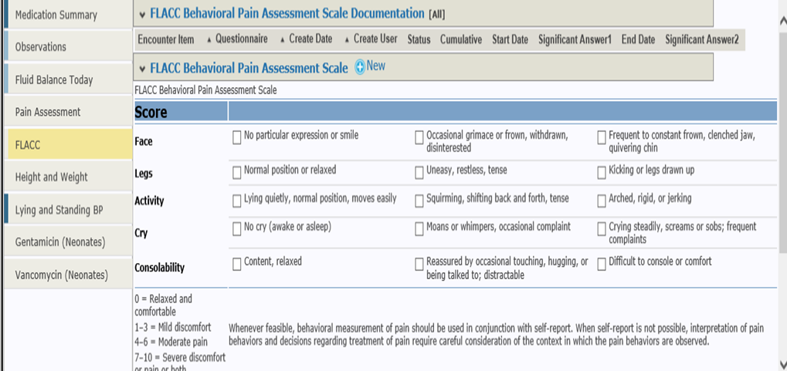

Slide 34
How we measured our change
Development and implementation of a staff knowledge survey with 5 staff per ward randomly chosen per week.
Survey included various topics relevant to people living with dementia, but specifically which pain scales are available and if staff knew where to find them on our system. Demonstrating to all staff surveyed where they can find the tools.
All disciplines represented if possible.
Notes:
What measures did we collect?
focussed on a vital few (about 3 measures)?
Could it be integrated into our routine?
Were there any unintended consequences we had to worry about (ie. Aim to reduce length of stay but what if readmission rate increased)?
Could we measure the outcome directly or did we use proxy measurements?
Who was affected directly by the changes you made?
How did we measure
Continuous measurements
Count of classification of observations
What people thought/felt
Ratings
Rankings

Slide 35
Quality Assurance data

Slide 36
Results
Results of staff knowledge survey will identify areas where further knowledge/training is required.
(Early indications show that staff are still utilising the Abbey pain scale on paper, and the question only on intentional rounding's, as they are not aware of the availability of the FLACC/were not familiar with FLACC)
Feedback given to ward matron where available immediately on completion of staff survey, and full results will be presented at Vulnerability Committee which includes service leads and board members.
It will also identify which staff speciality may need extra support in relation to pain tools.
Staff feedback has been positive so far when they have been made aware of the tools
Notes:
What did we measure and what were the results – continuous measurements, count of classification of observations, what people thought/felt, ratings, rankings

Slide 37
Where are we now and what are our future plans?
Ongoing quality assurance survey to identify staff knowledge, this will indicate areas to target
Pain tools available on Trakcare
Pain team also promoting the FLACC and the FACE tools. Pain Team also looking to have a pain score as a mandatory field on Trakcare. On completion of QI survey meet with the pain team again on completion of the quality assurance results
Attend ward training days to discuss pain assessment tools and the benefits on patient care
Attend induction/overseas training to promote the tools
Attend Doctors training sessions
Planned Comms promotion
Share survey outcome with matrons, medics, senior clinical matrons, service leads, board and care group leads at Vulnerability Committee for action planning
Round 6 of the NAD is likely to show similar results to round 5 due to time between audits being limited. Also Trakcare did not have the FLACC available at commencement of round 6. If Pain is an included category in round 7, we would anticipate improvement
Notes:
Summary of the project at the moment and any future plans.
What worked – strengths of this approach
Limitations and learnings – what would you do differently

Slide 38
Group work
On your tables, share your local QI activities (15 minutes)
Agree which piece of work will provide the best learning for everyone in the room (10 minutes)
Work together to create a short presentation/interview/role play which covers the 6 heading points (20 minutes)
What was your problem?
What was your ‘Aim’?
Who was in your Team?
What change ideas did you test?
What results did you get?
What would you do differently if you did it again?
11.00

Slide 39
Break
10 minutes – please come back at 11.55
11.45

Slide 40
Group work: feedback
You have 5 minutes per table to present and 3 minutes to answer any questions
We don’t want to be late for lunch!
+
=
11.55

Slide 41
Lunchtime!
12.50-1.20: Lunch (Room 1.1)
1.20-1.50: sharing and helping each other (Room 1.7)
Please use the coloured stickers to show what you are most interested in discussing, or just congregate at a meeting point.
Remember to exchange contact details or note them on the form at registration table for us to share with everyone later.

Slide 42
Feedback from carers and patients about the quality of care
Recap of work and results to date
Sharing Practice: Rebecca Goadsby, Northampton General Hospital
Group work and discussion
1.50

Slide 43
Carer questionnaire
Developed independently for NAD by the Patient Experience Research Centre at Imperial College London
Used since Round 3 of the audit and validated in practice
Consists of 10 questions, results can be looked at separately
Also produces two scores or ratings: carer rating of overall care quality, carer rating of communication
Results fed back in local and national reporting

Slide 44
Method
200 coded questionnaires are distributed to each site, with prepaid envelopes
Also available to complete online and in other languages
Returns:
Round 3 – 4664 total, 1-104 per site, average 24
Round 4: 4736 total, 1-95 per site, average 26
Round 5: 2223 total, 1-75 per site, average 23
Round 6 (initial cleaned): 2403 total, 1-132 per site, average 16

Slide 45
Change over time
Carer rating of information and communication - quartile scores breakdown
Round 3 | 89.3 - 71.7 | 71.5 - 63.4 | 63.1 - 57.3 | 57.2 - 22.2
Round 4 | 86.8 - 72.5 | 72.4 - 65.4 | 65.3 - 59.4 | 59.3 - 35.9
Round 5 | 90 – 69.4 | 69.3 – 60.1 | 60.0 – 52.4 | 52.3 - 31.6
Average R5 60 (R4 66)

Slide 46
Carer overall rating of care – quartile scores breakdown
Round 3 | 93.3 - 77.9 | 77.8 - 72.4 | 72.3 - 66.1 | 64.7 - 21.7
Round 4 | 91.1 - 78.5 | 78.4 - 73.2 | 73.1 - 67.9 | 67.8 - 48.1
Round 5 | 94.3 – 73.1 | 73 – 65.6 | 65.5 - 57.9 | 57.9 – 39.6
Average R5 66 (R4 72)

Slide 47
Feedback from comments
Top themes: patient care, staff, communication, staffing levels, discharge, support for carers
“Care could have not been better in anyway. The staff in 2 wards have been brilliant.”
“ …left without fluids, oral or IV for 24 hours… unclear who was providing care - ward was chaotic. Staff do not have time to feed the patients.”
“ … dementia coordinator, excellent very happy to leave my [RELATIVE] in her care.”
“I have been very well supported by Carers Leads at the hospital and I have appreciated seeing their workers in the hospital setting. They have given me very good advice and support and were able to help me talk to staff so that they listened to me,.”
“ … surprised at the number of staff are not aware of what dementia entails. All bands - consultant asking loads of questions, giving instructions that my [RELATIVE] is not able to follow. “

Slide 48
Definitely not enough staff on ward. Discharged as they wanted her home, back in after 4 days on doctors’ advice
“Dementia care team were outstanding in their support and in keeping me very well informed at all stages.”
“Many times I would arrive on the ward to find her drinks and magazines out of reach. I wasn't kept fully informed … problems were not caused by a lack of care but by the fact that the staff were rushed off their feet. Every member of staff I met was absolutely lovely but they just had too much to do and not enough time to do it all. Credit to them for doing their very best in a bad situation.”
“Admiral nurse…offered support to me and always available when needed. Doctor not very approachable, one doctor asked me not to call again…Dementia team amazing, goodness knows what I would have done without them.”

Slide 49
Patient feedback survey
Previously requested from the project by hospital leads and specified for Round 5 of audit
In 2019 and over the pilot period, NAD conducted some surveys and interviews with hospitals with experience of collecting feedback directly from people living with dementia admitted to hospital
These were often time-limited projects and not across the hospital
Feedback had been used to measure and enhance quality improvement activities
2.00

Slide 50
Survey development
We asked people living with dementia about their priorities for good quality hospital care​
With patient and carer representatives on the NAD Steering Group we developed a short questionnaire ​
The questions cover ​
Staff understanding dementia​
Communication​
Being kept informed​
Getting help when you needed it​
Pain relief​
Being treated with dignity and respect​
Additional questions were added following consultation relating to food and seeing family/visitors​
Available in plain text and emoji versions, and in other languages​
Can be used as a questionnaire or a semi structured interview​
Hospitals were asked to try and collect 3-5 per month/ at least 30 per year – this tool is designed to be ongoing, and available for use independently of audit periods

Slide 51
Returns and Results
First 6 month period: September 2022- February 2023
1602 returns from 120 hospitals (1-57)
Second 6 month period: March-October 2023
1138 returns from 100 hospitals (1-78)
In total to date, over 3000 responses (majority feedback from a person with dementia, not a family member)
We are aiming to commission evaluation of the psychometric properties of the questionnaire and to publish national results

Slide 52
Overview – compiled from first 2 periods of data collection

Slide 56
Example Comments:
“You can sense the system is breaking like the media says but on the whole staff are trying.”
“They would sit with me when I got upset when my wife was not there.”
“I felt safe and cared for even when I first arrived on the different wards. It was much better than my last stay.”
“Very good but staff are so busy that you have to wait for care when you need it and sometimes they might not get to you in time.”
“Was kept waiting for toilet. Haven't had a shower for 2 weeks.”
“Staff have been so kind.”

Slide 57
National Audit of Dementia: Patient and carer questionnaire
January 2024
Rebecca Goadsby, Dementia Liaison Nurse

Slide 58
Who was in our team
Deputy Chief Nurse, Rowena Harvey
Associate Director of safeguarding, Julie Hall
Dementia Liaison Nurse (lead), Rebecca Goadsby
The Volunteer service (allocated volunteer to collect patient questionnaires), Aleena Sunny
Patient and Carer Experience and Engagement Team
Chris Johnson, Sara Francis, Jason Geary
Northamptonshire Carer, Hospital Manager, Lynette Emary
Consultant Head of Dementia, Dr Kannagara
Notes:
The Dementia nurse led on the work
Head of patient experience, hospital managers carer service championed the work
Carers voices and patient involvement
Who lead the work on a day to day basis?
Who supported your improvement work and acted as the champion with your SMT?
Who understood the various parts of the system you tried to improve? What expertise/experience did they bring?
Did you need to recruit service users/carers?
Who will be affected directly by the changes you made?

Slide 59
Collecting feedback
Allocated volunteer (3 hours a week)
Screensavers
Delivering leaflets and targeting ward sisters
Notes:
The initial report showed

Slide 60
Understanding the problems
Analysing the patient feedback report and the carer feedback report
Themes from complaints
3x Listening events held across 2023
Advertised via social media, posters put up around hospital site and posters sent to all local GP surgeries in the local area.
Two via Microsoft teams and one in person.
Risk assessment of the environment
Bookings were managed by patient experience team.
Notes:
We wanted to get a better idea of why our quality of care was not meeting national standard.

Slide 61
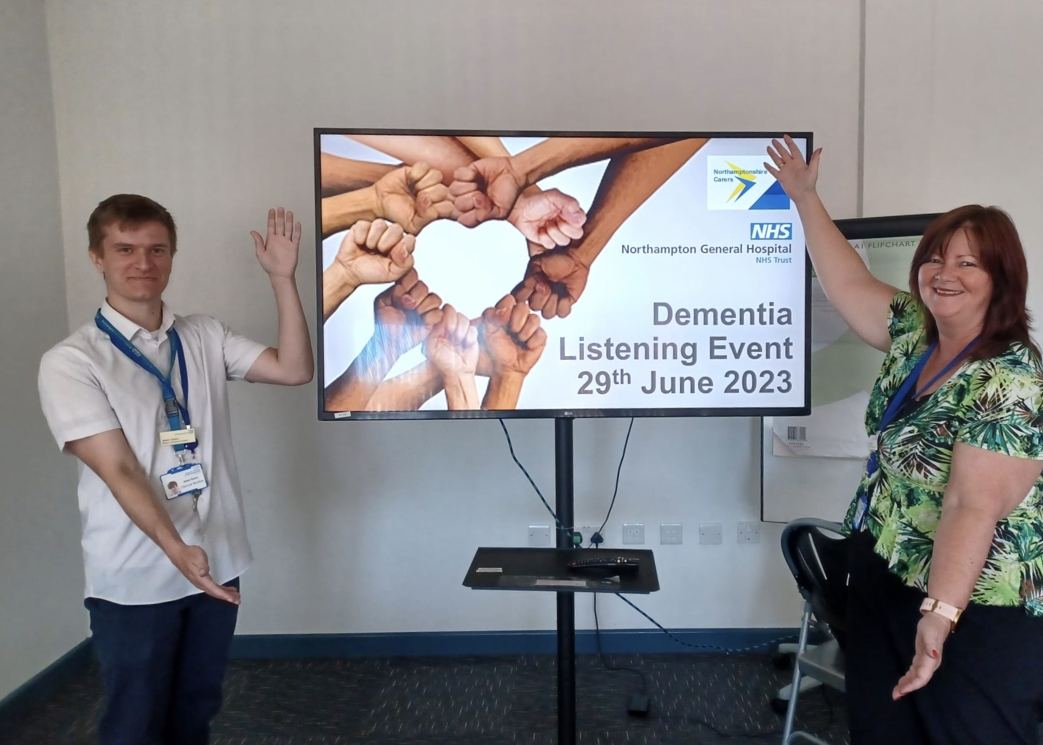
Implementing Change
Across the 3 listening events we heard from 1 person who had lived experience of dementia and 9 carers and/or relatives of people living with dementia.
The event was funded by the ‘do it for dementia’ charity fund from Northamptonshire Health Care Charity.
This provided us with insight into the lived experience.
This provided the details of the problems
An initial action log was created
Such as:
John’s Campaign is fully supported

Slide 62
We’ve Heard report
Communication
We heard - That patient and carers don’t always feel listened to by staff. We heard - Requests for information not always being correct, timely and actioned. We heard - That carers and patients are not always updated and kept involved and included in decision making. We heard - That it is hard to find the right staff member to talk too. We heard - Staff don’t read the notes and not always aware of the dementia diagnosis. We heard - Communication is not always compassionate, adapted, and suitable for the carer and patient. We heard - That patients aren’t being kept informed about their care and treatment.
Patient Care
We heard - That staff can make assumptions about patients’ abilities and needs. We heard - That we don’t always care for the person as an individual and understand their needs. We heard - That staff don’t respond to people when they call for help. We heard - That assistance at meals times isn’t always present. We heard - There is a power dynamic between staff, patient and carers. We heard - Staff don’t always give patients enough time during care. We heard - That pain relief isn’t always given. We heard - Carers are do not always feel supported.
Processes
We heard - That visiting isn’t always allowed for carers. We heard - Patients living with Dementia are moved wards too frequently. We heard - That patient’s property can get lost. We heard - We don’t feedback when lessons are learnt.
Notes:
We sent this out to the public domain, we wanting to really understand what the problem was before we went into making changes and ensure that we were including people with lived experience into the action plans and change.
This led to this report where we asked back to all the participants and including all the feedback we received in the NAD patient and carer feedback report.
We simply asked, have we hear you correctly?
If so, would you like to work with us to make changes?

Slide 63
Dementia Focus Group
This group is for the membership of experts by experience only and facilitators.
First meeting was held on 18th January 2024
To implement an action plan from the we’ve heard report, which is co-produced and transparent.
Prioritise 3 main actions and review 3 monthly
To monitor this action plan and feedback to senior leaders and the dementia steering group
Initial meeting created the Terms of Reference and next steps
Opportunity for further involvements offered
Ongoing monitoring of the carer and patient feedback reports (21 feedback since September 2023)

Slide 64
Level of co-production | Brief overview of role and responsibility | Level of commitment
Tier 1 | One off involvement (relaying their story) | No formal commitment
Tier 2 | Regular commitment online via Microsoft meetings and emails. Providing feedback on reports, minutes, and other key documents. To be involved remotely in service design, development, and evaluation of dementia care. | To read relevant policies and sign an information governance agreement and consent form.
Tier 3 | Regular commitment online via Microsoft meeting, emails and in person. Opportunity to help deliver training, attending events on site, involved in environment assessments, supporting listening events, assisting with surveys and actively involved in service design, development, and evaluation of dementia care. | To register as a volunteer at Northampton General Hospital
Tier 4 (Not currently in place, our aim for the future) | To be an employed member of staff who provides a contractual duty to support in the service design, development and evaluation of dementia care at Northampton General hospital. | A paid employee
Notes:
Tier 4 not implemented yet but this is our aim

Slide 65
Thank you for listening, any questions? Rebecca Goadsby, Dementia Liaison Nurse, rebecca.goadsby@nhs.net

Slide 66
Group work: carer and patient data
How are you using this data?
e.g. feedback to the Board, or Dementia Strategy Group, or groups of patients and carers or staff?
What is its impact?
E.g. Have the results fed into or triggered any other piece of work related to improving aspects of care?
What challenges were you presented with in collecting the data and how were they overcome?
2.20

Slide 67
Top tips from you…
On your tables, agree up to 3 ‘Dos’ in relation to collecting or using the data
Write your 3 Dos on a Flip chart
You have 10 minutes
2.40

Slide 68
Break
10 minutes – please come back at 3.00
2.50

Slide 69
Feedback and top tips review
3.00

Slide 70
Plenary discussion: priorities for future audit
This year the audit goes out to open tender
Specification development: feedback has been collected from the project, including results to date, and learning from the past period
We’d like to take this opportunity to discuss with you the current dataset and what you see as priority topics for auditing the quality of care
There are, however, some things we need to bear in mind …
3.30

Slide 71
Priorities for future audit: some factors to consider
In Round 5 and 6 the dataset was curtailed from the longer list of items previously audited
Consultation took place at the end of 2019, and from this key metrics in the casenote audit and items in the Annual Dementia Statement were chosen and refined by the Steering Group
Data items are aligned to identified priorities and national guidance and standards (NICE and Royal College guidelines; Dementia Friendly Hospital Charter)
Data items should be:
Relevant: measuring the above, and having an impact on care quality
Available to collect
Applicable to all patients, (in order to be able to make comparisons)
3.30
Notes:
I put these onto one slide so they can reflect on them. I suggest we give them a couple of minutes to chat before we open up the discussion.

Slide 72
Mentimeter
Capture your feedback on Mentimeter – or use flip chart
www.menti.com
Code: 23636974
Enter your top priorities – up to 5
3.45

Slide 73
Mentimeter
Review and vote!
3.50

Slide 74
Thank you!
Please complete a feedback form and collect your certificate!
4.00

