Slide 1

Welcome to the NCAP Quality Improvement- Improving Data Quality Introductory Session
Thursday 4th June, 3-4pm.

Slide 2
NCAP Quality Improvement Programme 2026: Driving Better Data Quality
This year's programme will focus on improving data quality to ensure services have accurate and complete information to deliver better care and treatment for people with psychosis. This emphasis supports NCAP’s transition from bespoke data collection to the use of national routine datasets, reducing burden on services and enabling more frequent reporting.
By prioritising data quality, we aim to:
  Enable teams to act on data and deliver targeted interventions where they will have the greatest impact
  Reduce clinical risk and optimise resource allocation through better visibility of performance and needs
  Improve care and treatment for people with psychosis by embedding evidence-based decision-making into practice.

Slide 3
This years Core QI programme offer
Open to all EIP and CYP teams
Resources include; Bite-sized training videos which outline essential QI principles and practical tools—such as tracking progress and using data to drive lasting change.
Monthly drop-in coaching calls for tailored support and idea sharing.
Online shared learning workshops where Enhanced teams showcase their projects and success stories.

Slide 4
Drop-in calls
Please find below a list of available drop-in call slots for June and July 2026.
These sessions are for any NCAP team that is interested in starting a QI project, are currently running one, or would like to restart a previous project. Slots are allocated on a first-come, first-served basis. Project topics can align with any NCAP key standard.
**June drop-in Call Slots (45 mins):**
Tuesday 16 June: 1:30pm
Thursday 25 June: 10:00am | 11:15am | 12:15pm
**July drop-in Call Slots (45 mins):**
Thursday 16 July : 1:30pm | 2:45pm
Tuesday 21 July: 2:00pm
Friday 24 July : 11:30am | 2:00pm
To book in your call please email NCAPQI@rcpsych.ac.uk with your preferred time slot.
Please complete and return the pre-call proforma at least one week before your call.

Slide 5
Core programme online resources:
QI collaborative Workbook:
The QI workbook helps you track each stage of your project while providing useful tips and practical examples to guide you along the way.
NCAP QI team workbook 2026 (DOC)
QI training videos:
Quality Improvement Training Video 1 - What are you trying to accomplish?
Quality Improvement Training Video 2 - Work out what's causing your problem
Quality Improvement Training Video 3 - Agree how much improvement you want and the types of change ideas you want to test
Quality Improvement Training Video 4 - Work out how you'll measure progress

Slide 6
Shared learning sessions for 2026 and 2027
Five teams have been selected for this year’s Enhanced QI Programme and completed their in‑person training in April. They are now developing their projects and carrying out diagnostic work to better understand their data quality issues.
The shared learning events in October and January (dates below) will offer a valuable opportunity for all NCAP teams to hear about their progress—highlighting successes, challenges, and how meaningful cultural shifts can emerge through QI work.
Many projects involve extensive multidisciplinary collaboration, including data collection team members marking a significant change for services that have not previously collaborated on a project at this scale.
Key dates:
  Wednesday 7th October (time TBC) -First shared learning session.
  Thursday 28th January 2027 (time TBC)- Final shared learning session.

Slide 7

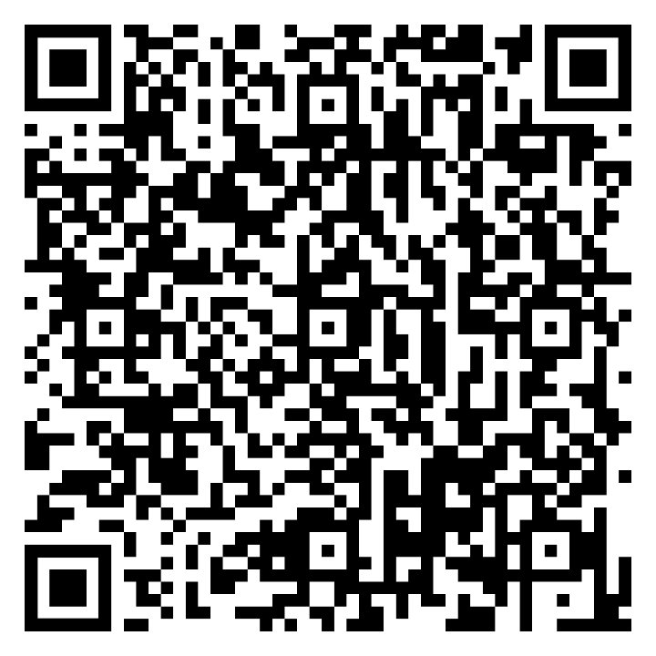
For webinar recordings, online resources and more about this year's programme please scan the QR code which will bring you to the NCAP QI webpage.

