Slide 1
Wave 1 Evaluation ‘Snapshot’
This snapshot presents a picture of the progress that the 15 teams involved in wave 1 of the Advancing Mental Health Equality (AMHE) quality improvement (QI) collaborative have made by October/November 2022, 15-16 months after the collaborative was launched in July 2021.

Slide 2
Objectives of the evaluation
To describe the organisations involved in the AMHE QI collaborative, including overarching project teams and sub-teams
2. To describe the aims developed and change ideas tested across the collaborative
3. To evaluate the implementation, impact and success of the AMHE QI collaborative model

Slide 3
Organisations in the collaborative
15 organisations were involved in wave 1 of the AMHE QI collaborative
NHS Trusts
Avon and Wiltshire Partnership NHS Trust
Barnet, Enfield and Haringey Mental Health NHS Trust
Devon Partnership NHS Trust
Herefordshire and Worcestershire Health and Care NHS Trust
Leicestershire Partnership NHS Trust
Norfolk and Suffolk NHS FT
Pennine Care NHS FT
Somerset NHS FT
Southern Trust Health and Social Care Trust (Northern Ireland)
Voluntary, community and social enterprises (VCSEs)
Livewell Southwest
Mind in Croydon in partnership with Mind in Kingston
Mind in Hampshire (3 local Minds: Andover, Havant & East Hampshire, Solent)
Mind in Tower Hamlets and Newham in partnership with Mind in Haringey
Neath Port Talbot Mind
Mind in Lincolnshire in partnership with Mind in North Staffordshire

Slide 4
Overarching teams’ characteristics
The total number of members in each of the overarching project teams ranged from 4 to 17 members
4 teams (27%) had roles that were unknown by the coach at the time of the snapshot
10 was the average number of team members across teams
1 team had only identified the lead
1 team (7%) had lived experience advisers
The structure and the different roles/professions varied across teams. For example:
Directors/Chief Executives
Lived experience advisers
Equality and diversity workers
Managers

Slide 5
Sub-teams characteristics
Number of team members with a clinical role ranged from 1 – 21 Average: 4
14 of the 15 teams (93%) had identified at least one of the three population sub-groups
The total number of sub-group members (per population identified) ranged from one to 28.
Average: 9 members
Number of team members with a managerial role ranged from 1 – 11 Average: 4
Number of team members with a lived experience adviser role ranged from 1-2
4 teams (27%) had included a lived experience adviser in at least one of the population sub-groups
1 team (6.5%) had established 0 population sub-groups
1 team (6.5%) had established 1 population sub-group
6 teams (40%) had established 2 population sub-groups
7 teams (47%) had established 3 population sub-groups

Slide 6
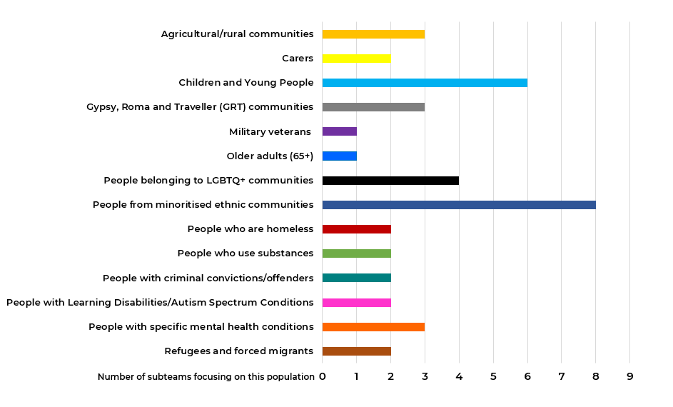
Populations identified per sub-groups
The graph illustrates 14 main population categories .
Some sub-teams cover multiple categories per population.
The 3 categories in which most of the populations were identified were:
Children and young people
People belonging to LGBTQ+ communities
People from minoritised ethnic communities

Slide 7
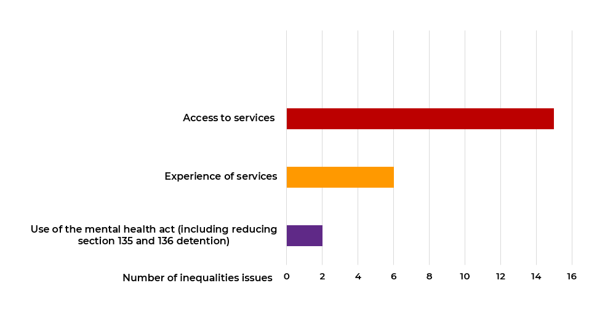
Inequalities issues identified
The graph illustrates the 3 main categories in which the inequalities issues were grouped and the number of inequalities per category
The most common inequalities issues identified were access and experience of services

Slide 8
Inequalities issues identified – Where teams are at
9 of the 15 teams (60%) had specified at least one of the inequalities issues for the populations identified
6 of the 15 teams (40%) had not specified any of the inequalities issues for the populations identified
2 of the 15 teams (13%) had specified the inequalities issues for all the 3 populations identified

Slide 9
Three-part data review description
Engaging with care teams/ supporting services to understand their perspective on the chosen population’s greatest
needs and assets
Reviewing available data to identify overall patterns that impact the chosen population
Engaging with service users/carers to understand their experience and perspective
1. Data review
2. Staff engagement
3. Community engagement

Slide 10
Three-part data review – Where teams are at
1. Data review
2. Staff engagement
3. Community engagement
11 of the 15 teams (73%) had started the data review for at least one of the 3 populations identified
3 of the 15 teams (20%) had started the data review for the 3 populations identified
4 of the 15 teams (27%) had not started the data review for any of the populations identified
5 of the 15 teams (33%) had started staff engagement for at least one of the three populations identified
1 of the 15 teams (7%) had started staff engagement for the 3 populations identified
10 of the 15 teams (67%) had not started staff engagement for any of the populations identified
8 teams (53%) had started community engagement for at least one of the 3 populations identified
1 of the 15 teams (7%) had started community engagement for the 3 populations identified
7 of the 15 teams (47%) had not started community engagement for any of the populations identified

Slide 11
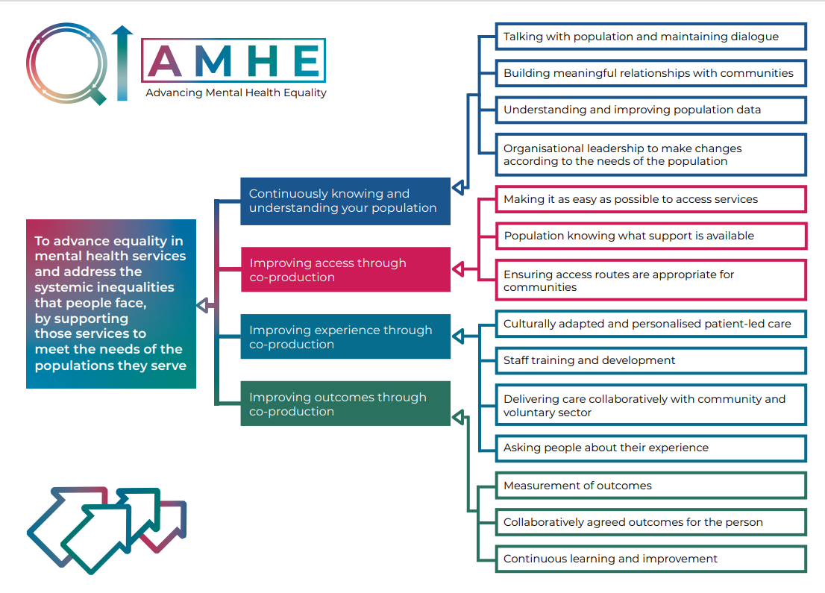
Content analysis of driver diagrams
The aims, primary drivers and change ideas of these driver diagrams will be ‘coded’ using a deductive approach.
The code types correspond to the co-developed Driver Diagram for the AMHE collaborative
None of the sub-teams had developed their driver diagrams yet

Slide 12
NoMAD Questionnaire
The Normalisation Measure Development Questionnaire (NoMAD) is a validated research measure based on the Normalisation Process Theory (NPT).
The questionnaire has been adapted for the AMHE QI Collaborative and aims to assess how people implement AMHE into their everyday work and how they are supported to implement it.
NoMAD
1. Coherence
2. Cognitive Participation
3. Collective Action
4.Reflexing Monitoring
20 questions are grouped by 4 Normalisation Process Theory (NPT) constructs
The NoMAD questionnaire was sent to all overarching and sub-team members
14 responses were received

Slide 13
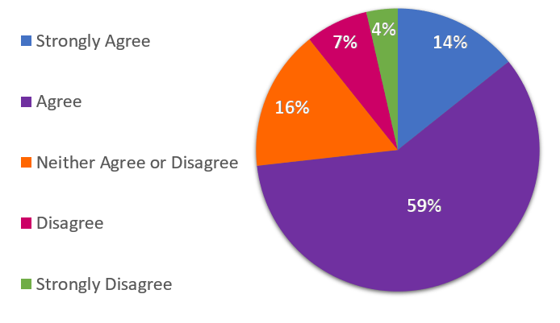
Results from the NoMAD Questionnaire
Refers to having a shared understanding of the purpose of the AMHE QI Collaborative, how it differs from the usual ways of working and its potential value for people’s roles and everyday work
1. Coherence
73% of the respondents either agree or strongly agree with the elements included in Coherence

Slide 14
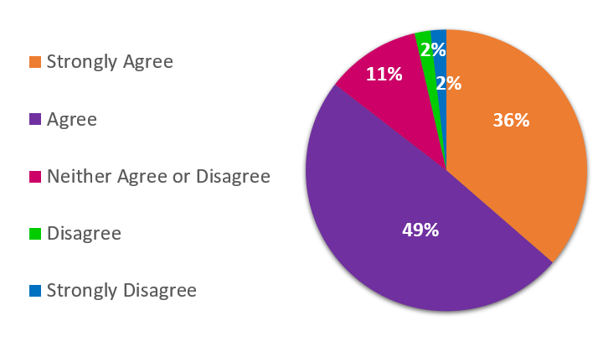
Results from the NoMAD Questionnaire
Refers to being open to work with colleagues in new ways to implement and support the AMHE QI Collaborative Model and having people within the teams who drive the collaborative forward and promote team work
2. Cognitive Participation
85% of the respondents either agree or strongly agree with the elements included in Cognitive Participation

Slide 15
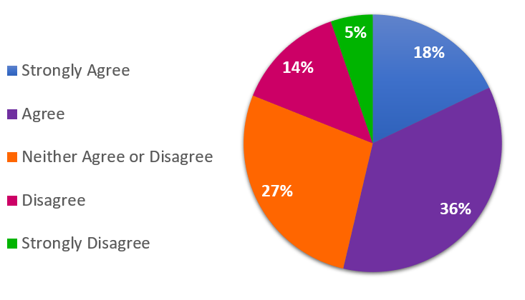
Results from the NoMAD Questionnaire
Refers to: (1) having the confidence in the team’s ability to implement the AMHE QI Collaborative (2) integrating relevant elements of the AMHE QI Collaborative model into existing work (3) having sufficient resources and training available to support the AMHE QI Collaborative (4) having support from managers to take part in the AMHE QI Collaborative
3. Collective Action
54% of the respondents either agree or strongly agree with the elements included in Collective Action

Slide 16
Results from the NoMAD Questionnaire
4. Reflexing Monitoring
Refers to the process of appraising: (1) people’s views on the value that the AMHE QI Collaborative has had so far and (2) the potential of using feedback to modify and improve their work and the delivery of care
82% of the respondents either agree or strongly agree with the elements included in reflexing monitoring

Slide 17
Evaluation Survey
A 16-question survey was created to collect information about what has gone well and about challenges or difficulties experienced by the teams regarding 4 main areas:
Survey
1. AMHE QI Collaborative Model
2. Working as part of the wider AMHE team
3. Establishing the QI Approach
4.Co-production
The survey was sent to all overarching and sub-team members
16 responses were received

Slide 18
Results from the evaluation survey
1. AMHE QI Collaborative Model
The ‘model’ refers to the method used in the collaborative. It includes the structure of the QI programme, the way QI coaches work with teams, and how the programme helps the service to improve
Benefits reported in relation to:
1.1. Benefits of the model
Recognising equality as a central driver for service setup and delivery
Identifying communities that need prioritisation
Providing a structured approach and useful evidence collation guidance
Focusing on making incremental and achievable changes
Bringing together colleagues from across health care and facilitating joint working and co-operation
Thinking about how to engage populations
94% of respondents reported benefits

Slide 19
Results from the evaluation survey
Continued from previous slide
1. AMHE QI Collaborative Model
1.1. Benefits of the model
It has focused managers, nurses and doctors to consider how equality needs to be a central driver for how we set up our service and has highlighted blind spots in how we deliver our service
Project Team Member

Slide 20
Results from the evaluation survey
1. AMHE QI Collaborative Model
The ‘model’ refers to the method used in the collaborative. It includes the structure of the QI programme, the way QI coaches work with teams, and how the programme helps the service to improve
Challenges reported in relation to:
1.2. Challenges of using the model
Getting momentum and the right people in the team
Pressures on staff and managers
Lack of funding, resources, capacity, time and leadership support
Lack of clarity on timelines, barriers, expectations and processes
The amount of time it requires to move through the programme
Examples of projects that are too far from where teams are at
Keeping the vision tangible, contained and achievable
Working across multiple agencies/stakeholders
Taking a values-based approach from start to finish
Engaging service users
Focusing team members’ mindsets to work in a QI way
Getting the right and enough data for the 3-part data review
81% reported that the team has discussed how to overcome these challenges

Slide 21
Results from the evaluation survey
Continued from previous slide
1. AMHE QI Collaborative Model
1.2. Challenges of using the model
Lack of resourcing within the organisation. Needing to do on top of an already challenging role. Lack of priority given by the organisation
Project Team Member

Slide 22
Results from the evaluation survey
1. AMHE QI Collaborative Model
Benefits reported of working with the QI coaches:
Providing support and positive encouragement to overcome barriers
Asking challenging questions and helping steer the project
Connecting with the broader AMHE collaborative
Providing support and guidance
Helping maintaining momentum
Facilitating discussions and generating ideas
Providing expertise
Clarifying the requirements
Helping stay motivated and focused
Helping to start the conversation
Facilitating reflective practice
Managing expectations
1.3. Benefits of working with the QI coaches
81% of respondents reported benefits

Slide 23
Results from the evaluation survey
Continued from previous slide
1. AMHE QI Collaborative Model
1.3. Benefits of working with the QI coaches
Having someone who is based at the Royal College of Psychiatrists is really beneficial, it connects you more to what is happening across AMHE/the country, opens the project up a bit more
Project Team Member

Slide 24
Results from the evaluation survey
1. AMHE QI Collaborative Model
Challenges reported of working with the QI coaches
Changes in the QI coaches
Lack of clarity about the role of the QI coach and information about the College’s role in this work
Lack of clarity about where the team is within the timeline
Lack of funding, time, capacity and resources
Joining up AMHE QI coaches with in-house QI leads/approaches
Working alongside someone from outside the communities
1.4. Challenges of working with the QI coaches
54% reported that the team had discussed how to overcome these challenges
Mixed opinions about meetings held with the coaches:
Some preferred in-person meetings and others virtual
One person mentioned having too many meetings and another very few and a long gap in between if they were cancelled

Slide 25
Results from the evaluation survey
Continued from previous slide
1. AMHE QI Collaborative Model
1.4. Challenges of working with the QI coaches
Feeling as though we are letting them down when we have not been able to progress what we have wanted to do. Principally as short-term deadlines get in the way of longer-term
development work, unless we have a dedicated person responsible for doing the development work
Project Team Member

Slide 26
Results from the evaluation survey
2. Working as part of the wider AMHE team
This refers to working alongside and together with other services and organisations involved in the collaborative.
Benefits reported in relation to:
2.1. Benefits
Highlighting blind sports regarding equality
Sharing ideas, experiences and learning from other organisations including encountering and overcoming barriers
Feeling part of a bigger team
Developing links within the organisation and with external organisations
Starting the conversation
Space to think collectively and more broadly on subject
75% of respondents reported benefits
25% only just started or not involved yet

Slide 27
Results from the evaluation survey
Continued from previous slide
2. Working as part of the wider AMHE team
2.1. Benefits
Motivating to learn from colleagues in other organisations, also really inspirational
Project Team Member

Slide 28
Results from the evaluation survey
2. Working as part of the wider AMHE team
This refers to working alongside and together with other services and organisations involved in the collaborative.
2.2. Challenges
Challenges reported in relation to:
57% challenges had been discussed within the team
44% reported challenges
Limited time to fully take advantage of the opportunity to liaise with other services and organisations and pursue links with them in a meaningful way
Limited capacity and resources
Haven't had many people join the team yet
Having meetings cancelled
Lack of consistent attendance by group members
Slow progress in identifying and implementing actions
37% had not worked alongside other organisations
19% had not perceived any challenges

Slide 29
Results from the evaluation survey
Continued from previous slide
2. Working as part of the wider AMHE team
2.2. Challenges
Hard to make the time to fully appreciate/ understand each other's work, remit and role
Project Team Member

Slide 30
Results from the evaluation survey
3. Engagement with establishing the QI approach in your organisation/service
This refers to how the QI approach has been used in your organisation/service and how this has been received by the project team
The team started the driver diagram, theory of change and project roadmap
The team was encouraged, valued and supported by the organisation/trust
The team implemented follow up actions
The team was committed to progress with the project
Members of the team were encouraged to be more proactive
Positive response to project and aims was received within the service
56% reported that team has engaged with establishing the QI approach
44% mentioned challenges
Difficulties with arranging meetings
Lack of time and capacity

Slide 31
Results from the evaluation survey
Continued from previous slide
3. Engagement with establishing the QI approach in your organisation/service
This refers to how the QI approach has been used in your organisation/service and how this has been received by the project team
It was difficult trying to arrange an initial meeting with colleagues from around the organisation, but with guidance and seeing the benefits of this work, everyone who was interested came on board enthusiastically
Project Team Member

Slide 32
Results from the evaluation survey
Continued from previous slide
3. Engagement with establishing the QI approach in your organisation/service
Lack of capacity
Lack of clarity about how the QI approach should be engaged with, at a team level, due to barriers
31% reported that they had not achieved this stage yet
13% reported that team had not engaged with establishing the QI approach

Slide 33
Results from the evaluation survey
New Approaches teams have used so far
Engaging with communities, voluntary groups, schools and youth organisations
Hosting community information stands
Empowering communities
Engaging with stakeholders
Surveys for staff
Engaging staff to feedback service insights and service user feedback
Staff communications
1/2 day per week staff time to begin engagement work in the local community and asset mapping
Engaging Research & Development
Online peer to peer groups
Engaging with colleagues from other directorates and other trusts
Working alongside lived experience colleagues
Using interpreters when working with non-English speaking populations
Conducting the British Association for Behavioural and Cognitive Psychotherapies (BABCP) Improving Access to Psychological Therapies (IAPT) audit
Looking at increasing accessibility and/or anti-oppressive practice
3. Engagement with establishing the QI approach
63% reported the use of new approaches

Slide 34
Results from the evaluation survey
3. Engagement with establishing the QI approach in your organisation/service
New approaches teams have used so far
Been good engagement with all stakeholders, staff communications and attending community events with lived experience in the project group
Project Team Member

Slide 35
Results from the evaluation survey
4. Co-production
This refers to an ongoing partnership between people who design, deliver and commission services, people who use the services and people who need them
50% had taken steps towards co-production
Having a service user consultant as a sub team lead
Having people with lived experience in the team
Scoping how to connect with people with lived experience
Encouraging people with lived experience to share their stories
Carrying out initial interviews with people from the community
Engaging with the local groups and organisations who work within target communities
Receiving service users’ feedback
Engaging with local participation groups to ask about how to improve engagement with families from all races/ethnicities.
25% had not reached this stage
12.5% already embedded in organisation
12.5% were planning co-production
Co-production workshop
Engaging with the Community Mental Health Framework

Slide 36
Results from the evaluation survey
This refers to an ongoing partnership between people who design, deliver and commission services, people who use the services and people who need them
4. Co-production
Currently service users’ feedback through our Wellbeing Practitioners, non-service users will feedback through community groups and peer to peer with our Researcher
Project Team Member

Slide 37
MUSIQ tool
The Model for Understanding Success in Quality (MUSIQ) tool is a validated measure which explores how contextual factors influence the implementation of quality improvement, in this case the AMHE QI Collaborative
Adaptations to the original tool were made by the team to suit the purposes of the AMHE QI Collaborative
Project leads completed the tool with their QI coach
6 teams have completed the MUSIQ Tool so far

