Slide 1
Quality Improvement in Tobacco Treatment (QuITT) Collaborative
End of Programme Celebratory Event
21 January 2025, 10:00 – 15:00

Slide 2
Welcome and introductions
Tom Ayers
Director
National Collaborating Centre for Mental Health (NCCMH)

Slide 3
Time | Item | Speaker
09:30-10:00 | Registration
10:00-10:20 | Welcome and introductions | Tom Ayers, Director, National Collaborating Centre for Mental Health Dr Lade Smith CBE, President, Royal College of Psychiatrists (RCPsych)
10:20-10:45 | Celebrating your impact | Clementine Fitch-Bunce, Quality Improvement Coach, National Collaborating Centre for Mental Health Jaz Seehra, Quality Improvement Coach, National Collaborating Centre for Mental Health
10:45-11:05 | NHSE: The Next Steps in Tobacco Treatment | Professor Sanjay Agrawal, National Specialty Adviser for Tobacco Dependency, NHS England
11:05-11:15 | Break
11:15-11:25 | Early Implementer sites: evaluation report | Juliette Westbrook, Research Assistant, National Collaborating Centre for Mental Health
11:25-12:25 | Sharing your QuITT stories | Clementine Fitch-Bunce, Quality Improvement Coach, National Collaborating Centre for Mental Health
12:35-13:35 | Lunch and networking
Today’s event – morning

Slide 4
Today’s event – afternoon
13:25-13:35 | Post-lunch activity | Ros Warby, Senior Quality Improvement Advisor, National Collaborating Centre for Mental Health
13:35-13:45 | Action on Smoking and Health (ASH): legislation and beyond | Hazel Cheeseman, Chief Executive, Action on Smoking and Health (ASH)
13:45-13:55 | National Centre for Smoking Cessation and Training (NCSCT) | Mary Yates, Expert Mental Health Consultant (NCSCT)
13:55-14.15 | Q&A for ASH and NCSCT | Hazel Cheeseman, Chief Executive, ASH Mary Yates, Expert Mental Health Consultant, NCSCT
14:15-14:50 | Reflecting back and looking forward | Jaz Seehra, Quality Improvement Coach, National Collaborating Centre for Mental Health
14:50-15:00 | Close and next steps | Matthew Milarski, Head of Quality Improvement, National Collaborating Centre for Mental Health

Slide 5
Housekeeping
Toilets are located to the right of the lifts on level 1 (men’s and women’s toilets) and the ground floor (gender neutral toilets and disabled toilets).
Lunch will be from 12:35pm-1:35pm and will be served in room 1.6 (left side of the auditorium). Refreshments (tea/coffee/water) will also be available in room 1.6 throughout the event.
Room 1.1 (right side of the auditorium) is available if anyone who needs to take a break at any point or needs some quiet space. Please ask a member of the team or Reception desk if you would like to use the quiet space.
Please use the Mezzanine area (1st floor) if you need to step outside for anything else.

Slide 6
NCCMH shared principles
Listen with respect and openness
We seek to value learning from different people and stay open to new ways of doing things.
Confidentiality
People may share something they wish to be kept confidential. We require everyone’s agreement not to share anyone’s information without their permission.
Collaborate
We seek to make decisions by consensus. Everyone’s input is equally valued.

Slide 7
NCCMH shared principles
Contribute
We seek to share ideas, ask questions and contribute to discussions. We can also choose not participate at any stage.
Disagree with the point - not the person
We seek to resolve conflicts and tensions.
Use plain language
We seek first to understand, then to be understood. If possible, avoid using jargon and explain acronyms if they must be used.

Slide 8
Dr Lade Smith CBE
President
Royal College of Psychiatrists (RCPsych)

Slide 9
Celebrating your impact
Clementine Fitch-Bunce and Jaz Seehra
Quality Improvement Coaches
National Collaborating Centre for Mental Health (NCCMH)
Notes:
Clem

Slide 10
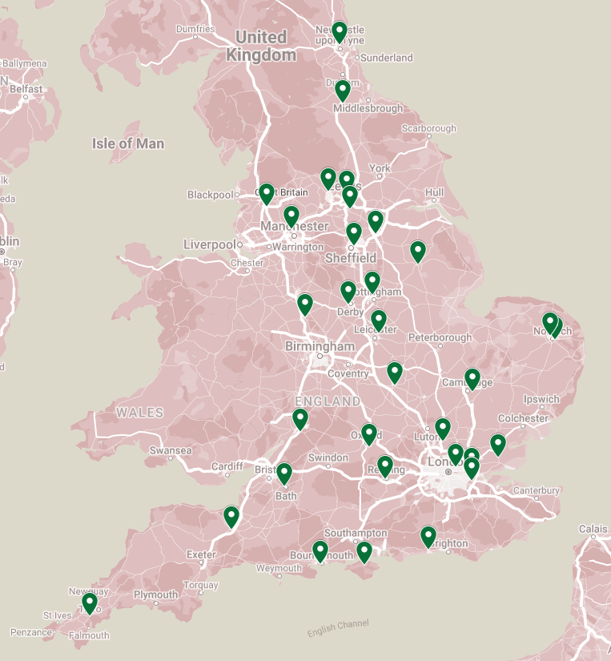
Participating organisations
Notes:
Clem
R1 ad 2 spread across the country
Briefly explain about the DN which was specifically developed for this collaborative (reason why developed – community, sharing for thosd with significant barriers to taking part in the full collaborative but still to learn from other services to support their establishment/future plans for development)

Slide 11
QuITT QI Programme and achievements
19
Events (in-person and virtual)
597
Patient surveys completed
30
Number of Tobacco Dependency Services involved
Notes:
Jaz
At the end of this collaborative, we can celebrate
19 Events – We have been hosting in-person events, online workshops and development network meetings. Almost something every month, so thanks for coming along to all those events!
A huge 597 patient surveys completed by round 1 and round 2 teams – this deserve a massive well done and congratulatiosn!
30 TDS across the country involved
Patient and staff – surveys 1 and 2

Slide 12
QuITT QI Programme and achievements
52
Number of Trusts involved
46
Number of wards involved
92
Change ideas generated and tested
Notes:
Jaz

Slide 13
Our Learning community
Notes:
Jaz

Slide 14
Notes:
Clem

Slide 15
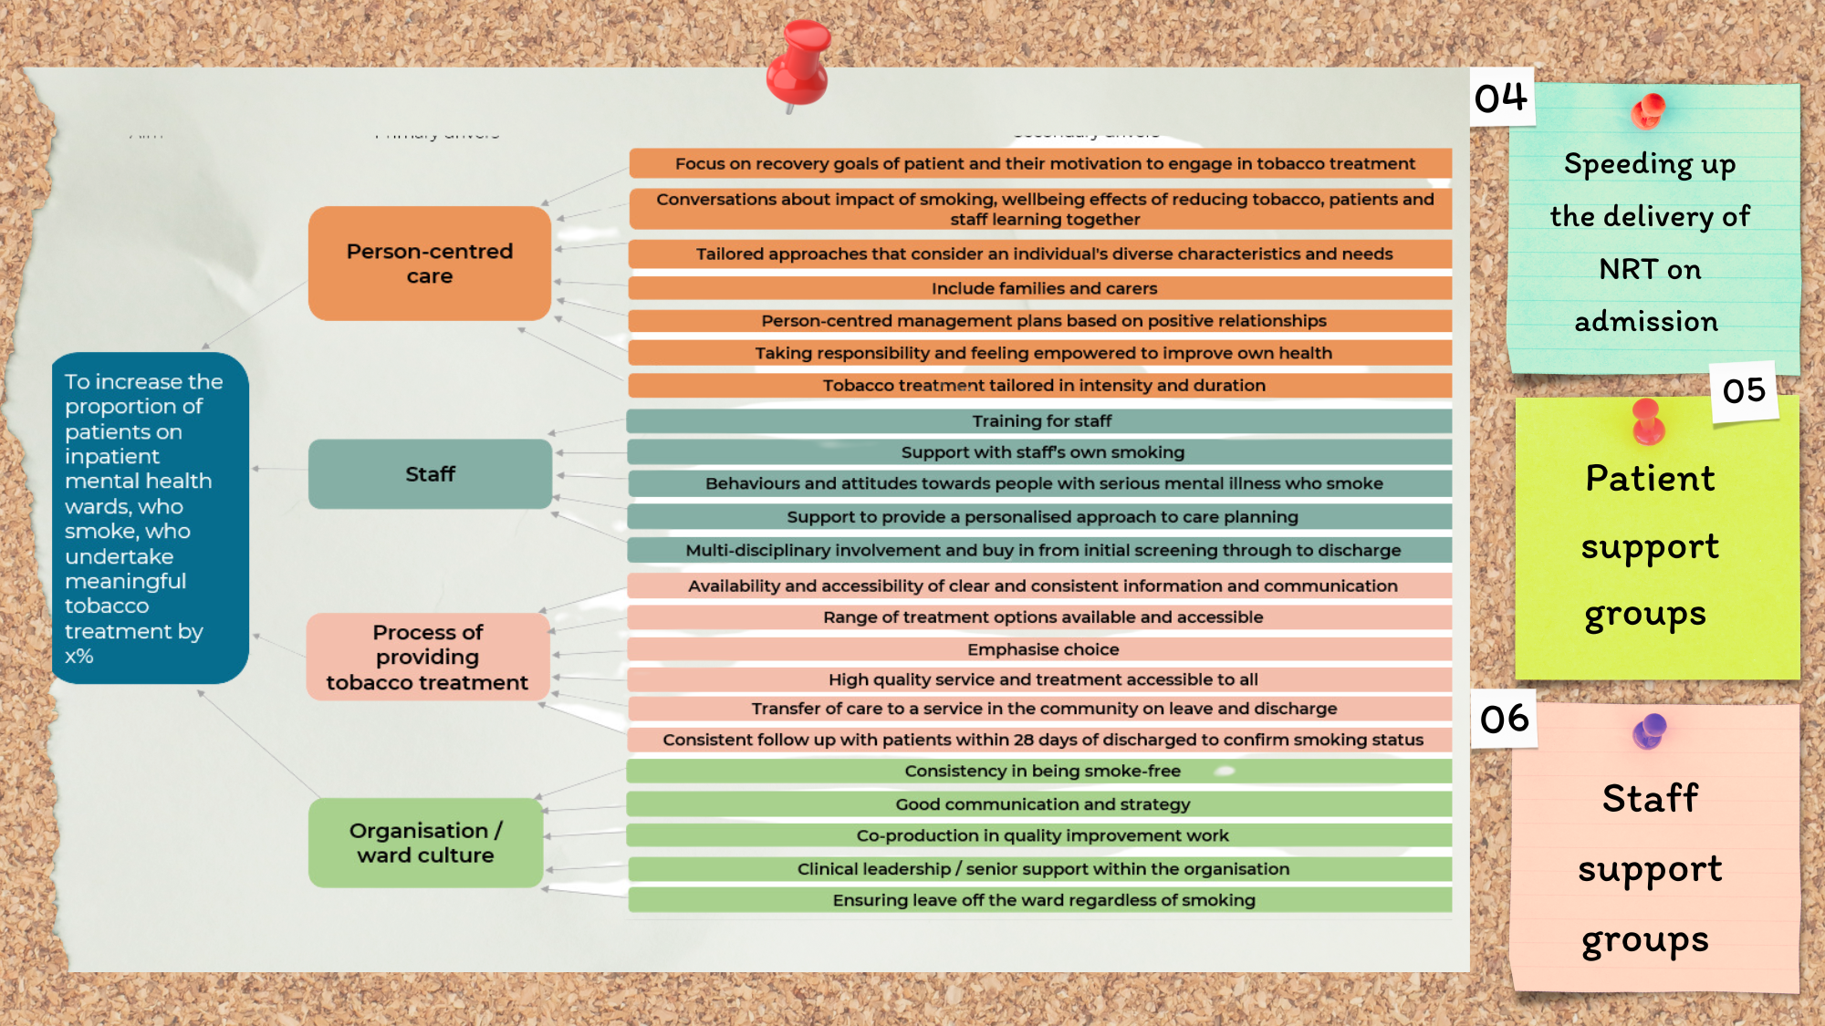
Notes:
Clem
Shared learning has spread
Networking/support

Slide 16
QuITT Project Data What impact have your changes had?
Notes:
Clem – to round 1

Slide 17
Round 1 teams
November 2022 – January 2025
Notes:
If possible, someone from Round 1 in every group

Slide 18
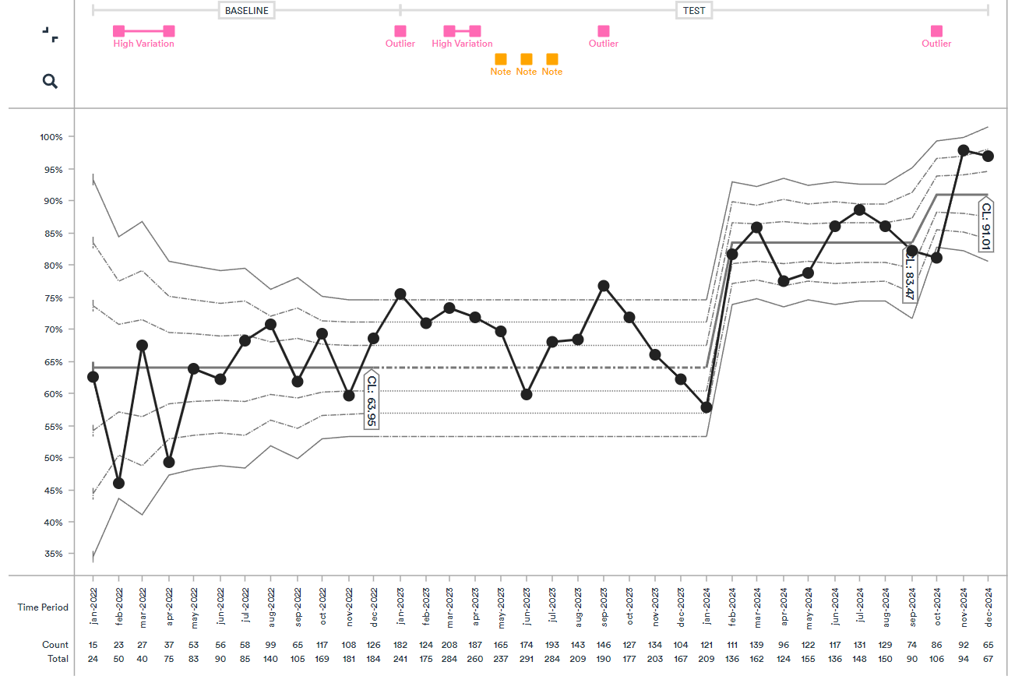
QuITT Aggregate data
Measure 1: Percentage of patients screened for smoking status on admission
Direction of improvement
December 2024, 91% of patients were screened on admission
In December 2022, 62% of patients were screened on admission
= 47% improvement
Notes:
Remove ranges and just use the month it changes

Slide 19
QuITT Aggregate data
Measure 2: Percentage of patients engaged with a tobacco dependency treatment service (TDTS)
Direction of improvement
January 2024, 43% of patients were engaged with a TDTS
December 2022, 21% of patients were engaged with a TDTS
= 106% improvement

Slide 20
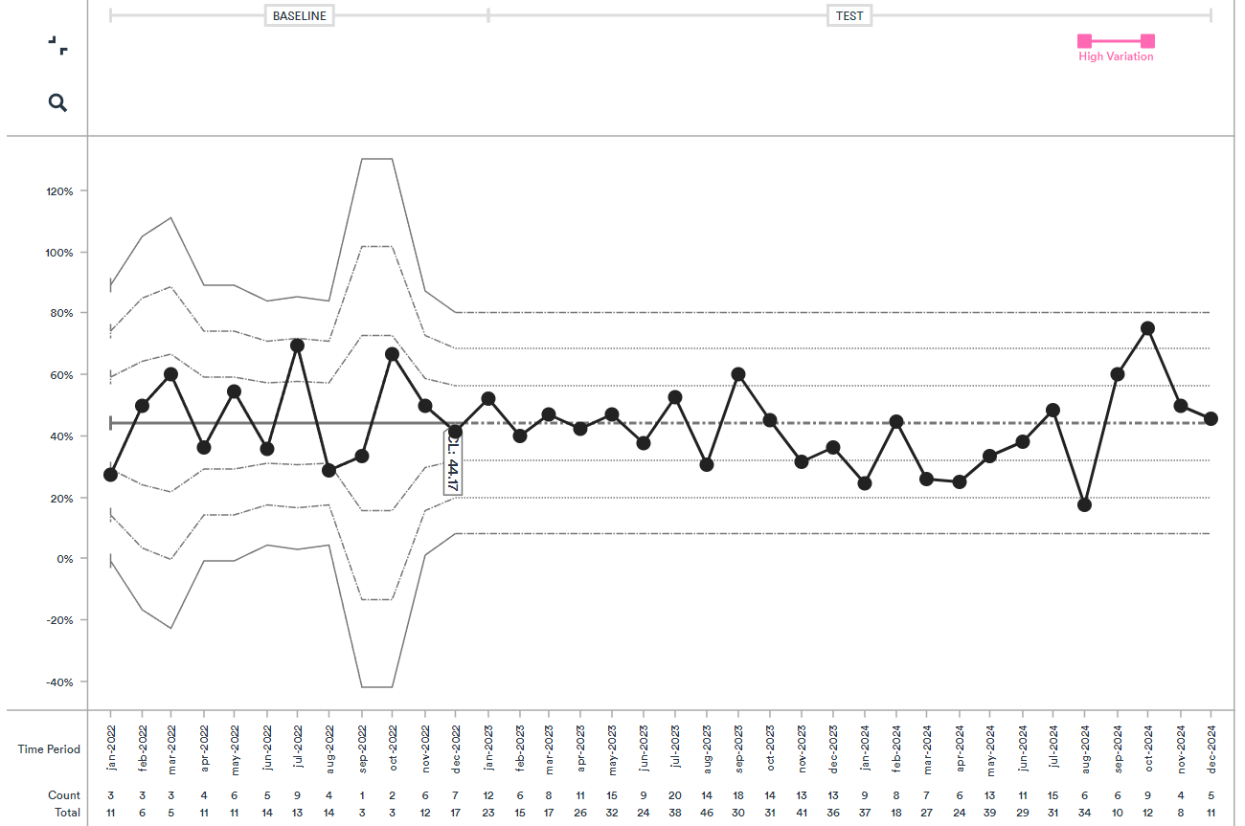
QuITT Aggregate data
Measure 3: Percentage of patients engaged with a TDTS who have quit tobacco use after 28 days
Direction of improvement
At baseline, 44% of patients followed up had quit tobacco use after 28 days
Data within normal variation – no change to date
Notes:
see round 3 data and the fact that denominators are higher later on so it is more people that have stayed consistency

Slide 21
Round 2 teams
January 2024 - January 2025
Notes:
Jaz do this bit

Slide 22
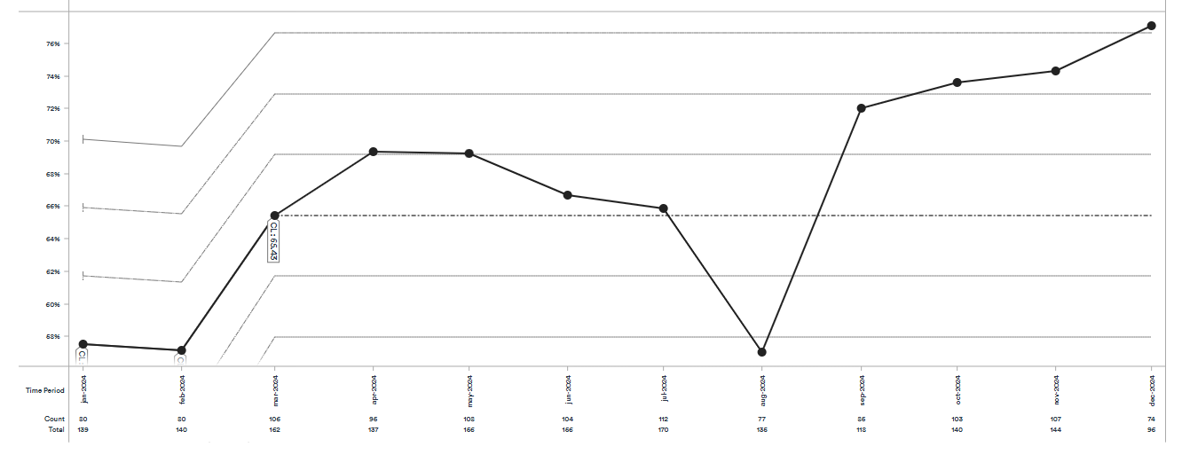
QuITT Aggregate data Round 2 Teams
Direction of Improvement
Measure 1: Percentage of patients screened for smoking status on admission
At the end of the collaborative the mean of patients screened on admission was 65%
Notes:
The mean number of patients engaging in tobacco dependence services went up from 61% around March 2024, to 69% in Dec 2024.
As we are still waiting for some data to come in, this figure may change, but as a rough estimate this is really lovely to see.

Slide 23
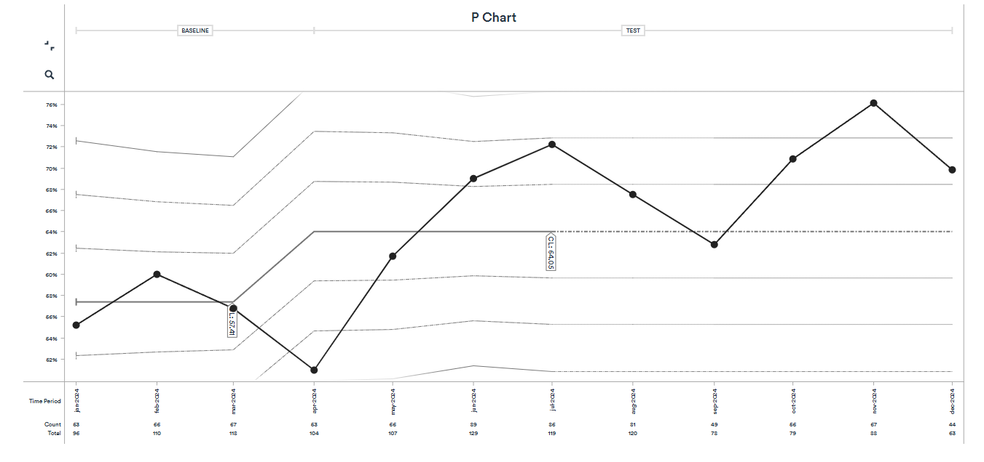
QuITT Aggregate data Round 2 Teams
Direction of Improvement
Measure 2: The percentage of patients engaged with a tobacco dependency treatment service
By Dec 2024 the mean of patients engaging with a TDTS was 64%
Notes:
The mean number of patients engaging in tobacco dependence services went up from 57% around March 2024, to 67% in Dec 2024.
As we are still waiting for some data to come in, this figure may change, but as a rough estimate this is really lovely to see.

Slide 24
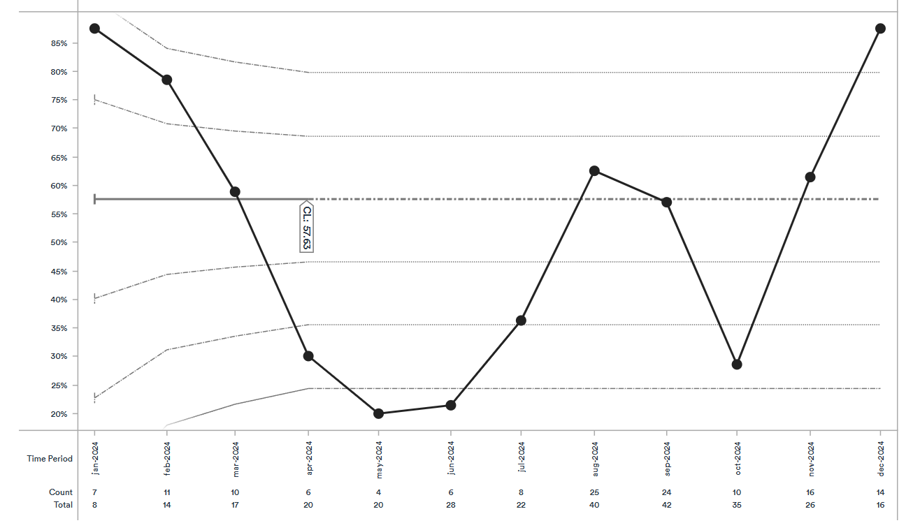
QuITT Aggregate data Round 2 Teams
Direction of Improvement
Measure 3: Percentage of patients engaged with a TDTS who have quit tobacco use after 28 days
By Dec 2024 the mean was 58%.
Notes:
This is how the Measure 3 aggregate graph is looking for measure 3.......to be honest there are just not enough data points for us to get much from this currently.

Slide 25
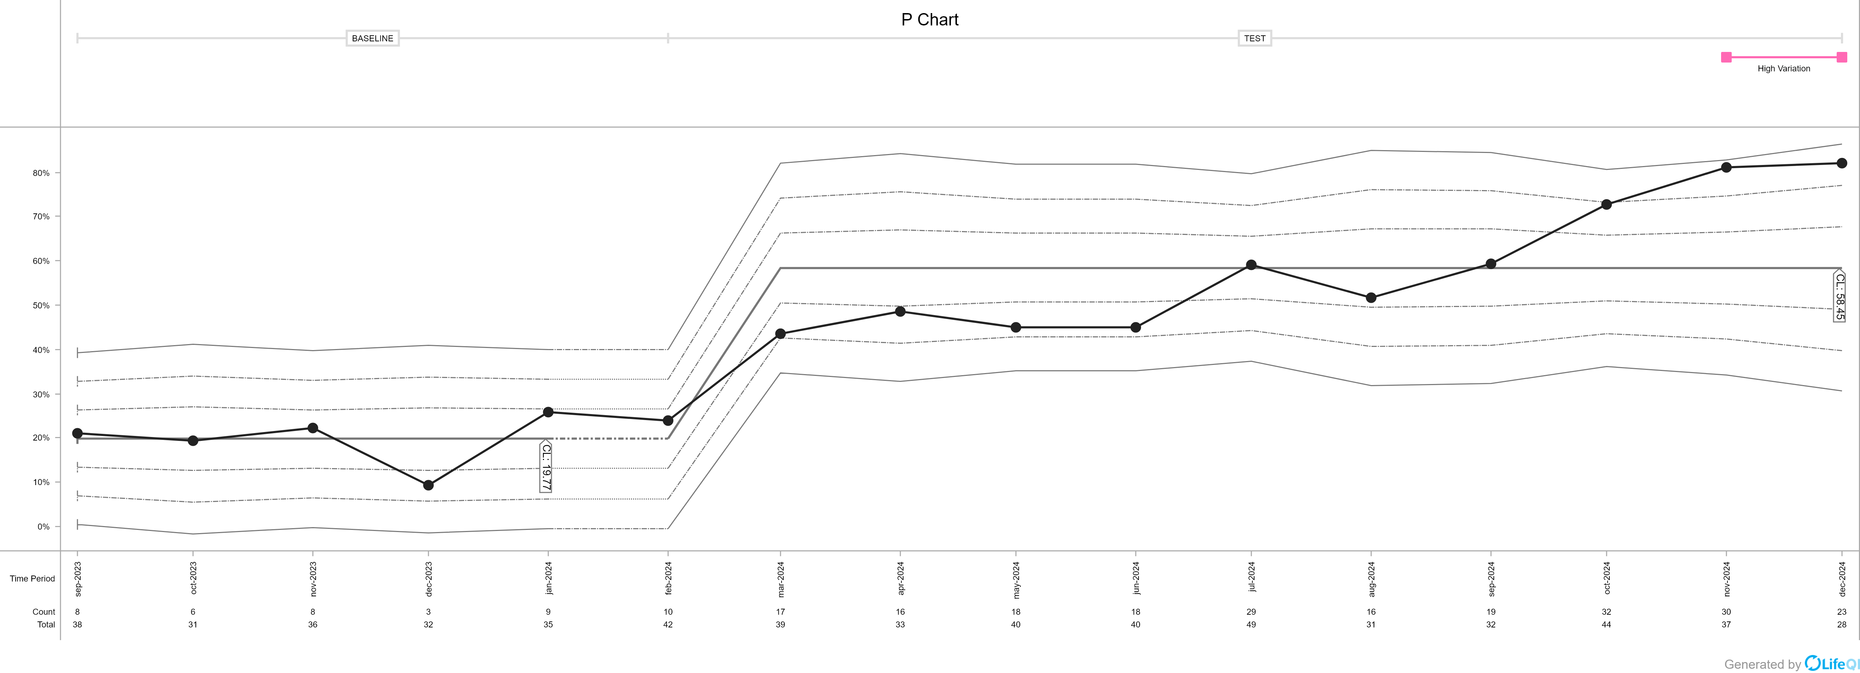
Oxleas NHS Foundation Trust
Measure 1: Percentage of patients screened for smoking status on admission
Direction of improvement
Co-production
Breathe easy group
VBA Training
December 2024, 59% of patients were screened on admission
January 2024, 20% of patients were screened on admission
= 195% improvement
Notes:
Clem
Measure 1 – screened for smoking on admission
20% to 56%
74% improvement in the percentage of patients who smoke engaging with a tobacco dependence treatment service, from an average of 21% to an average of 36%,

Slide 26
Oxleas NHS Foundation Trust
“The QI project has undoubtedly improved our TDT service. It has enabled us to strengthen relationships with MDTs” – TDT team
“I now understand the importance of smoking cessation for mental health patients. I previously held the belief that they could not quit, but I have learned that this is not true” – Nurse
“I am proud to share that I have been smoke-free for almost two months—the best decision I have ever made” – Patient
Notes:
TDT
Nurse
Patient – the peer groups tailored to my needs

Slide 27
Surrey and Borders NHS Foundation Trust Measure 2: The percentage of patients engaged with a tobacco dependency treatment service
By June 2024, there was a shift in the mean to 72% of patients engaged in a TDTS
At baseline, 53% of patients were engaging in meaningful tobacco treatment
A shift in the data

Slide 28
NHS England: the next steps in tobacco treatment
Professor Sanjay Agrawal
National Specialty Advisor for Tobacco Dependency
NHS England
Notes:
Jaz
Professor Sanjay Agrawal - remember from the round 2 launch event.
Supported similar work in Acute trusts and then kindly supported us to deliver this QI colllabroative more widely.
He is going to talk more to this longer term and the bigger picture
Organisational barriers, cultural things, these take longer than QI collaborative project to make significant change.

Slide 29
QuITT - Next Steps
January 2025
Professor Sanjay Agrawal
National Speciality Advisor (tobacco dependency) - NHS England
Consultant in Respiratory & Critical Care Medicine - Leicester
Notes:
Standard title slide

Slide 30
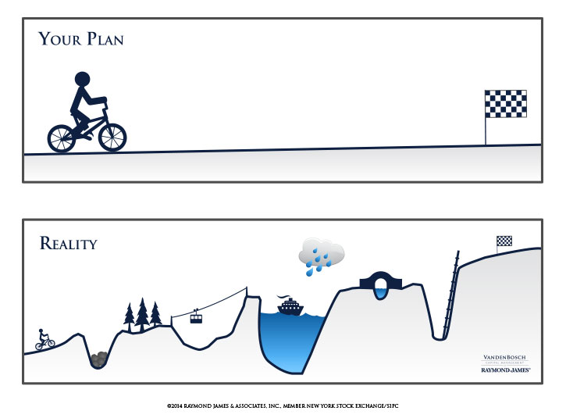

Slide 32
LTP - Objectives & priorities
Identify
Acute hospital in-patients
Mental Health in-patients
Maternity (and partners)
Community Mental Health
NHS Staff
Treat
High quality service
Culture change
Sustained

Slide 33
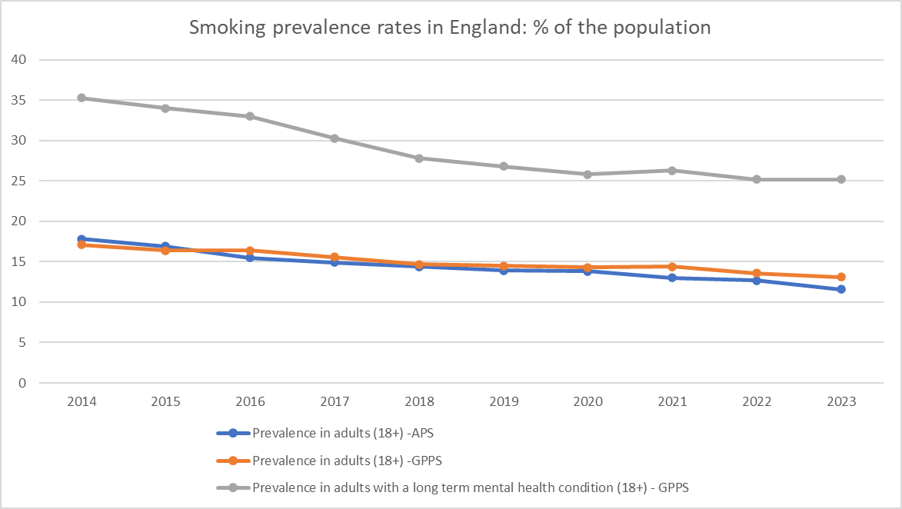
Smoking prevalence
https://www.ons.gov.uk/peoplepopulationandcommunity/healthandsocialcare/healthandlifeexpectancies/bulletins/adultsmokinghabitsingreatbritain/2023

Slide 34
Tobacco addiction
Dead
Quit
attempt
Never
smoker
Current
smoker
Recent
quit
Relapse
Relapse
Long- term quit

Slide 35
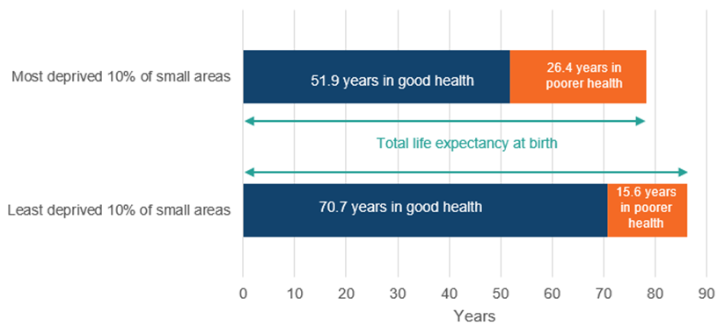
Our patients

Slide 36
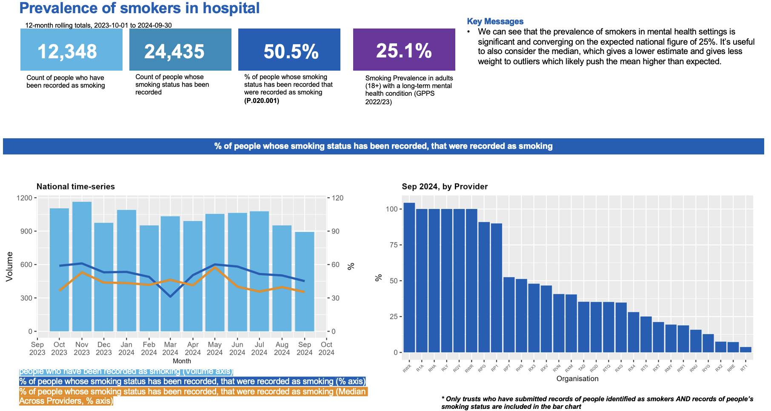

Slide 41
Sustaining progress
Impact = Reach x Effectiveness

Slide 42
Sustaining progress
Reach
Effectiveness
All hospital patients
Training for staff
Smokefree sites
Referral to & input from TDA ‘s
↑ provision of meds/vapes
↑ transfer of care rates
Good quality data
Build QI into pathways
Impact

Slide 43
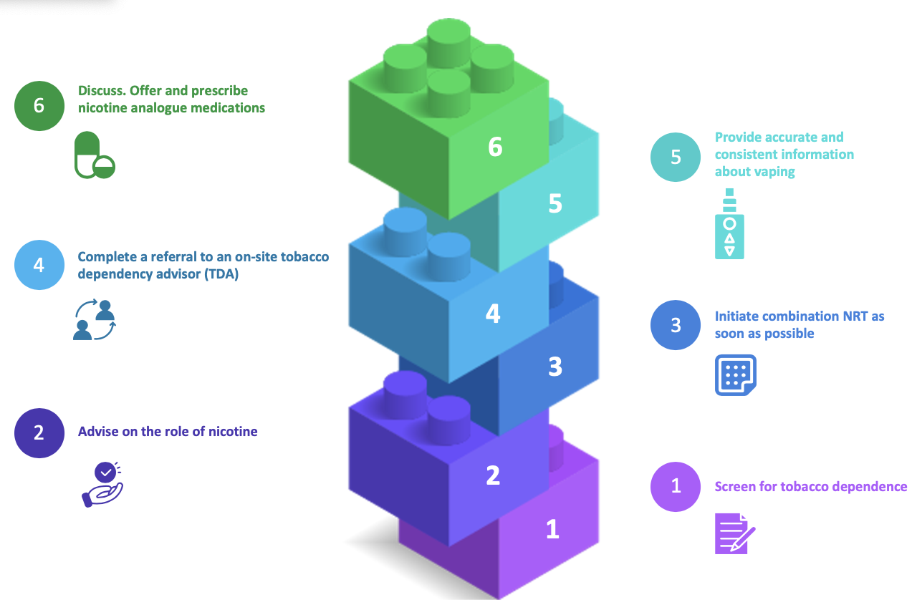
Treatment of tobacco dependency
https://thorax.bmj.com/content/79/Suppl_1/3

Slide 44
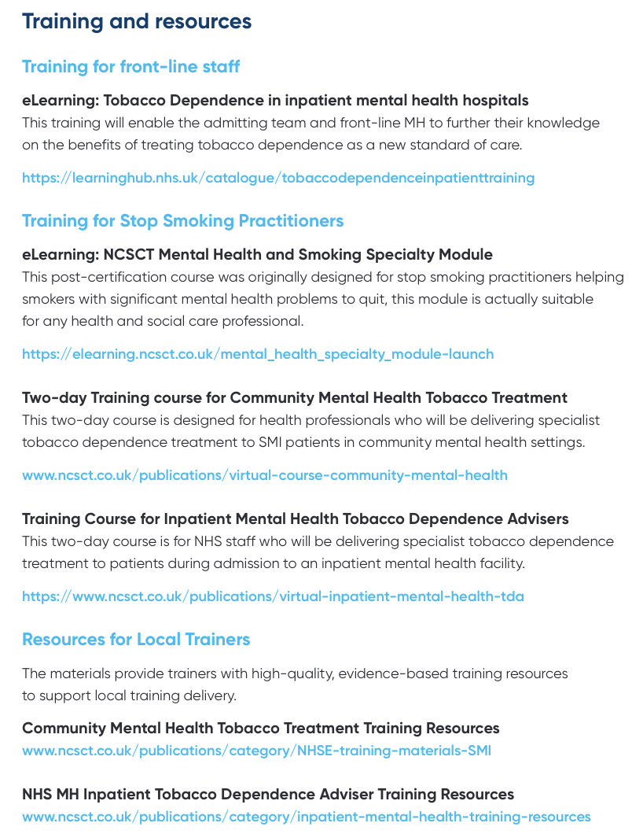
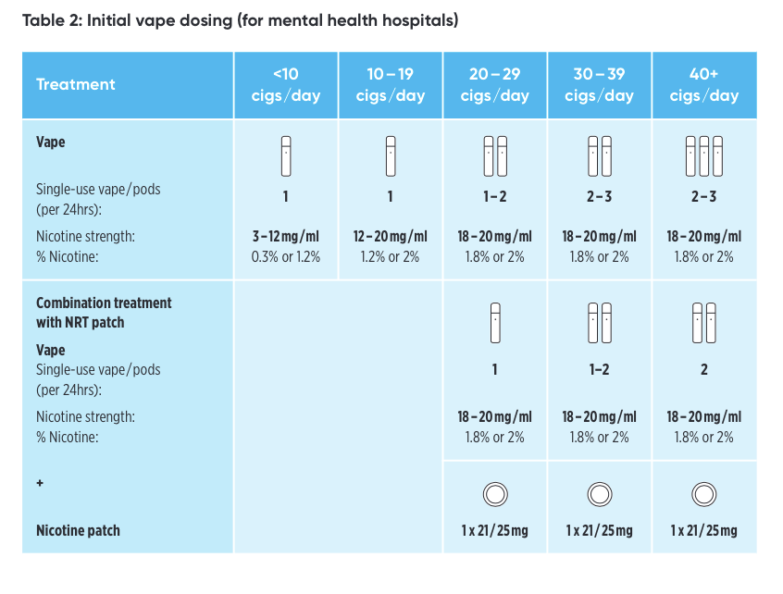

Slide 46
Questions from the audience

Slide 47
Break 11.05- 11.15 Refreshments served in room 1.6
Notes:
Ros –close for break

Slide 48
Tobacco Dependency: Early Implementer Sites Evaluation
Juliette Westbrook
Research Assistant
National Collaborating Centre for Mental Health (NCCMH)
Notes:
Clem

Slide 49
Tobacco dependency community-based services for people with severe mental illness
An evaluation of NHS early implementer sites
Juliette Westbrook
January 2025

Slide 50
Background – referrals
Model 1: Physical health check for people with SMI or primary care contact
Model 2: Discharged from mental health inpatient setting or attending MH outpatient clinic
Model 3: Making every contact count embedded in CMHS
North East and North Cumbria
Norfolk and Waveney
Nottingham and Nottinghamshire
Sussex
Greater Manchester
East London
Cornwall and Isles of Scilly
N = 7 sites
Notes:
Original model of care, although some may have changed over course of pilot to encourage referrals/adapt to barriers.

Slide 51
Evaluation design
December 2022 – April 2023
July – September 2023
October - November 2023
Notes:
Site lead surveys-people involved in the initial set up of the services
Qualitative interviews with staff members-referral and treatment
Patient feedback following appointments in the stop smoking services
Presentation will focus mainly on qual interviews, as this is where we have the richest data

Slide 52
Site lead surveys
Aimed to understand:
Context services were introduced in
Main elements of the implementation of services
Barriers and facilitators to implementation
Notes:
no wrong door approach- being limited to one model of referral often a barrier to reaching patients
More awareness- sometimes lack of communication between referrers and treatment services meant patients who could benefit not referred.

Slide 53
Encourage more referrals
“No wrong door” approach
Expansion of definitions of service eligibility
Increase awareness of service
Funding
Collaboration via pre-existing partnerships, experienced managers and stakeholders
Lack of certainty prevented establishment of long term protocols and plans, staff recruitment and staff retention
Use or knowledge of pre-existing protocols
Sharing workloads with partner organisations
Drawing on previous experience to reach out to additional stakeholders
= Reduction in workload
Notes:
Electronic survey sent out between December 2022 and April 2023.
Responses from all 7 early implementer sites
no wrong door approach- being limited to one model of referral often a barrier to reaching patients
More awareness- sometimes lack of communication between referrers and treatment services meant patients who could benefit not referred.

Slide 54
Staff interviews
Qualitative interviews with treatment providers (N=7) and referrers (N=4)
Aim: to gain an understanding of what staff found helped or hindered them in the mobilisation and implementation of their services
Framework analysis
Notes:
AIM: to gain an understanding of what staff delivering the services found helped or hindered the mobilisation of services and their implementation through an exploration of the common themes in staff experience.
Eleven interviews conducted.
7 interviews with treatment providers, 4 with referrers
The participants were from North East and North Cumbria, Norfolk and Waveney, Sussex and East London. (ie make clear may not be representative of everyone)
This is the overall diagram of themes. A bit more detail on each…..

Slide 55
Staff interviews
Staff experiences of community services
Importance of flexibility
Setting up the service
The SMI population
Reducing health inequalities
Team collaboration and communication
Intervention training and support
Notes:
AIM: to gain an understanding of what staff delivering the services found helped or hindered the mobilisation of services and their implementation through an exploration of the common themes in staff experience.
Eleven interviews conducted.
7 interviews with treatment providers, 4 with referrers
The participants were from North East and North Cumbria, Norfolk and Waveney, Sussex and East London. (ie make clear may not be representative of everyone)
This is the overall diagram of themes. A bit more detail on each…..

Slide 56
Patient experience surveys
‘I got to change vapes as I did not like the first device.’
‘I like the friendly approach my mentor has and not giving up with me as I am not the easiest to get hold of.’
‘The weekly calls I am offered really helps to keep me on track and makes me hold myself accountable.’
13 responses
Overall, very positive feedback
Two main themes:
Choice- in treatment format and prescriptions contributed to more positive experiences
Regular engagement with empathetic staff who provided support irrespective of potential setbacks
Notes:
AIM: gain an understanding of how patients found the process of accessing and using tobacco dependency services

Slide 57
What should be considered for future services?
Adequate funding and planning
Clarity on, and longevity of funding is important for well-planned services
Extended “lead in” phase to plan all protocols, referral pathways and policies
Collaboration
Collaborative relationships between services, staff, and stakeholders is a key facilitator
Person-centred and flexible tobacco dependency treatment
Supportive relationships between staff and patients
Choice for patients to encourage retention and improve outcomes
Develop a robust network of experienced stakeholders and experts who can support service set up and delivery
National training programme for staff to support access to and consistency in mental health and related support, importance of smoking cessation in people with SMI and how to develop rapport.
Ongoing communication and knowledge exchange between referral and treatment staff

Slide 58
Report
Please see the QR code for the full report

Slide 59
Questions from the audience

Slide 60
QuITT Teams: Sharing your stories
Clementine Fitch-Bunce
Quality Improvement Coach
National Collaborating Centre for Mental Health (NCCMH)
Notes:
Clem

Slide 61
FOUR CORNERS OF STORIES
BLUE CORNER:
Team stories to read and discuss with others
RED CORNER:
What challenges do you still face? How could you tackle this going forward?
1O minutes at each corner
ORANGE CORNER:
What challenges have you overcome during your QuITT journey, and how?
GREEN CORNER:
What has been the greatest impact of the work you have done?
Notes:
Clem –blue
Jaz – Green
Ros – orange
Matt – Red
Hannah to choose where she wants to be

Slide 62
Round 1 launch event ‘23

Slide 63
Round 2 launch event ‘24

Slide 64
Class of 2025 picture
Notes:
Move to next slide for background for photo

Slide 65
As you leave there are a couple of boxes for your ideas, please write on the slips of paper in front of you and pop them in the box on your way out.
What one thing would you like your organisation or commissioners to know about tobacco treatment services?
What is one thing you would like NHSE to know about tobacco treatment services?
Notes:
Think about asking this at lunch as well as at the end of the day....?

Slide 66
Quality Improvement in Tobacco Treatment (QuITT) Collaborative
End of Programme Celebratory Event
21 January 2025, 10:00 – 15:00

Slide 67
Lunch 12.35 - 13.25 Room 1.6
Notes:
Matt to intro lunch

Slide 68
Post lunch energiser- Doodling together
Draw a shape, and pass your paper on to the person on your left
Make something out of the shape you got from your neighbour (an object or a person or an animal) - pass your paper on

Slide 69
Post lunch energiser- Doodling together
Add context to the paper you got from your neighbour - pass your paper on
Add action or drama to the paper you got. Refrain from using text, this will be the next step! - pass on
Add some text to the picture

Slide 70
Action on Smoking and Health (ASH): Legislation and beyond
Hazel Cheeseman
Chief Executive
Action on Smoking and Health (ASH)
Notes:
Ros to intro Hazel

Slide 71
Next steps for tobacco control
Hazel Cheeseman, Chief Executive
Action on Smoking and Health (ASH)
ASH receives funding from:
Cancer Research UK
British Heart Foundation

Slide 72
Legislation- where are we now?
The Tobacco and Vapes Bill will:
Raise the age of sale for tobacco by one year every year
Create new regulations around vapes and other nicotine products
Introduce retail licensing
Extend smokefree legislation
Outside the Bill
Disposable vapes will be banned under secondary legislation from June 2025
Vape liquid excise tax from October 2026
Pack inserts and extension to standard packaging

Slide 73
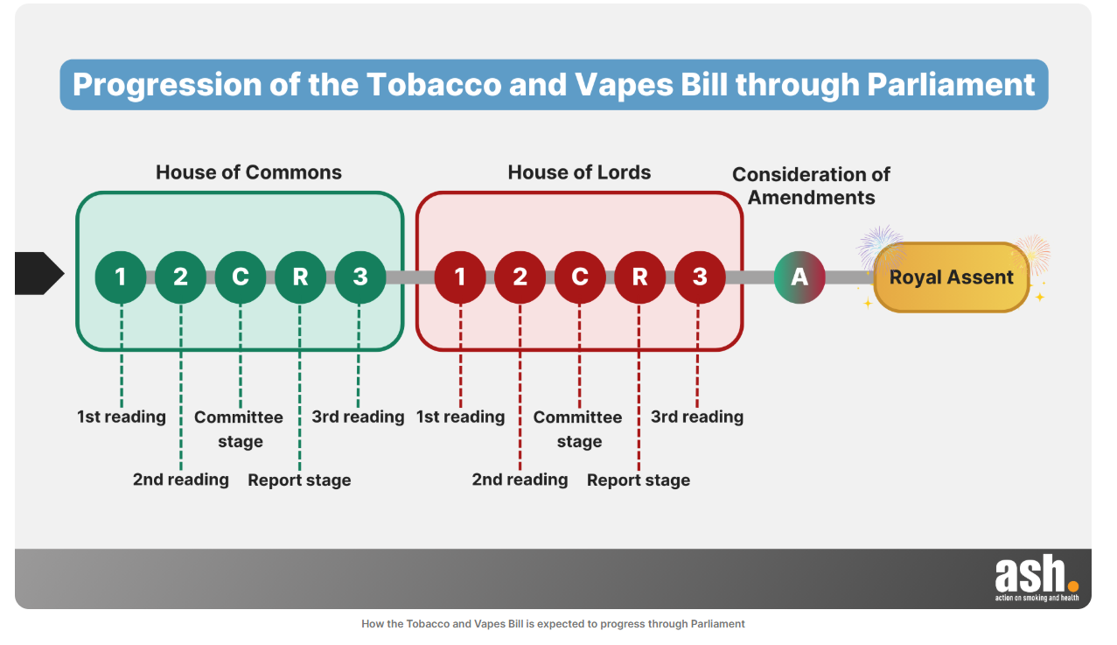
Secondary regulations: consult, table, implement

Slide 74
Implications for mental health settings
From June 2025
Disposables banned
Following Royal Assent
Vape vending machines banned
Ad ban – not for health bodies promoting cessation
From October 2026
Vape liquid excise tax
Following consultation and regulations
New smokefree and vapefree restrictions
Retailers licensed
Marketing/ packaging restrictions
Product design and flavour restrictions

Slide 75
Investment in tobacco control outside NHS
Additional funding - what | Before election | Current status
New funding for LA stop smoking support | Additional £70 million from 24/25 committed for 5 years (doubled investment) | Committed till end of 25/26
Swap to stop scheme | £45 million over two years | Ends March 2025
New enforcement funding | £30 million from 24/25 for 5 years | £10 million till end of 25/26
National mass marketing campaigns | £15 million from 24/25 for 5 years | Ends March 2025
National financial incentive scheme for pregnant women | £10 million over two years | Ends March 2025

Slide 76
Looking beyond the Bill
Legislation has few things to benefit current smokers. We need:
Roadmap to a smokefree UK, with prevalence targets for those with mental health conditions
Targeted funding across all mental health settings to address the higher rates of smoking
Effective guidance from NHSE about deploying smokefree sites/ vaping etc
Engagement of staff to maintain cultural change in MH settings

Slide 77
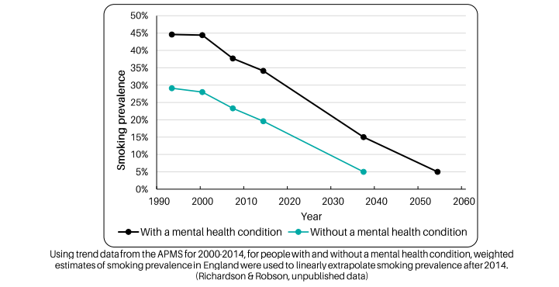
Get prevalence falling faster

Slide 78
Vapes on wards
ASH surveyed MH trusts at the end of 2024:
65% of trusts surveyed allowed vaping indoors (12% in communal indoor areas)
35% only allowed vaping outdoors
78% provided vapes for free on wards
50% had vapes for sale on wards/ on site
33% of trusts had utilised the swap to stop scheme

Slide 79
Looking beyond inpatient services
Community MH services
Talking Therapies
Local Authority services
VCSE groups
3rd sector support
New ASH report coming soon!
Notes:
Utilising LA increased funding under the Bill

Slide 80
Driving a drop in prevalence
Comms and mass media on the links between smoking and mental health
More work to understand barriers and motivators to quitting
Financial incentives for people with Serious and Moderate MHCs

Slide 81
Conclusion
There has been progress:
New legislation
Investment
Embedding of inpatient services
Long way still to go to erode the profound inequalities in smoking rates among people with MH conditions
Maintain and completely progress inpatient but look far beyond these settings
Smoking among people with MH conditions must be a strategic priority in any plan to address inequality and provide equal health outcomes for people with SMI

Slide 82
National Centre for Smoking Cessation and Training
Mary Yates
Expert Mental Health Consultant
National Centre for Smoking Cessation and Training (NCSCT)

Slide 83
Tailored guidance and training for Tobacco Dependence Treatment in Mental Health Hospitals
Mary Yates
Mental Health Nurse Consultant & National Tobacco Dependence Trainer

Slide 84
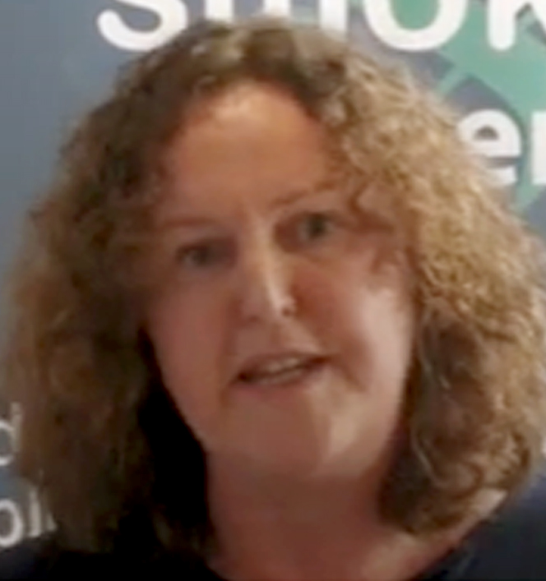
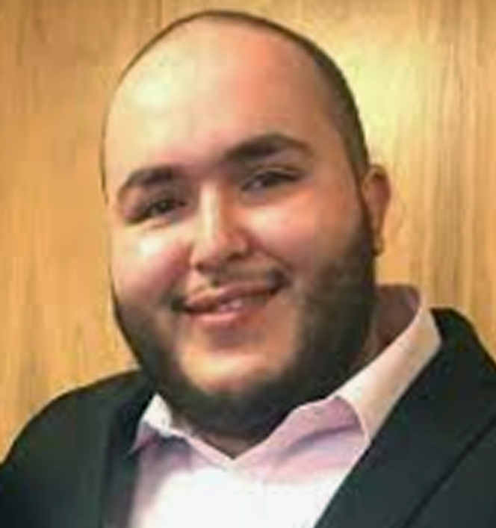
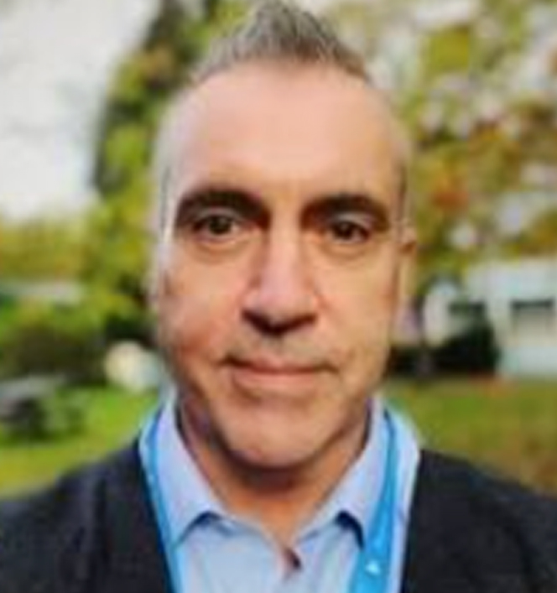
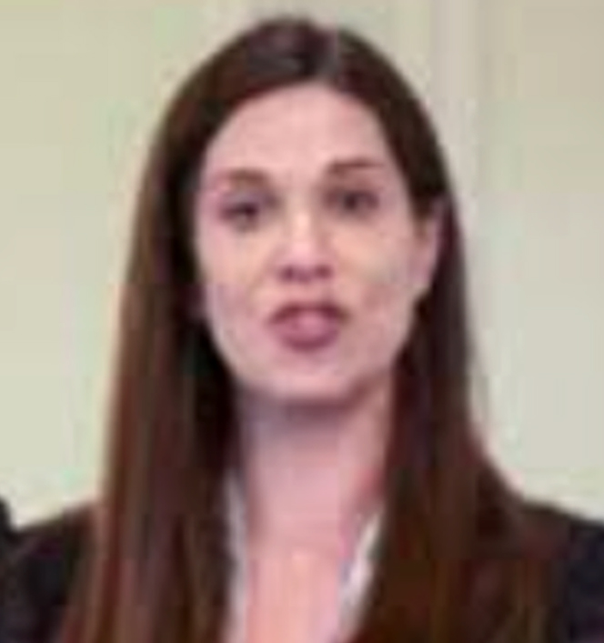
Thank you to the Inpatient MH Task Group
Mary Yates
Debbie Robson
Martin Lever
Pete Stewart
Moira Leahy
Tracy Sutton
Helen Philips
Kerry Apedaile
Raf Hamazia
Sophia Papadakis

Slide 85
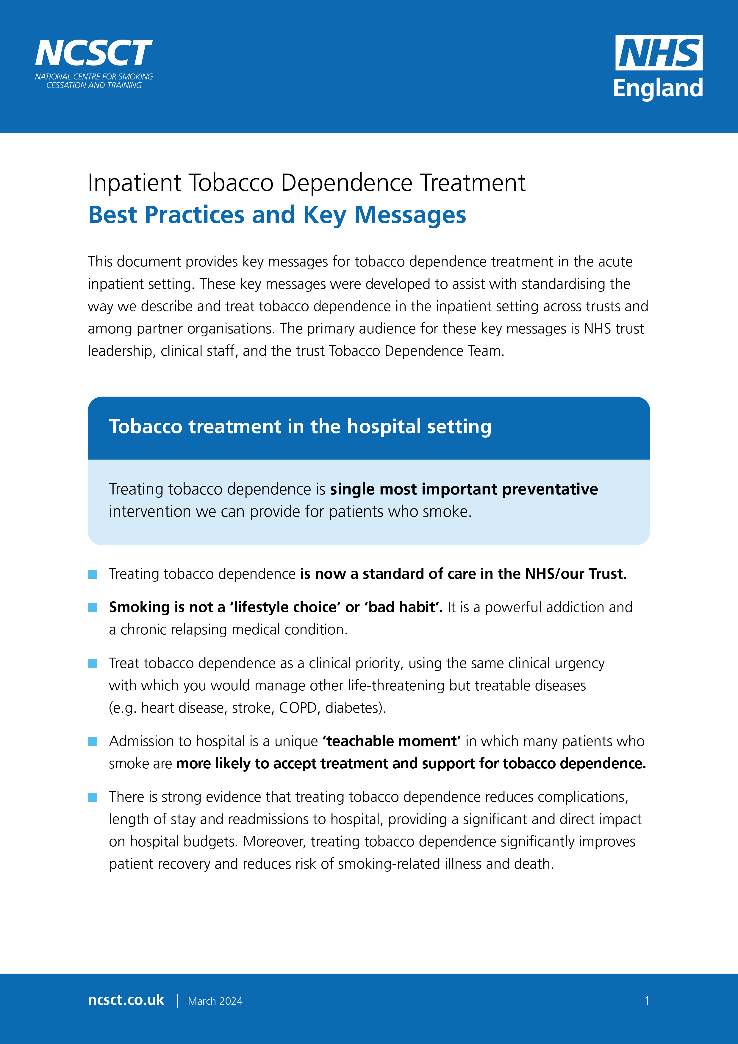
New Guidance and Training: Inpatient MH services
NEW JAN 2025
Standard Treatment Plan
TDA Training Suite
eLearning for frontline staff / admission team

Slide 86
NHS Standard Treatment Plan (STP) Tobacco Dependence in Mental Health Hospitals
Clinical tool to support delivery of the Inpatient Tobacco Dependence Treatment Bundle
www.ncsct.co.uk [via NHS page]
Notes:
The NHS-NCSCT standard treatment Plan (STP) for inpatient tobacco dependence treatment is grounded in evidence-based behaviour change techniques.
The STP is designed to guide you you through delivery of the inpatient tobacco dependence Treatment Care Bundle. Follow the STP and you will be maximising the effectiveness of the support that you give.
An electronic version of the STP is included within your participant pack and is also available for download on the NCSCT website, via the NHS link on the main page.
We recommend taking time to read through the STP.
We will refer to sections of the standard treatment plan throughout the course.

Slide 87
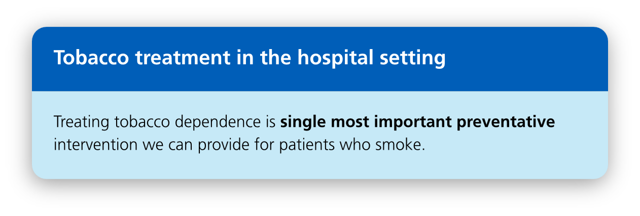
Best practices and
key messages

Slide 88
Within 30 minutes

Slide 90
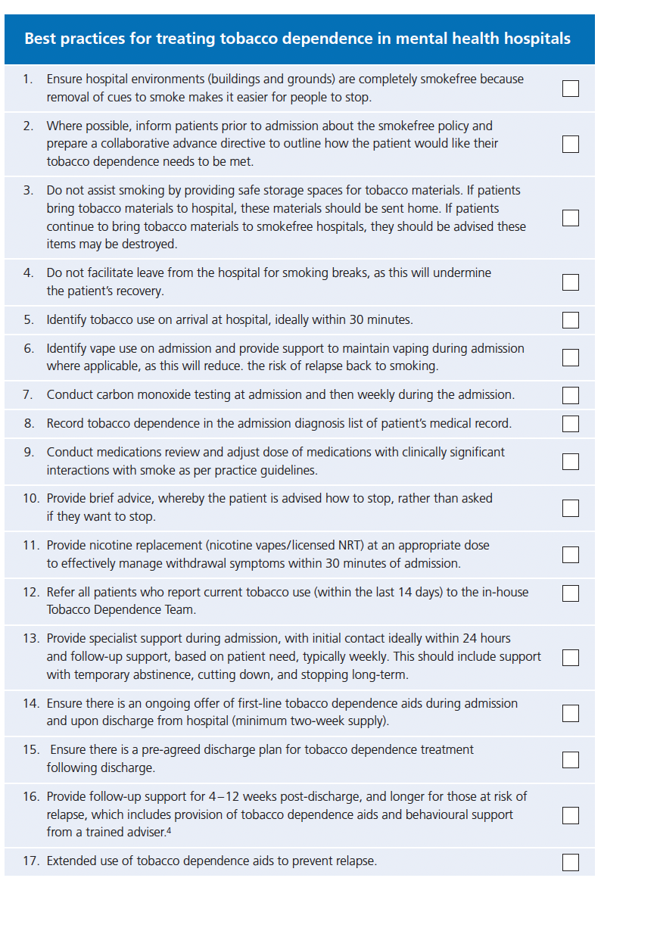
Best Practices for MH Hospitals

Slide 91
First-line tobacco dependence aids
Nicotine vapes for adults only

Slide 92
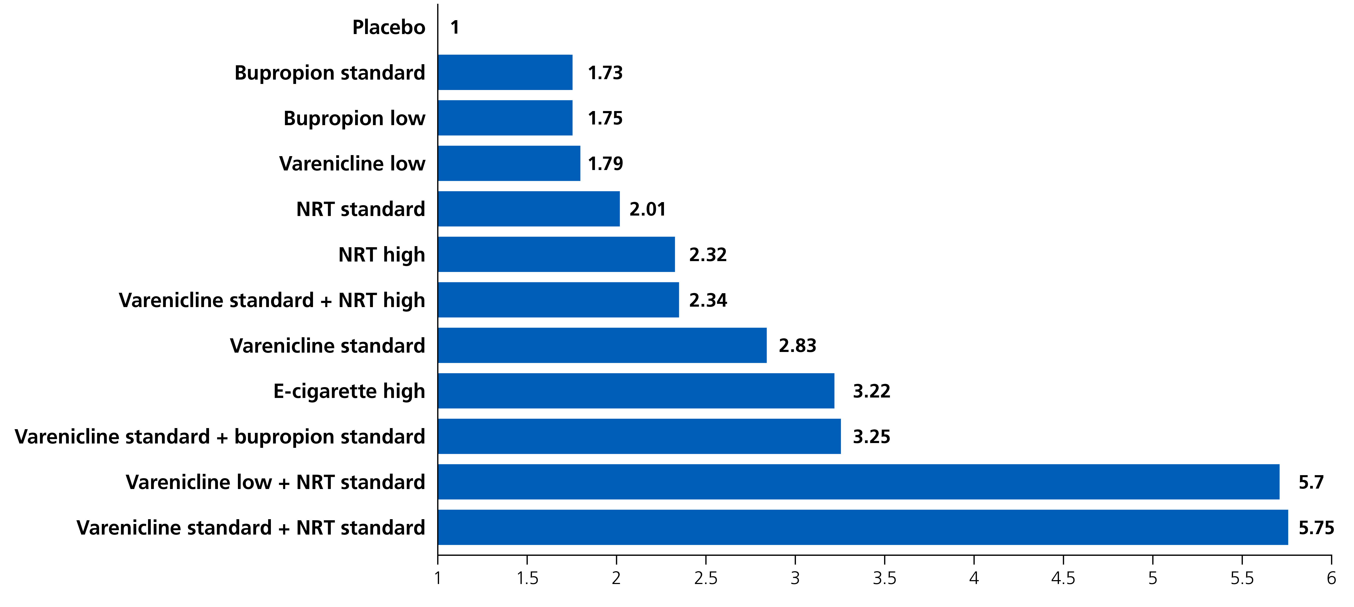
Combining tobacco dependence treatments
Source: Thomas KH, et al. Comparative clinical effectiveness and safety of tobacco cessation pharmacotherapies and electronic cigarettes:
a systematic review and network meta-analysis of randomized controlled trials. Addiction. 2022;117(4):861-76.

Slide 93
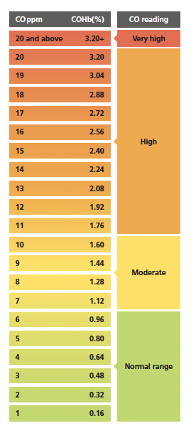
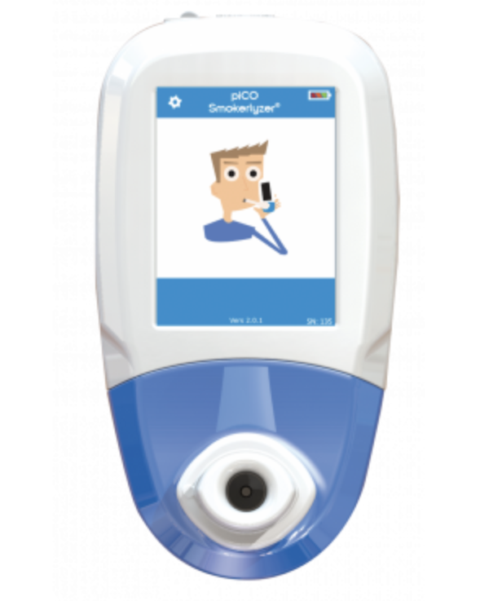
Vital sign monitoring
Smoking exposure = above 5 ppm
Normal Reading = 1 to 6 ppm
The test results should be recorded in the patients ​
notes and discussed in the clinical review meetings
Notes:
[Animated slide]
Test results should be shared with patients, in the context of increasing their interest in stopping smoking.
Many of you may have seen these CO charts. You can find a copy of a CO chart in Appendix 9 or the STP. This chart can be a useful tool for sharing CO test results with patients.
Importantly, because CO monitors can only measure CO from exposure to smoking within 24 -48 hours, you will want to place that in context with patients.
When a series of test results are available to view, the patient and TDA should reflect together to see if there are any patterns which might help further strengthen the care plan.
The test results should be recorded in the patients notes and discussed in the clinical review meetings.

Slide 94
eLearning Modules
Core module: Treating tobacco dependence in inpatient acute and mental health care settings (30 mins)
Bolt-on modules:
Inpatient Mental Health (30 mins)
Tobacco dependence aids (20 mins)
CO Testing (5 mins)
Primary target audience: Team members who admit NHS patients to receive acute and mental health care.
Secondary target audience: All NHS staff.

Slide 95
eLearning Core Module Outline
Title: Treating tobacco dependence in inpatient acute and mental health care settings
Part 1 – Tobacco dependence treatment: A new standard of care
Overview
The scale of the problem
Tobacco dependence treatment
Understanding tobacco dependence
Smoking and medication interactions
Acute inpatient tobacco treatment pathway
Part 2 – The Admission Care Bundle
Identify
Advise
Treat
Refer
Record
Part 3 – Myths and Facts

Slide 96
Bolt on eLearning module:
Tobacco dependence in mental health hospitals
Module sections:
Smoking and mental health
Admission Care Bundle
Tobacco Dependence Aids
Smoking and medication interactions
Storage of Tobacco
Assessment (post course)

Slide 98
Course programme – Day 1
Smoking and mental health: a call to action
Understanding tobacco dependence
Treating tobacco dependence: a new standard of care in inpatient MH
Core communication skills and behaviour change techniques
Point of admission care
Engaging patients in treatment: best practices
Tobacco dependence aids (vapes, NRT, nicotine analogues)
Challenging conversations: responding to staff scenarios
Notes:
Review programme for day 1 of the training course.
Mention times of planned break and lunch. Mention interactive nature of course.

Slide 99
Course programme – Day 2
Initial assessment and treatment plan
Carbon monoxide testing: a motivational tool
Smoking and psychotropic medication interactions
Harm reduction (Cut Down and Then Stop)
Follow-up scenarios
Preparing for discharge and post-discharge follow-up
Clinical considerations; cannabis / trauma / staff support
Responding to patient scenarios
Notes:
Review programme for day 2 of the training course.

Slide 100
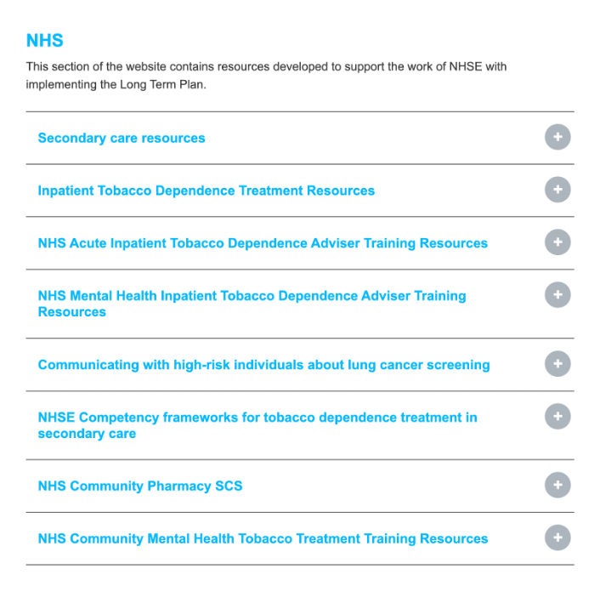
Accessing training – NCSCT Website
www.ncsct.co.uk [via NHS page]

Slide 101
Comments
Questions
Discussion

Slide 102
Questions for Hazel and Mary
from the audience

Slide 103
QuITT: Reflecting back and looking forward
Jaz Seehra
Quality Improvement Coaches
National Collaborating Centre for Mental Health (NCCMH)

Slide 104
Your Quality Improvement Journey
Notes:
Stealing this image from Prog Agrawal!

Slide 105
What did you learn as an individual as part of the collaborative and what are you taking away?
2 minutes
Notes:
Firstly, for 2 mins, think about your own journey through this collaborative.
What will you take away with you, how might you change the way you work?
What are you most proud of? Capture some ideas on the Post it notes in front of you.

Slide 106
Now, as a team, think about …........
What did you learn as a team as part of the collaborative and what are you taking away?
What are your long-term goals for your tobacco dependence service?
15 minutes
Notes:
Per team on the table.
Get them to stick their sticky notes to the flip chart after? (then we can collect)

Slide 107
Share your thoughts and Reflections

Slide 108
Feedback and close
Matthew Milarski
Head of Quality Improvement
National Collaborating Centre for Mental Health (NCCMH)

Slide 109
As you leave there are a couple of boxes for your ideas, please write on the slips of paper in front of you and pop them in the box on your way out.
What one thing would you like your organisation or commissioners to know about tobacco treatment services? (blue)
What is one thing you would like NHSE to know about tobacco treatment services? (yellow)
Notes:
Think about asking this at lunch as well as at the end of the day....?

Slide 110
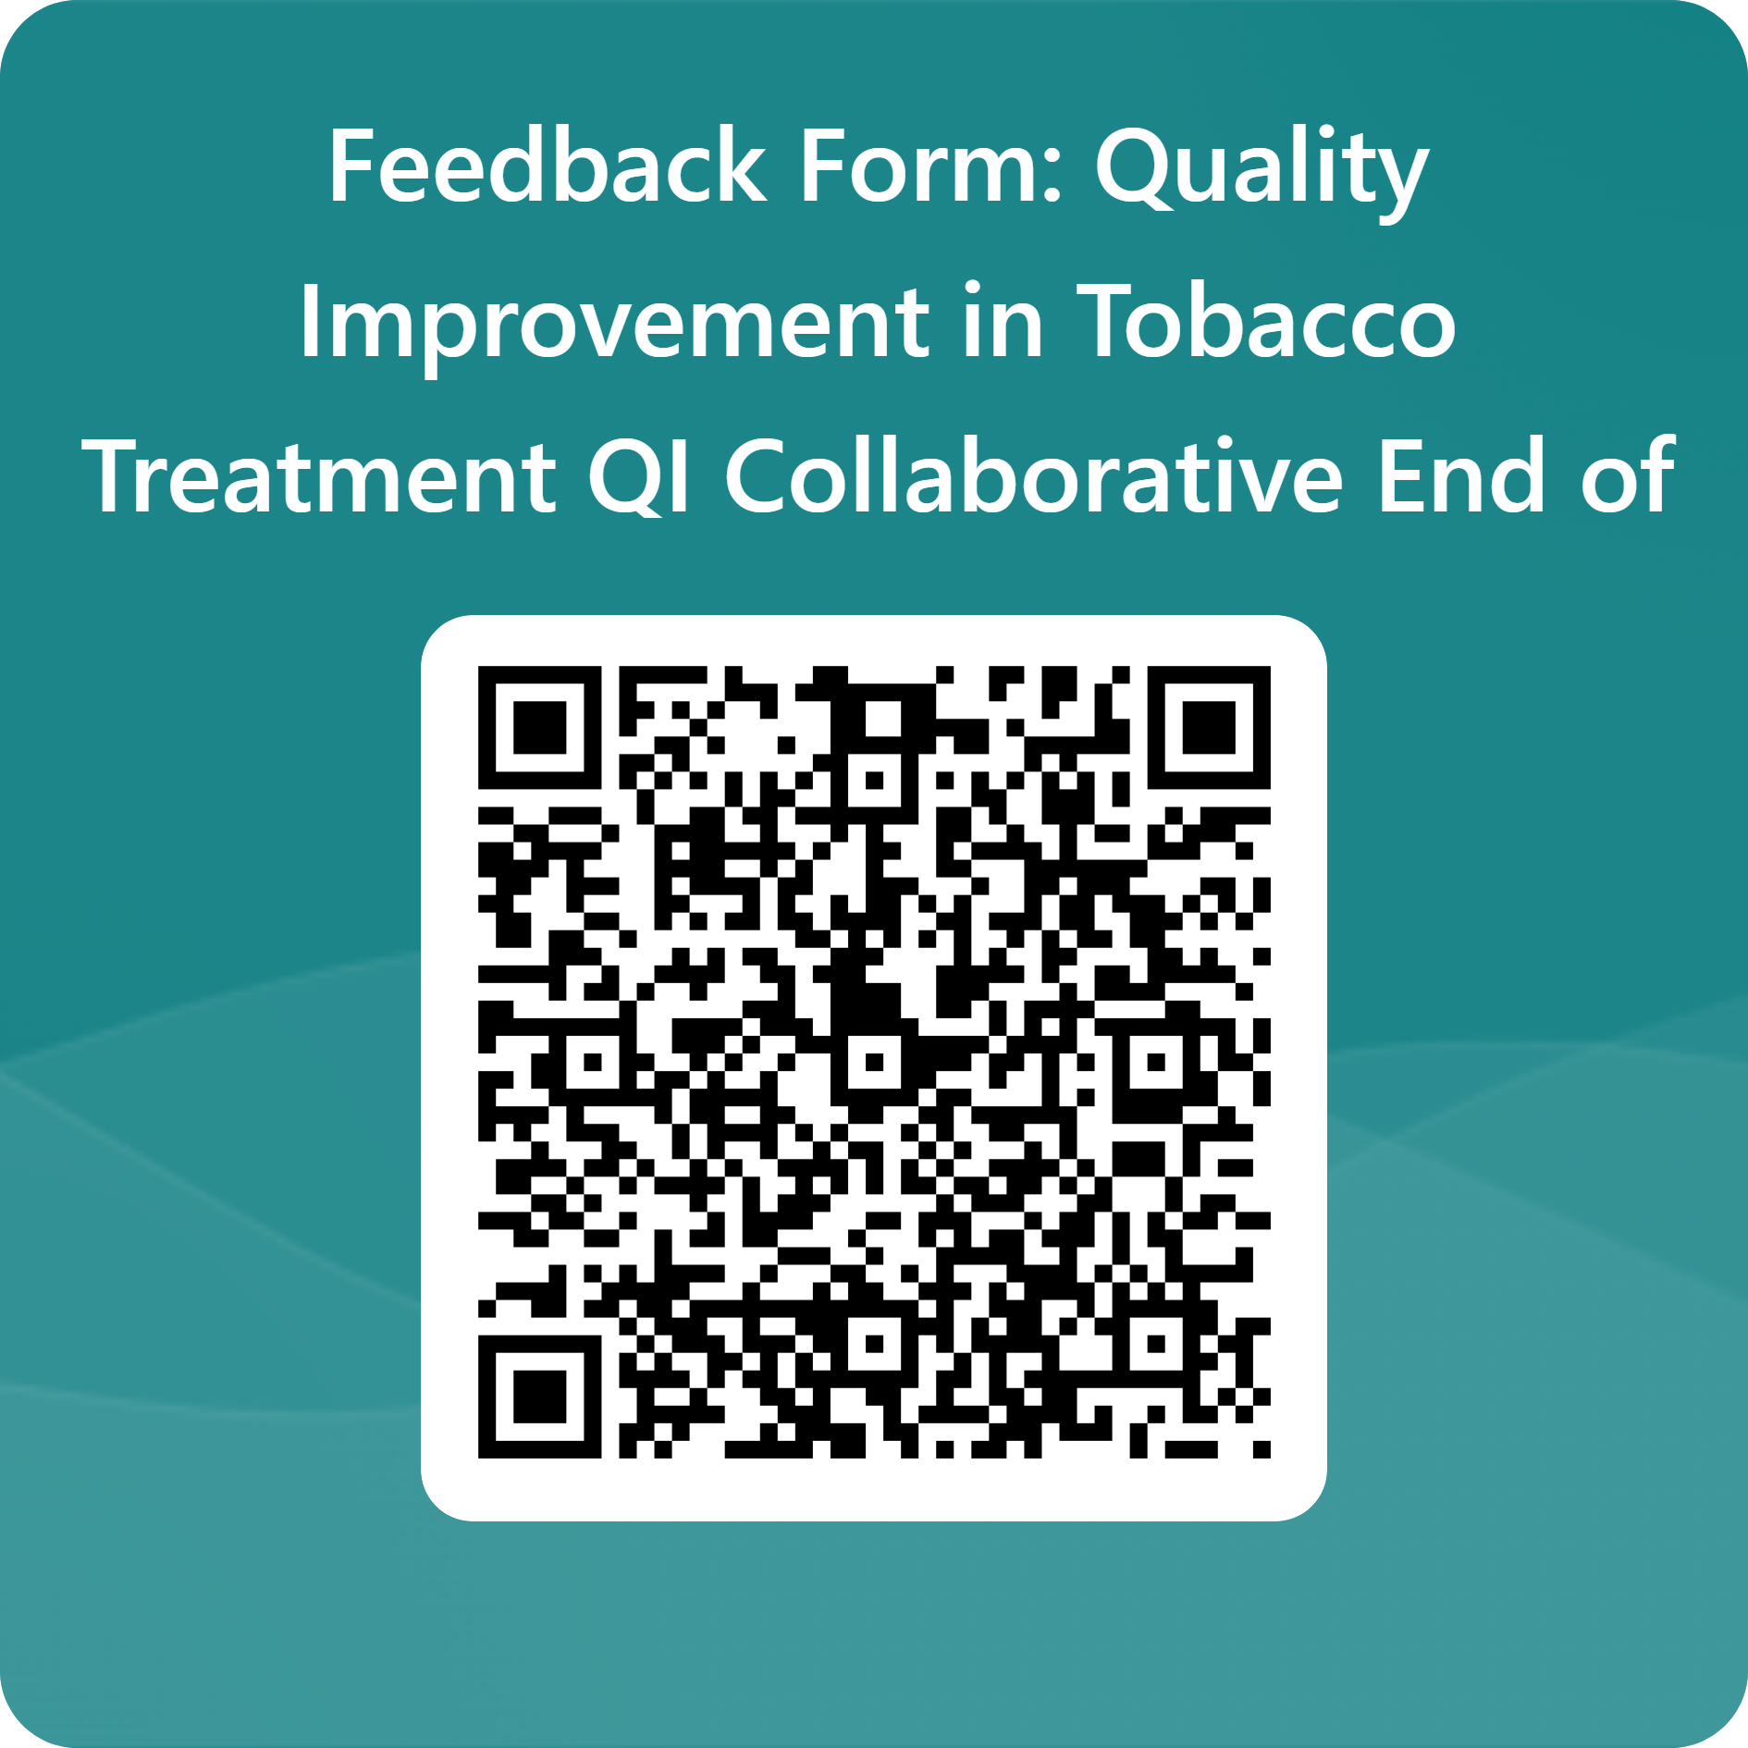
We value your feedback as this helps us to continue to improve event.
Please use the QR code to access the online form. Paper copies are also available on your tables.
How did you find today's event?

