Slide 1
Humber and North Yorkshire Health and Care Partnership Mental Health, Learning Disabilities and Autism Collaborative Programme
Suicide Prevention
Jo Kent – Suicide Prevention Programme Lead

Slide 2
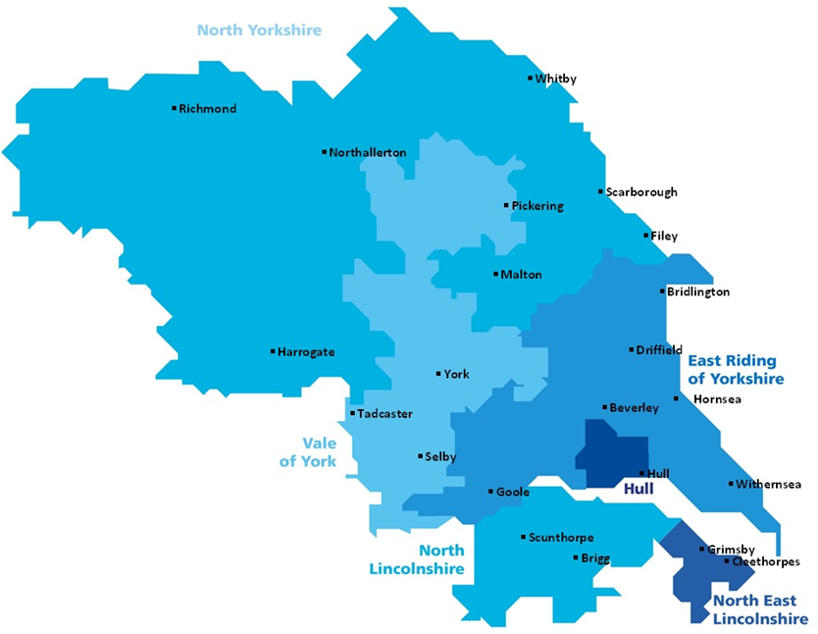
Humber & North Yorkshire
Humber and North Yorkshire serves a population of 1.7 million people

Slide 3
ONS Statistics
In 2019, there were 5,691 suicides registered in England.
Around three-quarters of registered deaths in 2019 were among men (4,303 deaths), which follows a consistent trend back to the mid-1990s.
Males aged 45 to 49 years had the highest age-specific suicide rate (25.5 deaths per 100,000 males).
Among men, the area with the highest rate in 2019 was Yorkshire and The Humber.
For females, the highest rate in 2019 was also seen in Yorkshire and The Humber (7.3 per 100,000).

Slide 4
ONS Statistics
In 2020, there were 5,224 suicides registered in England and Wales
In 2020, in both Yorkshire and The Humber (11.5 per 100,000 people) and the East of England (9.5 per 100,000 people) decreased significantly compared with 2019 (13.8 and 11.6 per 100,000 respectively).
These were the only significant changes in English regions, when comparing 2020 with 2019.

Slide 5
Priority 1: Men
Men
Work with Community Groups
To aim to change the culture amongst high risk groups
To deliver a men only service

Slide 6
Priority 2: Mental Health Service
Continually seek to improve the safety and quality
Shared learning
Promotion of 72 hour follow up post discharge
To complete the National Confidential inquiry into Suicide and Homicide toolkit

Slide 7
Priority 3: Self-harm pathway
To understand the profile of need relating to self-harm across the HNY footprint
To collate data via Liaison/crisis services
To provide a non-clinical self-harm service across the HNY

Slide 8
Communication and Engagement
Worked with grassroot projects across the patch
Podcasts with Andy's Man club
Engaged with the public providing training across the area

Slide 9
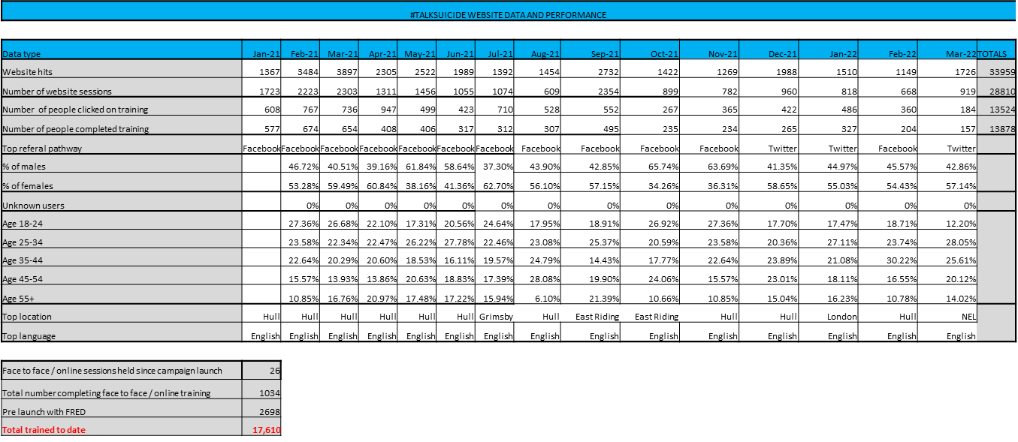
Training

Slide 10
Reducing suicides in public places
Restricting access to footpaths (at night)
Staff Safety
Data collection – Suicide v Emotionally distressed individuals
Frequent Attendees
Multi–agency working
Media
Emotional Wellbeing hub

Slide 11
Transferring learning to other locations
Shopping Centre– identified and contacted after high-profile suicide
Visit & audit of location with Partners
Site specific action plan put in place
Worked with other shopping centres
Introduced locations and encouraged sharing of learning
Becoming an area of good practice.

Slide 12
Achievements
Together service
Real Time Surveillance and QES suicide surveillance system
Campaign and Branding
Training
Qwell service
Webinars
High sheriff award

Slide 13
What’s next
Suicide learning panels – quarterly to learn from deaths and identify key areas for improvement
Ensuring sustainability
Women priority
Children & Young People priority- working with the C&YP Humber and North Yorkshire lead

Slide 14
Collaboration with East Sussex and Urban Scale Interventions
Our Mission
The Safer Public Spaces Network is a place for people to come together to progress issues of suicide in public space.
By joining together internationally and across different sectors, we will advance the thinking, research, and ways in which we create better public space.
In discussion with the Jordan legacy –design out suicide.

Slide 15
The End
Any Questions?

