Slide 1
CEO Perspective of Consultant Interviews
General reflections and overview
Leadership frameworks 3 lenses
Summary and conclusions
Questions and conversation

Slide 2
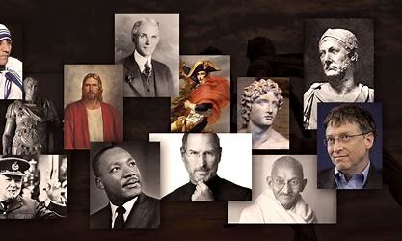
Leadership is the art of motivating a group of people to act toward achieving a common goal. There is not one type of leader

Slide 3
3 lenses………….. 1. Leadership Framework (The cake) 2. Engagement (The Icing) 3. Shifting the Paradigm(The Cherry)

Slide 4
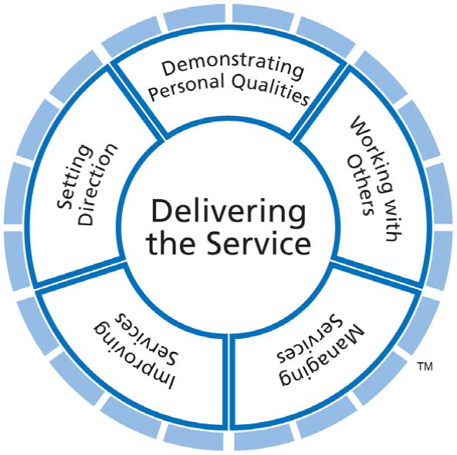
NHS Medical Leadership Framework

Slide 5
Engagement
Strategic Narrative
Visible, empowering leadership providing a strong strategic narrative about the service, where it’s come from and where it’s going.
Advocating, contributing to debate about the future of the service
Engaging as Clinical Leaders
Engaging consultants focus their people, treat their people as individuals and coach and stretch their people.
Employee and Service Users Voice
Valuing all voices throughout the service, for reinforcing and challenging views,
Differing opinions are seen not as the problem, rather as central to the solution,
colleagues and patients are involved, listened to, and invited to contribute their experience, expertise and ideas.
Organisational Integrity
The values on the wall are reflected in day to day behaviours. There is no ‘say – do’ gap. Promises made and promises kept, or an explanation given as to why not.

Slide 6
Shifting the Paradigm
Ideas and excitement about the future
Horizon scanning – interests in:
Data science
Application of new technologies – protocol-isation of care?
Understanding of how work will change and what that means to medical leaders
R&D and commercial partnerships

Slide 7
Summary
CEO will be interested in your leadership approach – this can come in many forms
CEO will not have much data to assess this – think about building your evidence base and raising your profile
Use a framework to assess yourself and form your articulation of your leadership approach
Set yourself apart from the competition by showing development and set your ambition to shift the paradigm

Slide 8
Thanks for listening …….any questions?

