Slide 1
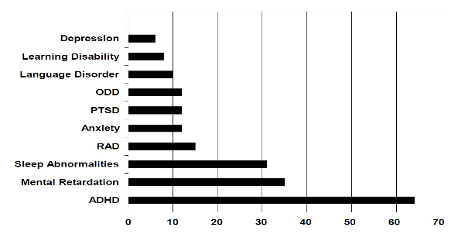
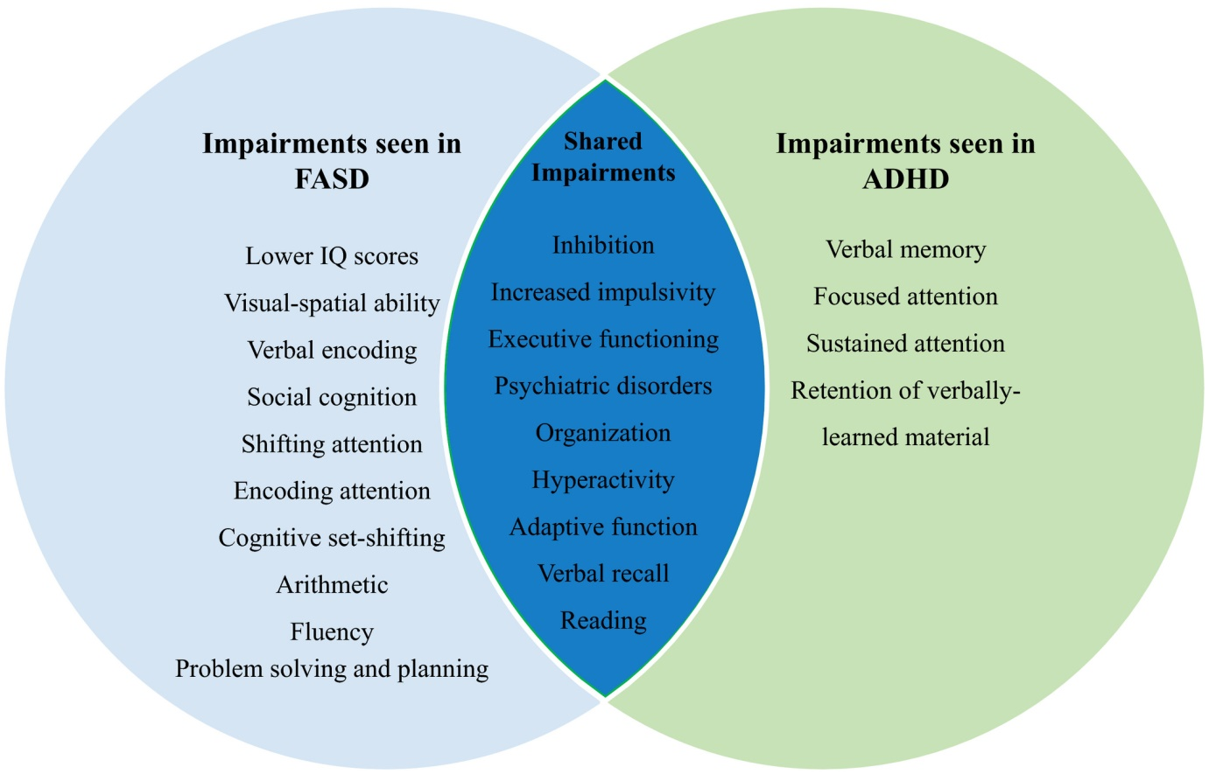
FASD PSYCHIATRIC PRESENTATIONS OFFENDING BEHAVIOURS Author: Dr. G K Simon Speciality Doctor KMPT NHS Trust Dartford KENT
FASD PSYCHIATRIC PRESENTATIONS
COMORBIDITIES COMPLEXTITES
OFFENDING BEHAVIOURS
RESEARCH, PUBLIC HEALTH IMPLICARIONS FUTURE
This poster is done following literature search undertaken by me for a narrative review of FASD and offending behaviours.
FASD Spectrum FAS, pFAS, ARND,ARBD
Diagnosis in mild cases needs scanning of the face
Alcohol use even to a small amount can cause mild forms of FASD
Psychiatric presentations include Autism, ADD, ADHD, ODD, Personality disorders and LD
Other diagnosis including psychotic illnesses, mood disorders and illicit drug use can complicate the picture.
Overlapping symptoms ADHD has many overlapping symptoms.
Cause of the presentations is hidden in the other diagnosis due to near normal face not making clinician suspect anything.
These patient group may present in various services and also with the criminal justice system.
Various presentations with LD ad impulsivity with communication difficulties leads to arrests.
The main offences are traffic offences, assault, threat, robbery and sexual offences.
The FASD population will have difficulty engaging the CJS Poor memory, difficulty to plan, difficulty to understand cause and effect, medicating depression and illicit drug use along with trouble in school will make the FASD sufferer more vulnerable in the criminal justice system and have difficulty to give evidence in court
Management after release from prison also will be complicated by their various impairments.
Most research is done in Aboriginal populations of Canada, USA, Australia and New Zealand.
Further research is needed in other populations.
No current NICE guidelines for FASD
The cost runs into billions and millions in various countries depending on the siz of the country and estimate in UK is about 2 billion annually.
This is a great opportunity for preventive medicine in Psychiatry.

