Slide 1
RCPsych President’s Lecture 2018
The cannabis revolution and its implications for psychiatry
David Nutt DM FRCP FRCPsych FMedSci Dlaws
Edmond J. Safra Prof of Neuropsychopharmacology
Imperial College London
d.nutt@imperial.ac.uk
profdavidnutt@twitter.com

Slide 2
A dangerous topic to talk about!
Still now I know I was right ……

Slide 3
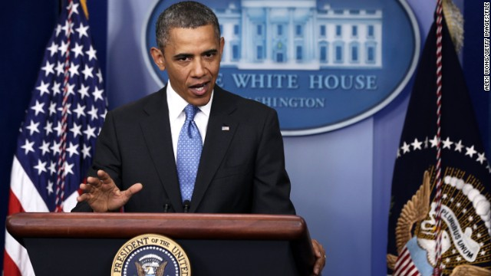
Obama now agrees with Nutt
Cannabis less harmful than alcohol
http://politicalticker.blogs.cnn.com/2014/01/19/obama-says-marijuana-no-more-dangerous-than-alcohol/

Slide 4
Elements of my talk
History of cannabis in religion and culture
Cannabis controls in 20th century – politics trumps science – and how psychiatry has become sucked into this
  The schizophrenia paradox
Restoring reason – Holland – USA – Canada ? UK
Current medical uses including in psychiatry
The challenge to psychiatry – balancing benefit-risk
Some sensible ways forward with recreational use

Slide 5
Cannabis and religion
Cannabis [+/- ephedra =/- magic mushrooms] was an ingredient in the “ soma” which helped the development of Hinduism visions
Still used today to celebrate the festival of Holi as the drink bhang = cannabis milkshake
And all the time by the
ascetic sect the Sadhus

Slide 6
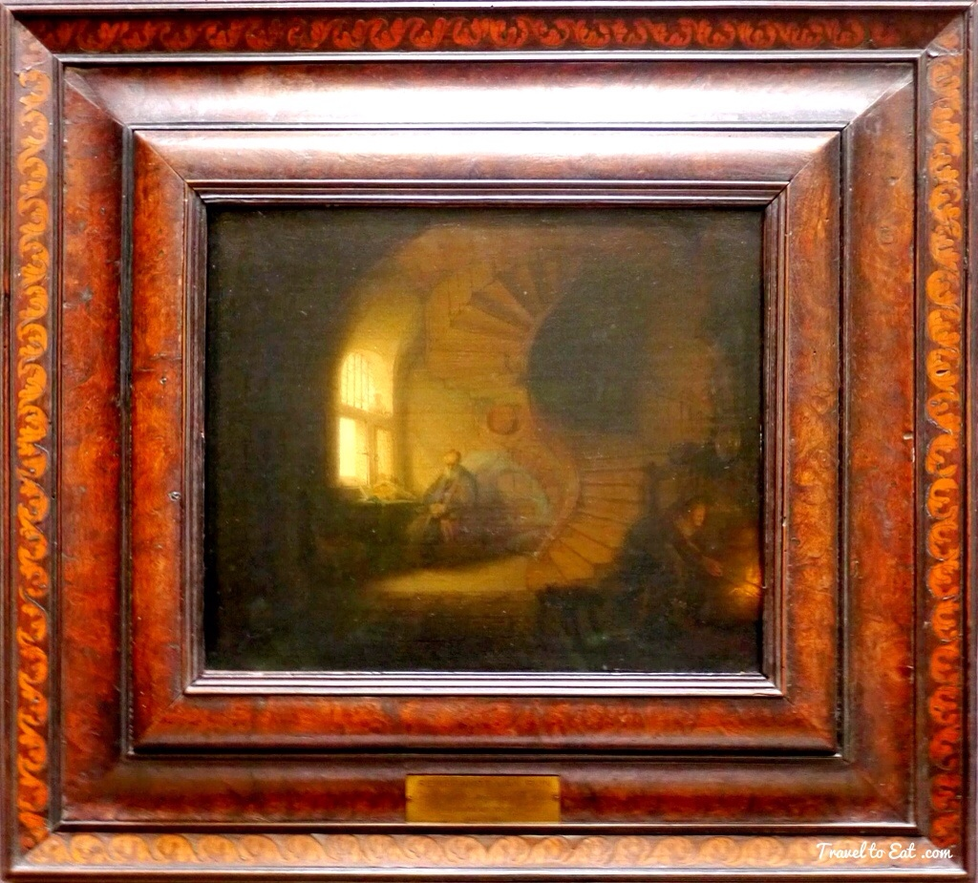
Cannabis and painting
Dutch school used cannabis to gain better ppreciation of colour and depth
Rembrandt
Meditation du Philosophe

Slide 7
Cannabis and music
Jazz developed because cannabis use “allowed” syncopation rather than precise replication of musical notation
Louis Armstrong and Cannabis: The Jazz Legend’s Lifelong Love of ‘the Gage’

Slide 8
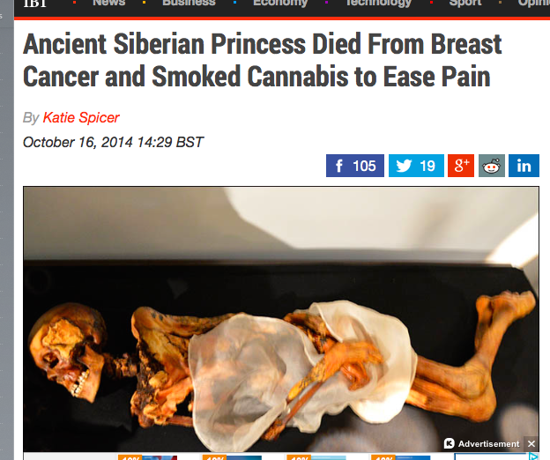
Cannabis - The worlds oldest medicine?
More than 2500 years of use

Slide 9
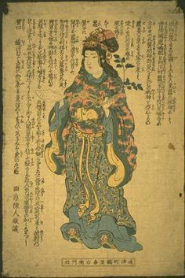
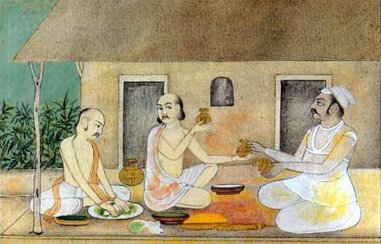
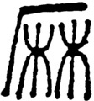
Medical uses
Cannabis for pain: China 2800 BC
India ~2000 BC

Slide 10
Ist UK report –Royal Society 1689

Slide 11
OTC cannabis products in the 1800s
1843 records by William O’ Shaughnessy with the even more epic title:
“On the preparations of the Indian hemp, or Gunjah (Cannabis indica): their effects on the animal system in health, and their utility in the treatment of tetanus and other convulsive diseases”

Slide 12
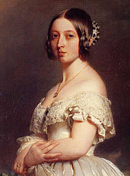
Medicinal cannabis
Much valued by Queen Victoria for gynae problems
  J Russell Reynolds was her physician and was a noted advocate
  of medicinal cannabis see Therapeutic Uses and Toxic Effects of Cannabis Indica,
  Lancet 1 (March 22, 1890) 637-683
Legal in UK till 1971
  Banned as two rogue GPs were prescribing for recreational use

Slide 13
Anti-cannabis campaigns began as part of general alcohol and drug prohibition
Islam - 9th C onwards – alcohol → cannabis → tobacco
Indian Hemp Commission – 1890s
WS Caine asked Houe of Commons to inter alia “..investigate the desirability of prohibiting the plant”
Conclusions
the moderate use of hemp drugs produces no injurious effects on the mind
..and produces no moral injury whatever [i.e. doesn’t cause dependence or addiction]

Slide 14
The 4 pillars of prohibition
19C puritan temperance movements
Political expediency
Prohibition
Competing commercial interests – alcohol and pharmaceuticals
Harry Anslinger and the DEA in the USA

Slide 15
Why was cannabis banned?
1932 Harry Anslinger in the USA needed a new role for the DEA after the repeal of alcohol prohibition
Created the first hysteria re Mexicans threatening US values
→renamed cannabis marihuana and a threat to youth

Slide 16
Time line of cannabis banning internationally
1961 = first UN convention → international ban
  Egyptian government lobbied USA for ban
    Based on very dubious data on harms from their health expert who was convinced it was source of most mental illness
    USA agrees in exchange for airbases
1968 Nixon declares “War on Drugs”

Slide 17
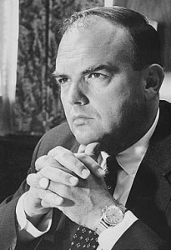
The reason for the war on cannabis
Ehrlichman states
The Nixon 1968 campaign had two enemies: the antiwar left and black people.
We knew we couldn’t make it illegal to be either against the war or black, but by getting the public to associate the hippies with marijuana and blacks with heroin, and then criminalizing both heavily, we could disrupt those communities.
We could arrest their leaders, raid their homes, break up their meetings, and vilify them night after night on the evening news.
Did we know we were lying about the drugs? Of course we did
As did the UK government when they cracked down on cannabis users in the 2000s

Slide 18
The problem with lies
“False facts are very injurious to science for they endure long”
  Charles Darwin
“How easy it is to make people believe a lie, and how hard it is to undo that”
  Mark Twain

Slide 19
Prohibitions that did more harm than good
Many examples over the last century of how prohibition has perverse consequences –
Smoking opium → injecting heroin
Ethanol prohibition → hooch and methanol
Cannabis → skunk → synthetics (spice)
Cocaine → crack
MDMA → PMA/PMMA
LSD/psilocybin → nBOMs etc.
Heroin → synthetics AH7921 and fentanyls

Slide 20
Time line of cannabis banning internationally
1971 UK government accedes to UN rules
  And puts in Schedule1 [no medical use]
  hospitals in UK need special license to hold it! (all can hold heroin and cocaine)
2000 House of Lords recommends medical cannabis
  Tony Blair government initially supportive
  Home Secretary David Blunkett allows cannabis → Class C
  But then New Labour see electoral opportunity from being “hard on drugs”

Slide 21
What really happened in the UK
In a deal with the Daily Mail, in exchange for their promised support for Labour in the 2010 election Prime Minister Gordon Brown agreed cannabis would be upgraded to Class B against ACMD advice
AND now 1 million young people in the UK have criminal convictions for cannabis possession!
Severe limitation of opportunities
Undermines belief in justice
Notes:
Cannabis use in 16-59 year olds in England obtained from British Crime Surveys 1996 – 2005/2006 (%)
Prevalence and incidence rates of schizophrenia obtained from Frisher et al (2009), shown in terms of patient years of exposure (PYE)
21

Slide 22
The cannabis conundrum
Up to half young people try cannabis
Very few experience health harm
  + very little harm to society
Current government policy largely criminalises those who will not be harmed or do harm to others
→ ruins future prospects
  + will have little impact on health
  + denies access to cannabis for treatment of pain and spasticity
  Is this just?

Slide 23
How New Labour cranked up the war on cannabis

Slide 24
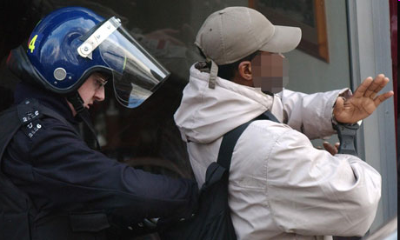
A just strategy?
3-4 fold over-representation of Black and Asian young men arrested despite same levels of cannabis use
Black people six times more likely to face drug arrest
Race bias in drug arrests or convictions is worse than in US, new research claims
Mark Townsend, Home affairs editor
The Observer, Sunday 31 October 2010

Slide 25
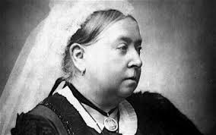
Waging the war on cannabis in the 20th century
Scottish ex teacher in her 50s
Long standing Multiple Sclerosis- wheelchair bound – only cannabis provides relief
Front door smashed down in dawn raids by police on three occasions in past few years
convictions for cannabis possession
may go to prison
Would Queen Vic been amused? I think not
Much valued by Queen Victoria for gynae problems
  J Russell Reynolds was her physician and was a noted advocate
  of medicinal cannabis see Therapeutic Uses and Toxic Effects of Cannabis Indica,
  Lancet 1 (March 22, 1890) 637-683

Slide 26
How cannabis laws corrupted the judiciary
Denying the medical defence
2005 – Law Lords decided that FOR CANNABIS ONLY the defence of necessity was no longer allowed
So all patients caught are convicted
And may have assets seized
Lords Bingham, Carswell & Rodger

Slide 27
Why?
“the Court was influenced by the government’s refusal to relax the legislation in this context despite recommendations to do so by the House of Lords Select Committee”
Stephen Leake, Barrister R. v Quayle and Other Appeals; Attorney-General’s Reference (No.2 of 2004), Re Ditchfield
Nutt 2010 - Necessity or nastiness? The hidden law denying cannabis for medical use Wordpress.com December 13th 2010

Slide 28
Whither judicial integrity?
What Bingham said in 2002
Question – B Johnson
"So you would legalise cannabis?”
Answer – Lord Bingham
'Absolutely. It is stupid having a law which isn't doing what it is there for.’
The Spectator
http://www.spectator.co.uk/essays/10024/top-judge.thtml

Slide 29
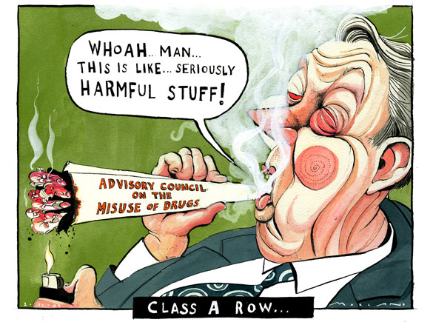
Harms of cannabis?
Guardian 2008
Alan Johnson justifies my sacking by ..
Schizophrenia
Driving
Skunk

Slide 30
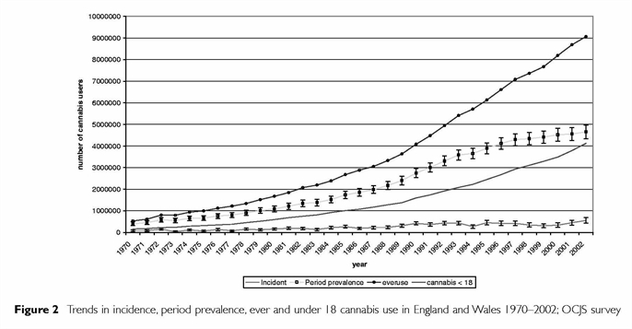
20x increase in cannabis users over last 50 years
Ever use
Period prevalence
Incident
Cannabis < 18
Rise in incidence and prevalence of cannabis use since 1970 in England and Wales
(Hickman et al 2007, Addiction 102, 597-606)
Notes:
Hickman M, Vickerman P, Macleod J, Kirkbride J and Jones PB (2007) Cannabis and schizophrenia: model projections of the impact of the rise in cannabis use on historical and future trends in schizophrenia in England and Wales. Addiction 102, 597-606
This is an estimate of prevalence, incidence and trends based on the 2003 Offending, Crime and Justice Survey. OCJS asked a number of questions on cannabis use including ever use, use last year, age at first and last use to a sample of approx. 10000, stratified so that just under half were aged 10-25. Response rate was 74%, and estimates were re-weighted against the England/Wales population and for differences in response rate by age and gender, assuming a design effect of 1.3. The data were converted to year at first and last use and allowed the estimation of the number of new initiates by year, the annual number of cannabis users over time, the length of reported use, the cessation rate and number and proportion of people who report first use at specific ages.
30

Slide 31
Alcohol much worse than cannabis on driving

Slide 32
No impact on population level schizophrenia/psychosis
To prevent one case of schizophrenia one would have to prevent 5000 young men from ever smoking cannabis
ACMD 3rd cannabis report 2009
Therefore no need to reclassify from Class C
Still it was upgraded – on the grounds of “public opinion, policing priorities and precaution….”
Frisher et al (2009) Weissenborn and (Nutt 2011)
Notes:
Cannabis use in 16-59 year olds in England obtained from British Crime Surveys 1996 – 2005/2006 (%)
Prevalence and incidence rates of schizophrenia obtained from Frisher et al (2009), shown in terms of patient years of exposure (PYE)
32

Slide 33
The psychiatrists cannabis conundrum
Our patients have been used to justify a politically inspired war on cannabis
- schizophrenia
- violence
Yet many of our patients seem to value it
? Dependence – minority
? Self-medication for adverse effects of antipsychotics – often
? Self medication for schizophrenia - ?

Slide 34
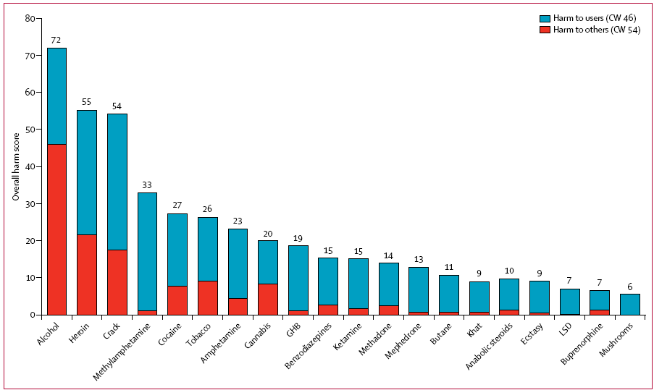
Comparative harms of 20 drugs in UK – using MCDA
Alcohol
Ratios of the total numbers represent ratios of harms.
E.g., alcohol is nearly three times as harmful as cannabis
Cannabis
Nutt et al 2010
Lancet

Slide 35
Cannabis less harmful than alcohol
UK MCDA of harms to users
 |  | Cannabis | Alcohol
DRUG SPEC MORT | 0 |  | 50
DRUG REL MORT | 20 |  | 60
DRUG SPEC DAMAGE | 20 |  | 80
DRUG REL DAMAGE | 40 |  | 80
DEPENDENCE | 30 |  | 30
SPEC IMPAIR MENT FUN | 30 |  | 65
REL IMPAIR MENT FUNC | 35 |  | 60
LOSS OF TANGIBLES | 25 |  | 30
LOSS OF RELAT | 30 |  | 60
 | Cannabis | Alcohol
Nutt King & Phillips Lancet Nov 2010

Slide 36
Cannabis less harmful than alcohol
UK MCDA of harms to others
 | Cannabis | Alcohol
CRIME | 20 | 50
ENVIRONM DAMAGE | 10 | 100
FAMILY ADVERSITIES | 15 | 100
INTERNATIONAL DAMAGE | 15 | 20
ECONOMIC COST | 20 | 100
COMMUNITY | 10 | 100
But note confound that more people use alcohol
Nutt King & Phillips Lancet Nov 2010

Slide 37
Cannabis is overall 3x LESS harmful than alcohol
 | Cannabis | Alcohol
TOTAL harm score [users and others] | 330 | 1085
For more detailed analysis see Weissenborn and Nutt (2011) Journal of Psychopharmacology
Nutt King & Phillips Lancet Nov 2010

Slide 38

Perverse effects of cannabis prohibition
CBD
cannabidiol
Reduces anxiety
Anti-psychotic effects
Improves memory
and learning
Δ9-THC
Induces anxiety
Psychotic-like effects.
Impairs memory and learning
Have opposite effects on cannabinoid receptors in the brain
Notes:
Cb1 receptor agonist – CBD inhibits the reuptake and hydrolysis of ananadamide, inverse nggonist
Given CBD attentuates the psychotomimetic effects of THC in the laboratory in healthy volunteers,

Slide 39
Vanishing CBD?
d9THC
Decrease in CBD due to prohibition → stronger THC products
“skunk” with greater profit margins

Slide 40
Increased high THC/no CBD cannabis strains
% Samples
2018 - >95% skunk
King et al 2005 Potter et al 2008 Hardwick/King Curran et al
2009
Police seizures Community sample
2008 – 80% skunk: CBD levels <0.1%; THC >15%.
2011 - 75% of samples skunk: CBD =0.01%

Slide 41
High THC low CBD
➔ more psychotic symptoms
Cannabis prohibition leads to greater harms
**
*
Morgan & Curran, 2008 Brit J Psychiatry

Slide 42
And greater cognitive impairments
*
Did this make government take stock on policies?
NO!
Memory – prose recall
group x day p=0.047
Morgan, Schafer, Freeman & Curran (2010) Brit J Psychiatry
Notes:
Group split according to the CBD:THC ratio in the cannabis they actually smoked on the intoxicated day.
Our results consistent with Wise et al 2009 who showed that the THC induced memory deficits in rats were reversed by the CB1 receptor antagonist rimonabant

Slide 43
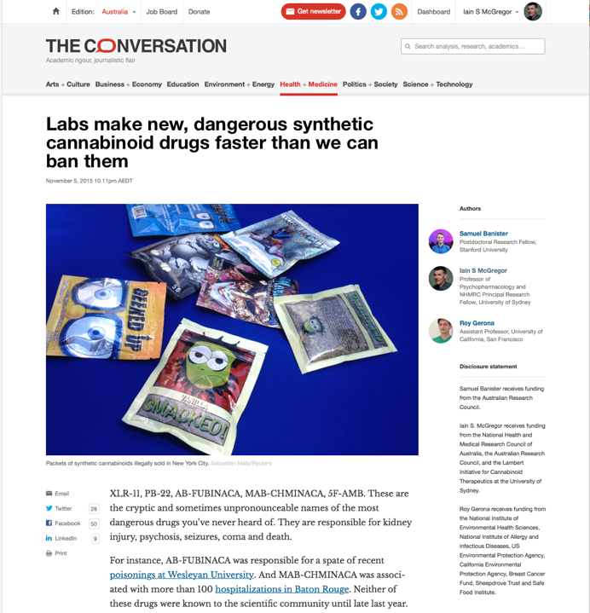
In fact they made it worse!
Testing prisoners for cannabis
➔ Synthetic cannabinoids = Opening Pandora’s box
Because cannabis is illegal and users are prosecuted and prisoners are tested
➔ (logically) seek legal alternatives

Slide 44
And there are very many potential synthetic cannabinoids…
Some prisons estimate up to 90% of inmates now using “spice” regularly despite their now being illegal
And corrupting up to 5% of prison officers
RCS-4
AB-001
XLR-11
5F-PB-22
ADB-CHMINACA
5F-AMB
~2010
2015
heteroaromatic
core
alkyl
substituent
pendant group

Slide 45
ACMD and Government responses
1st generation ban → those tested in humans
2nd generation ban → some tested in animals
3rd generation ban → still pending because would make illegal tens of thousands of NON-CANNABINOID medicines [e.g. indomethacin, several sartans] and research compounds
But countries with legal cannabis have much less synthetic cannabinoids use

Slide 46
Read more about it
Chemical definitions of synthetic cannabinoids include tens of thousands of pharmaceutical research compounds and many medicines e.g. indomethacin and several sartans
ACMD also continued ban of THCV a potential spice antidote

Slide 47
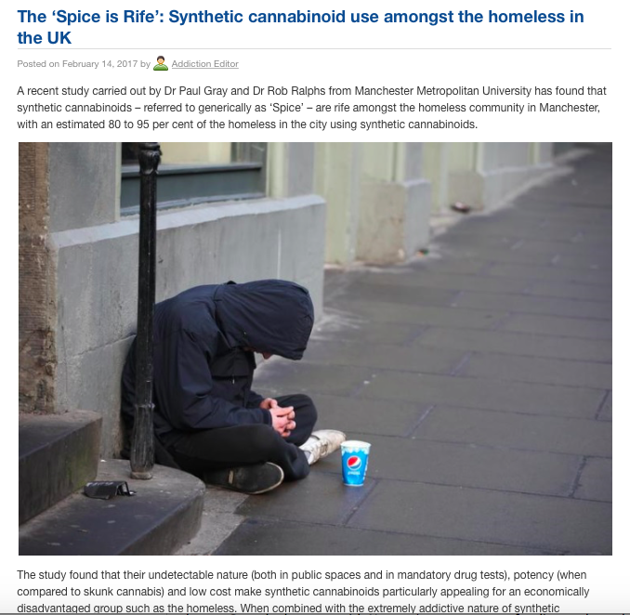
Now it gets worse!
Psychoactive Substances Act 2016 bans sale weak stimulants
Head shops used to sell “bubbles” and “sparkle”
= weak stimulants e.g. methiopropamine
Now all sales on black market
➔ synthetic cannabinoids

Slide 48
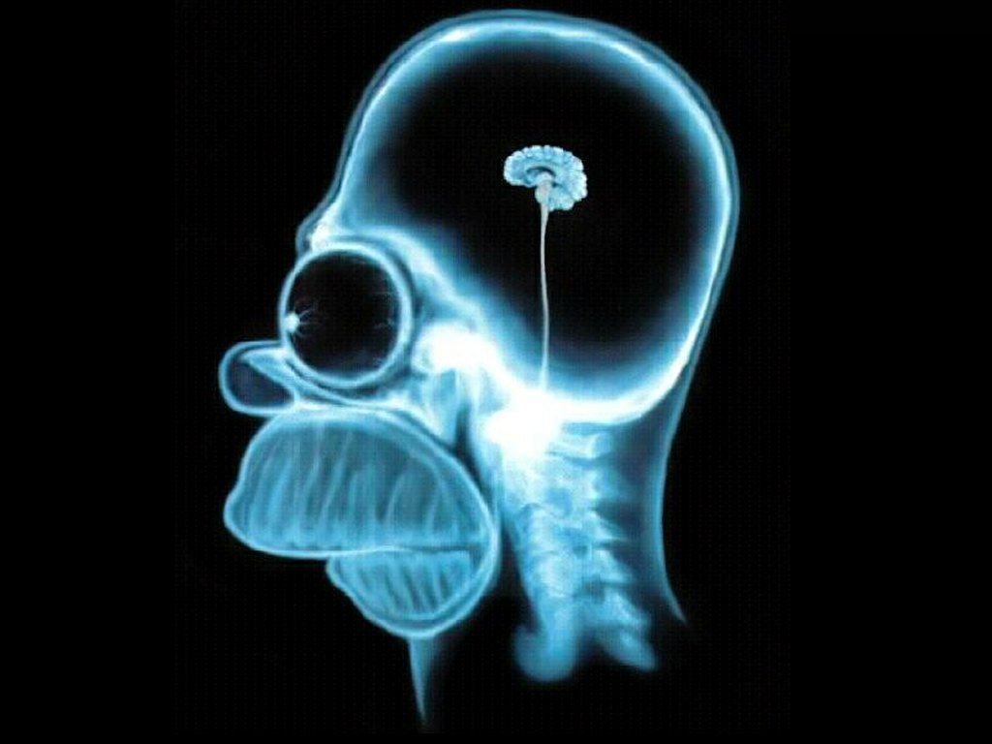
Cannabis and the brain?
No – that’s alcohol

Slide 49
Skunk has different brain effects from herbal
fMRI imaging - our C4 tv study Wall et al 2019 in press

Slide 50
Skunk has different brain effects from herbal
FMRI imaging - our C4 tv study
Large perturbation of insula conny connectivity with skunk
Wall et al 2019 in press

Slide 51
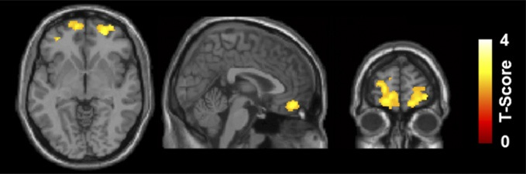
Long-term effects of marijuana use on the brain
Small reduction in volume localised in orbitofrontal cortex
48 users –v- 62 controls (average 9 years of use range 2-36 yrs)
Fibeya et al 2014 PNAS
￼

Slide 52
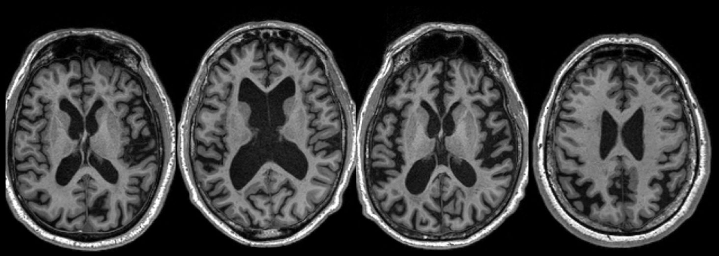
Alcohol is the most destructive drug to the brain
Normal
4 abstinent patients in our current ICCAM study

Slide 53
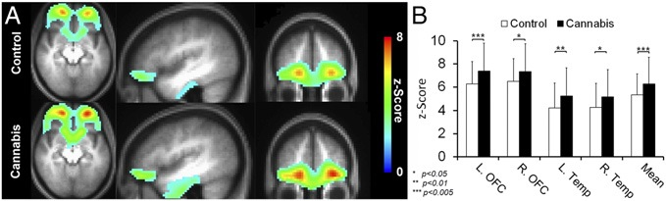
Cannabis → increase in OFC connectivity
? Increase in creativity ? Impaired decision-making

Slide 54
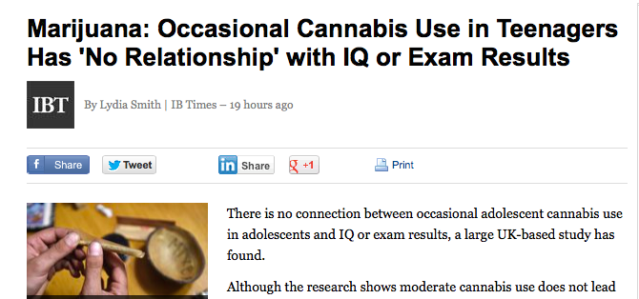
Cannabis and school performance
Mokrysz et al 2014 - data from 2,612 children IQ tested at eight and 15 + a survey on cannabis use. ECNP annual meeting Berlin
Didn’t stop David Cameron getting into Oxford

Slide 55
Dishonest logic impedes research
Cannabis is banned
In Schedule1 so almost impossible to research
No research on health benefits
Opponents claim no health benefits
And exaggerate harms

Slide 56
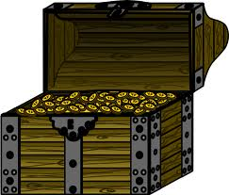
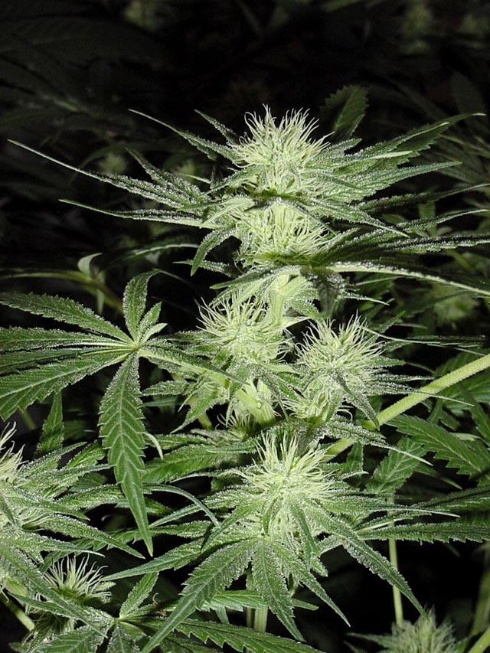

Wasted opportunities
The cannabis plant - a treasure chest of important medicines?
>100 cannabinoids in the plant

Slide 57
Restoring reason
Dutch coffee shops → separate hard and soft drug market
→ medical cannabis also
US states. Israel, Canada, Uruguay, Germany
→ medical cannabis
some → legal recreational cannabis
UK lags behind on medical cannabis for fear of slippage into recreational use despite having amongst highest percent recreational users in the world

Slide 58
Billy Caldwell – game changer for medicinal cannabis
> 2000 fits a month to zero
3 patients so far – how many more have died?

Slide 59
Medical cannabinoids
Current indications
  Anti-nausea
  Anabolic/appetite stimulating in cachexia
  Pain
  Muscle Spasms
Many potential uses
  Sleep - glaucoma - ADHD
  PTSD - arthritis - schizophrenia
  Tourette’s
  Cancer – topical (skin) and systemic (gliomas)

Slide 60
Cannabis for Adult ADHD
D9THC/cannabidiol combination significantly improved hyperactivity and inattention

Slide 61
Cannabidiol as treatment for schizophrenia
AJP in Advance doi: 10.1176/appi.ajp.2017.17030325

Slide 62
Cannabis and schizophrenia
– desperately seeking cbd?
Cannabis intoxication is nearest most people will get to being psychotic
  A model for psychosis [not quite as good a ketamine to psychedelics]
Balanced herbal mixtures do not appear to increase risk but may accelerate onset -
Skunk and synthetic cannabinoids may lead to a schizophrenia-like psychosis
Cannabis especially skunk and spice make positive symptoms worse
Current policy of testing and interdiction of traditional balanced cannabis tp prevent schizophrenia has markedly worsened the problem by promoting the use of skunk
A cannabis cb1 receptor antagonist is sorely needed as may help in these cases

Slide 63
How best to deal with recreational use?
New policy research by DrugScience funded by the Norwegian MRC
= MCDA [multicriteria decision making] process to evaluate BEST policies
Two decision conference meetings in London 2016-2017

Slide 64
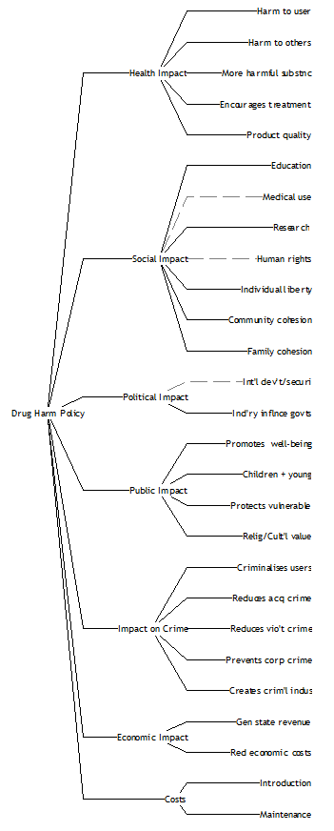
Drug Harm Policy Value Tree
Seven impacts
  Health
  Social
  Political
  Public
  Crime
  Economic
  Costs
➔ 27 Policy evaluation criteria
Rogeberg et al – 2018

Slide 65
Drug Harm Policy Value Tree - definitions
Cluster | Criterion | Definition
Health | Harm to user | Prevents medical harms to a user resulting from consumption of intended substance; includes blood-borne viruses (BBV)
 | Harm to others | Prevents health harms (including BBVs) to third parties due to either indirect exposure (e.g., second hand smoking) and behavioural responses to consumption (e.g., injury due to alcohol induced violence)
 | More harmful substances | Decreases consumption of more harmful substances or increases consumption of less harmful substances (e.g., cannabis prohibition leading to synthetic cannabinoids)
 | Encourages treatment | Encourages treatment of substance-use problems
 | Product quality | Assures the quality of products due to mislabelled or counterfeit/adulterated product, unknown dose/purity
Social | Education | Improves education about drugs
 | Medical use | Policy does not impede medical use
 | Research | Policy does not impede research
 | Human rights | Policy does not interfere with human rights as distinct from the individual’s right to use.
 | Individual liberty | Policy does not interfere with individual liberty (individual’s right to use)
 | Community cohesion | Policy does not undermine social cohesion in communities
 | Family cohesion | Policy does not undermine family cohesion
Political | International development & security | Policy does not undermine international development and security
 | Industry influence on governments | Impedes drug industry influence on governments (less lobbying is preferable)
Public | Promotes well-being | Promotes social and personal well-being
 | Children and young | Protects children and young people
 | Protects vulnerable | Protects vulnerable groups other than children and young people
 | Religious/cultural value | Respects religious or cultural values
Crime | Criminalises users | Does not criminalise users
 | Reduces acquisitive crime | Reduces acquisitive crime to finance use
 | Reduces violent crime | Reduces violent crime due to illegal markets
 | Prevents corporate crime | Prevents corporate crime, e.g. money-laundering, tax evasion
 | Prevents criminal industry | Extent to which the policy discourages illegal market activity
Economic | Generates state revenue | Generates state revenue
 | Reduces economic costs | Reduces public financial costs not directly related to the enforcement policy (e.g., spillover effects on health policy budgets)
Cost | Introduction | Financial costs of introducing the policy
 | Maintenance | Financial costs of enforcing the policy
Rogeberg et al – 2018

Slide 66
Policy options considered
Absolute Prohibition
State Control
Decriminalisation
Free Market
Production | Sale/distribution | Purchase | Purchase volume (for legal users) | Possession | Use
Illegal (strong sanctions) | Illegal (strong sanctions) | Illegal (strong sanctions) | None - illegal | Illegal (strong sanctions) | Illegal (strong sanctions)
Illegal (weak sanctions - de jure or de facto decriminalized) | Illegal (weak sanctions - de jure or de facto decriminalized) | Illegal (weak sanctions - de jure or de facto decriminalized) | Per person quotas | Illegal (weak sanctions - de jure or de facto decriminalized) | Illegal (weak sanctions - de jure or de facto decriminalized)
State controlled | State-licensed retail stores or pharmacies | Only adults (age restrictions) | Per purchase quotas | Limited quantity per person (e.g., for personal use) | Only in specific licensed venues or private homes
No restrictions for companies or individuals | No restrictions - any retail store | No restrictions | No restrictions | No restrictions | No restrictions
Rogeberg et al – 2018

Slide 67
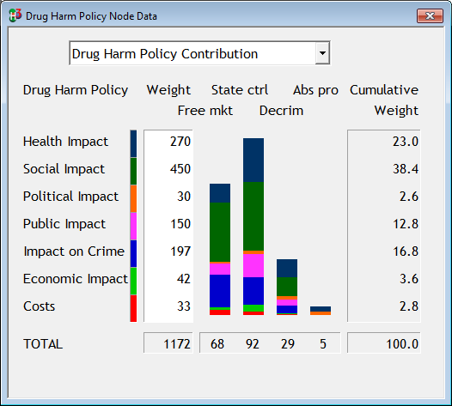
Policy MCDA results: cannabis
Rogeberg et al – 2018

Slide 68
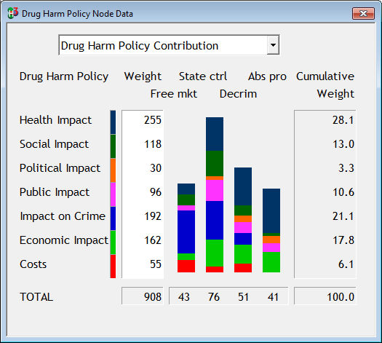
Best policy for alcohol too - MCDA results
Alcohol
Cannabis
Rogeberg et al – 2018

Slide 69
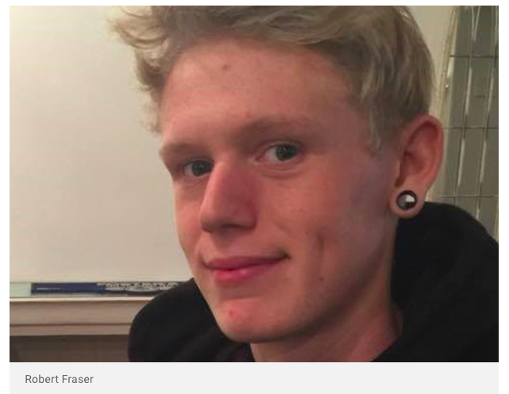
In UK, cannabis black market continues to kill
Nov 2016 in Kent
Robert goes to score some cannabis
Gets offered “ecstasy” as well -- takes it
Dies as its fentanyl not ecstasy

Slide 70
A framework for a regulated market for cannabis in the UK:
Recommendations from an expert panel https://www.libdems.org.uk/a_regulated_cannabis_market_for_the_uk
Panel Members
- Steve Rolles, Senior Policy Analyst, Transform Drug Policy Foundation (Chair)
- Mike Barton, Chief Constable, Durham Constabulary
- Niamh Eastwood, Executive Director, Release
- Tom Lloyd, Chair of the National Cannabis Coalition and former Chief Constable
of Cambridgeshire Police
- Professor Fiona Measham, Professor of Criminology, Durham University
- Professor David Nutt, Founder of DrugScience and former Chair of the Advisory
Committee on the Misuse of Drugs
- Professor Harry Sumnall, Professor of Substance Use, Centre for Public Health,
Liverpool John Moores University
Now adopted as Libdem policy

Slide 71
How to minimise pychiatric consequnces?
Use products with minimal d9THC concentration to get effect
Always have cannabidiol present
Make THCV available
Ensure no dependence before starting

Slide 72
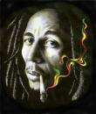
Was Bob right?
"Herb is the healing of the nation, alcohol is the destruction?"
Bob Marley

Slide 73
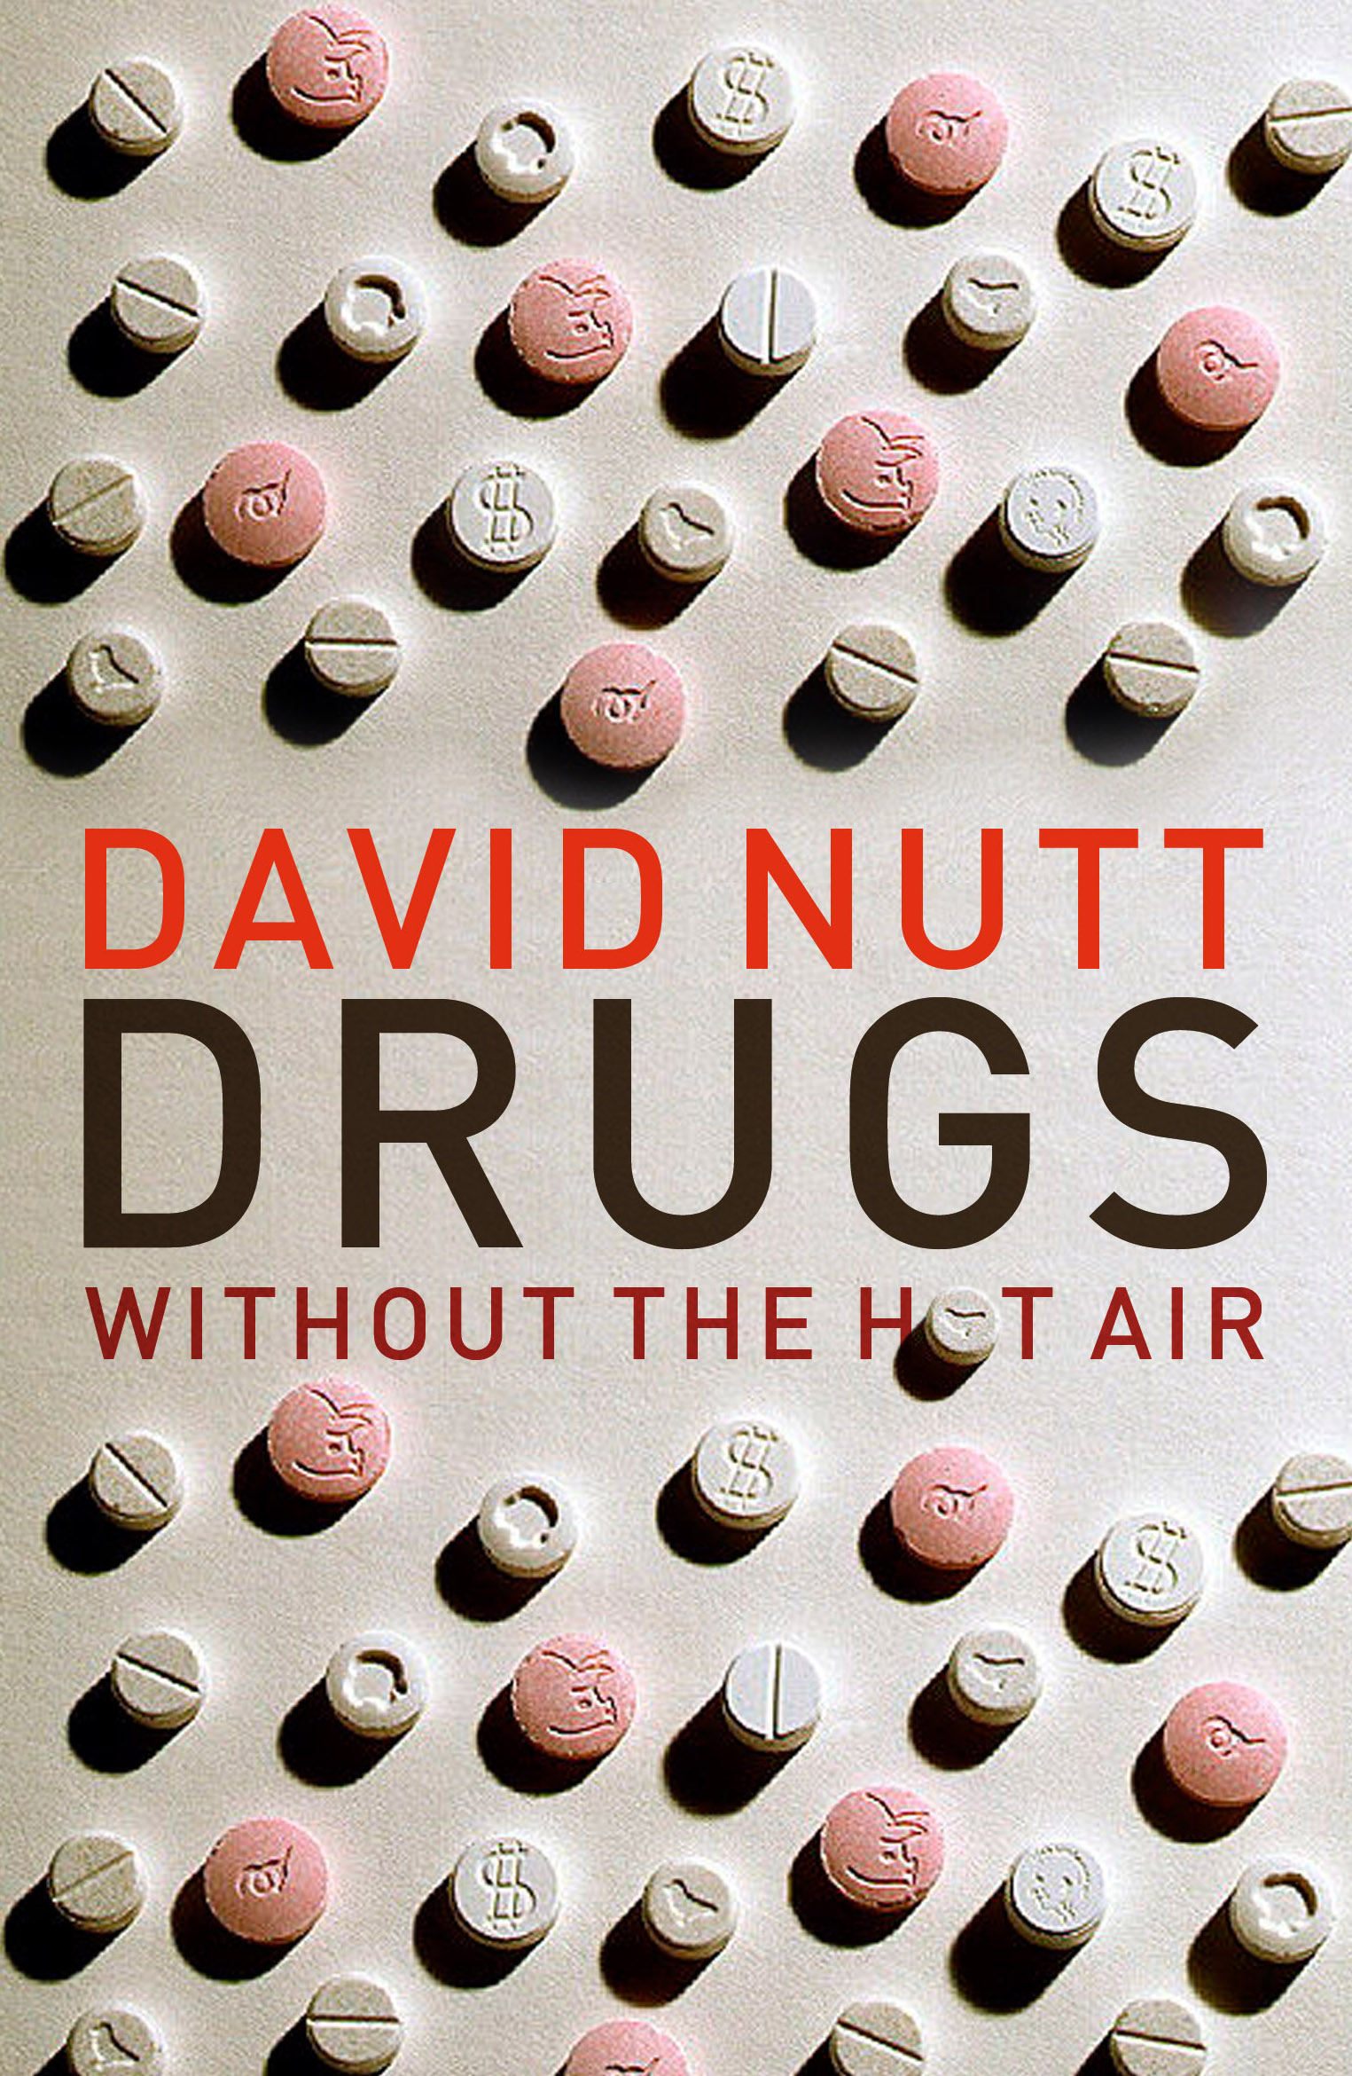
Thanks - and questions?
profdavidnutt@twitter.com = twitter
Buy this book for your parents/kids
All proceeds to my DrugScience charity

